Slide 1
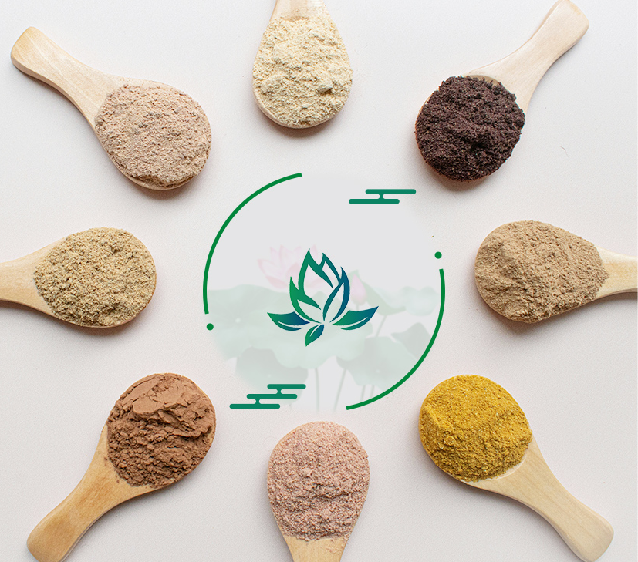
Product List
Life Energy Co., Ltd.
Life Energy: an outstanding pioneer in the foreign trade industry of Chinese herbal extracts
E-mail: info@flifenergy.cn
Telephone:+86 29-86450234
WhatsApp:+86 18192562267 Website:www.flifenergy.com

Slide 2
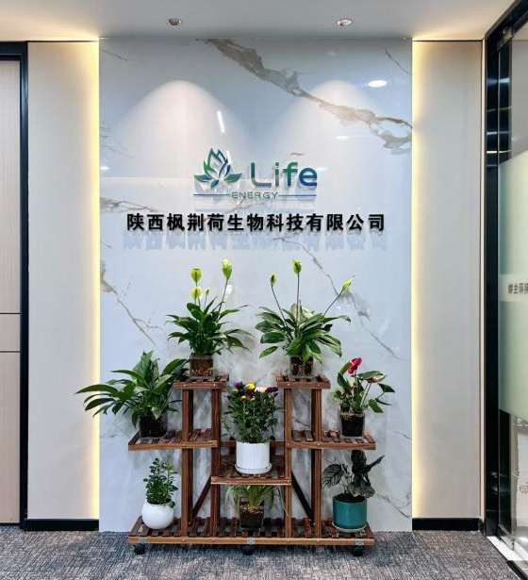
About Us
Life Energy is a foreign trading company that specializes in plant extraction and is committed to providing high-quality pure natural plant extracts for customers all around the world.
Founded in 2020, our Life Energy family has grown exponentially and is now home to some young people enthusiastic about export trade industry, Team members are full of enthusiasm and ideals, gathered a wealth of industry knowledge and professional skills, we advocate "integrity cooperation", and trusted by various brands to translate their creative vision into practical reality.
E-mail: info@flifenergy.cn
WhatsApp:+86 18192562267
Website:www.flifenergy.com

Slide 3
Herbal Extract
Atractylodes macrocephala Extract | Panax ginseng Extract | Maca Extract | Plantain Extract
Bacopa monnieri Extract | Polygoni multiflori radix Extract | Passion flower Extract | Sophora flavescens Extract
Curcumin | Rhodiola rosea Extract | Fenugreek seed Extract | Inulin
Cuscutae semen Extract | Semen coicis Extract | Yuhimbe bark Extract | Notoginseng folium Saponins
Dendrobii offcinalis caulis Extract | Sophora japonica Extract-Quercetin | Andrographis paniculata Extract | Valerian root Extract
Epimedium Extract | Sophora japonica Extract-Rutin | Tribulus terrestris Extract | Soy bean Extract
Eucommia cortex Extract | Spirulina Extract | Angelica Extract | Flax seed Extract
Ginkgol biloba Extract | Stephania tetrandra Extract | Cinnamon bark Extract | Kaempferol
Green tea Extract | Stevia Extract | Salviae miltiorrhizae Extract | Mucuna pruriens Extract
Honeysuckle flower Extract | Siberian ginseng Extract | Ligusticum Extract | Fucoidan
Ligustri lucidi fructus Extract | Ashwagandha standardized Extract | Resveratrol | Cassia seed Extract
Lotus leaf Extract | Wild jujube Extract | Garlic Extract | Boswellin Extract
Milk thistle Extract | Schisandra chinensis Extract | Griffonia seed Extract | Borage oil Powder
White willow bark Extract | Luteolin | Shilajit Extract | Lilium Extract
E-mail: info@flifenergy.cn
WhatsApp:+86 18192562267
Website:www.flifenergy.com

Slide 4
Fruit&Vegetable Powder
Grape Powder | Blueberry Powder | Sea buckthorn fruit Powder | Sugar beet root Powder
Strawberry Powder | Acai berry Powder | Purple potato starch Powder | Papaya Powder
Citrus Powder | Cranberry Powder | Kale Powder | Snow pear Powder
Grapefruit Powder | Mulberry Powder | Spinach Powder | Watermelon Powder
Wild cherry berry fruit Powder | Lemon Powder | Carrot Powder | Pineapple Powder
Walnut Powder | Acerola cherry Powder | Wheat seeding Powder | West blue pollen Powder
Apple Powder | Bilberry Powder | Noni fruit Powder | Celery Powder
Pomegranate Powder | Black currant Powder | Black wolfberry Powder | Tomato Powder
Raspberry Powder | Cherry Powder | Roxburgh rose Powder | Dragon fruit Powder
Orange Powder | Kiwi fruit Powder | Medlar Powder | Hawthorn Powder
E-mail: info@flifenergy.cn
WhatsApp:+86 18192562267
Website:www.flifenergy.com

Slide 5
Bio-Chemicals
GABA | Diosmin | L-Arginine | Fisetin
D-Ribose | Glycine | Inositol | L-Carnitine Base
L-Carnitine Hcl | Proline | Citicoline Sodium | Phytosterol Granule
L-Theanine | Glutamine | Zinc Picolinate | D-Mannose
N-Acetyl-L-Cysteine | Cysteine | Vitamin E | Indole-3-Carbinol
Alpha lipoic Acid | L-Arginine Hcl | Lecithin | Calcium Ascorbate
Coenzyme Q10 | Erythritol | Niacinamide | Sodium Ascorbate
3.3'-Diindolylmethane(DIM) | Glutamic acid | Melatonin | Pyrroloquinoline quinone Acid
Sodium Hyaluronate | β-Nicotinamide Mononucleotide (NMN) | Phosphatidylserine（PS） | Sunset yellow FCF coloration
Cyanocobalamin(Vitamin B12) | S-Adenosy l-L-methionine disulfate Tosylate | Phosphatidyl choline PC50 | L-ɑ-Glycerylphosphorylcholine(GPC)
E-mail: info@flifenergy.cn
WhatsApp:+86 18192562267
Website:www.flifenergy.com

Slide 6
Antioxidants
Acerola cherry Extract | Black currant Extract | Grape seed Extract | Raspberry Extract
Apple Extract | Black rice Extract | Lycopene Powder | Strawberry Extract
Astaxanthin | Black wolfberry Extract | Marigold Extract | Peanut skin Extract
Bilberry Extract | Blueberry Extract | Naringin | Hesperidin
Acai berry Extract | Mulberry Extract | Pomegranate Extract | Sea buckthorn Extract
E-mail: info@flifenergy.cn
WhatsApp:+86 18192562267
Website:www.flifenergy.com

Slide 7
Mushroom Extracts
Irpex lacteus Extract | Agaricus bisporus Extract | Chaga triterpene | Coprinus comatus Extract
Mushroom Extract | Boletus Extract | Poria cocos triterpene | Sparassis crispa Extract
Oyster mushroom Extract | Tremella fuciformis Extract | Phellinus igniarius triterpene | Agrocybe aegerita Extract
Poria Extract | Auricularia auricula Extract | Cordycepin | Cordyceps ciecadae Extract
Chaga mushroom Extract | Lycium chinense Extract | Coriolus versicolor sugar peptide | Polyporus umbellatus Extract
Lentinus edodes(shiitake) Extract | Coriolus versicolor Extract | Shell-broken reishi spore Powder | Maitake Powder
Hericium erinaceus Extract | Phellinus igniarius Extract | Cordyceps sinensis mycelium Powder | Agaricus blazei Powder
Agaricus blazei Extract | Antrodia camphorata Extract | Hirsutella hepiali mycelium Powder | Cordyceps militaris Extract
Maitake Extract | Cordyceps sinensis Extract | Cordyceps militaris Powder | Selenium enriched yeast Powder
Flammulina velutipes Extract | Ganoderma lucidum（reishi）Extract | Tea tree mushroom Extract | Shell-broken pine pollen Powder
E-mail: info@flifenergy.cn
WhatsApp:+86 18192562267
Website:www.flifenergy.com

Slide 8
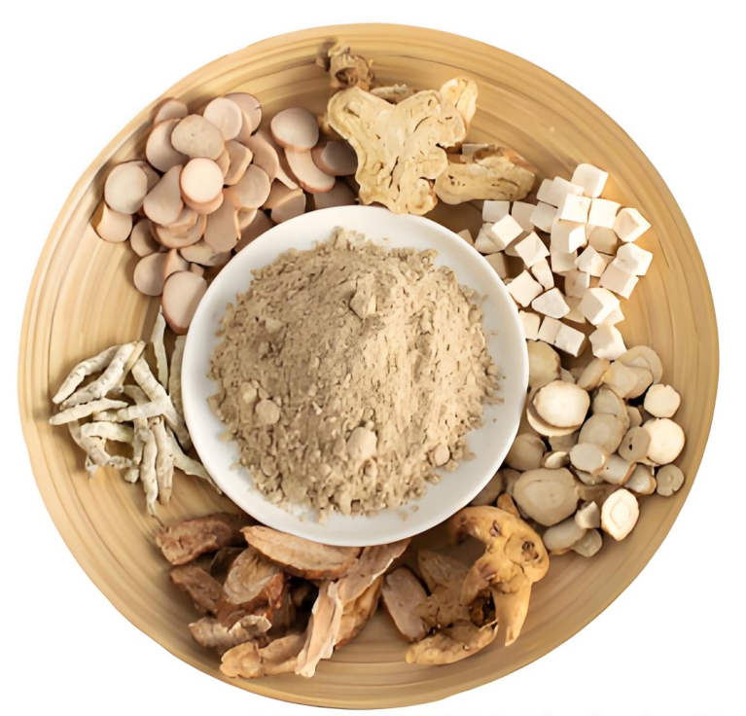
Application Area
From brain health enhancing ingredients that protect brain health, to functional nutrients that empower athletic performance;
From natural herbal extracts that improve sleep to innovative anti-aging ingredients that delay aging, every product embodies a profound understanding of "Precision Health".
E-mail: info@flifenergy.cn
WhatsApp:+86 18192562267
Website:www.flifenergy.com

Slide 9
Nootropics
Racetams | Natural Nootropics | Brain Support
Aniracetam | Huperzine A | Lion's mane mushroom Extract
Pramiracetam | Bacopa monnieri Extract | Alpha GPC
Piracetam | Galantamine | Phosphatidylserine(ps)
Oxiracetam | Vinpocetine | Ginkgo biloba Extract
Choline | Acetyl L-Carnitine | Vinpocetine
Choline Bitartrate | Lion's mane mushroom Extract | Panax ginseng Extract
Citicoline | Magnesium Threonate | Berberine Hcl
Alpha GPC | Ginkgo biloba Extract | PQQ
E-mail: info@flifenergy.cn
WhatsApp:+86 18192562267
Website:www.flifenergy.com

Slide 10
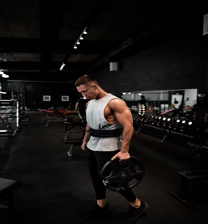
Sports and Fitness
Muscle Building | Pre-Workout | Athletic Performance
Casein | BCAAs | Ashwagandha Extract
D-Aspartic Acid | Beta-Alanine | D-Aspartic Acid
Deer antler Extract | Caffeine | L-Arginine
Ecdysterone | Creatine | L-Citrulline
HGH | D-Ribose | Nitric Oxide
Tribulus terrestris Extract | Hordenine | Panax ginseng Extract
Whey Protein | L-Carnitine | Rhodiola rosa Extract
GABA | L-Glutamine | Krill Oil
E-mail: info@flifenergy.cn
WhatsApp:+86 18192562267
Website:www.flifenergy.com

Slide 11
Improve Sleep
Ginkgo biloba Extract | Radix paeoniae alba Extract | 5-HTP
Lavender Oil | Chamomile Extract | Megnesium
Valerian root Extract | Jujube Extract | L-Theanine
Lemon balm Extract | Lycii fructus Extract | GABA
Ziziphi seed Extract | Lavender Extract | Melatonin
Passion flower Extract | Boswellin Extract | Thyme leaf Extract
Rhodiola rosea Extract | Fenugreek seed Extract | Black elder fruit Extract
E-mail: info@flifenergy.cn
WhatsApp:+86 18192562267
Website:www.flifenergy.com

Slide 12
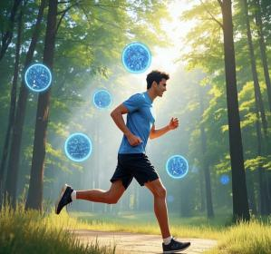
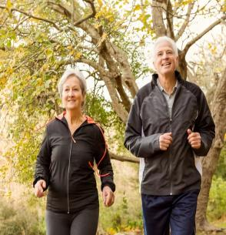
Longevity
Inflamation&Joints | Immune Support | Anti-Oxidants
Chondroitin | Artemisinin | Alpha lipoic Acid
Collagen | Astragalus Extract | Astaxanthin
Conjugated linoleic Acid | Chaga mushroom Extract | Coenzyme Q10
Turmeric Extract | Codyceps mushroom Extract | Creatine
Diindolymethane | Ginger Extract | Grape seed Extract
Fish Oil | Lactobacillus acidophilus | Lutein
Glucosamine | N-Acetyl Cysteine | Lycopene
Indole-3-Carbinol(I3C) | Panax ginseng Extract | Milk thistle Extract
Black wolfberry Powder | Reishi mushroom Extract | Pine bark Extract
Onion Extract | Turmeric Extract | Pterostilbene
E-mail: info@flifenergy.cn
WhatsApp:+86 18192562267
Website:www.flifenergy.com

Slide 13
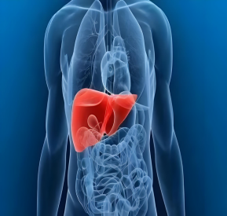
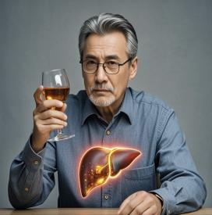
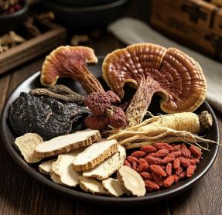
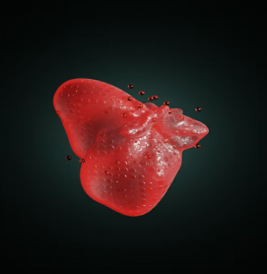
Liver Support
Andrographis Extract | Astragalus root Extract | Milk thistle Extract
Artichoke Extract | L-Glutathione | Turmeric root Extract
Ginseng root Extract | Phosphatidyl choline(PC) | Reishi mushroom Extract
Baicalin | SAMe | Resveratrol
Curcumin | Green tea Extract | Sesame Extract
Ginger root Extract | Schisandra chinensis Extract | Salviae miltiorrhizae Extract
Notoginseng folium Saponins | Andrographis paniculata Extract | Lotus leaf Extract
E-mail: info@flifenergy.cn
WhatsApp:+86 18192562267
Website:www.flifenergy.com

Slide 14
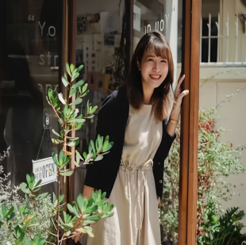
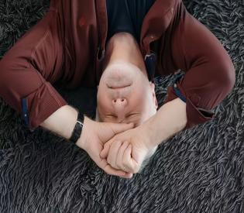
Mood
Stress Relief | Anxiety | Depression
Lemon balm Extract | GABA | 5-HTP
Phosphatidylserine | Phenibut | L-Tryptophan
Rhodiola rosea Extract | L-Theanine | Mucuna pruriens Extract
Poria Extract | Inositol | Sulbutiamine
Lavender Extract | Curcumin | Grape seed Extract
Valerian root Extract | Blueberry Extract | Boswellin Extract
Chaga mushroom Extract | Chamomile Extract | Schisandra chinensis Extract
E-mail: info@flifenergy.cn
WhatsApp:+86 18192562267
Website:www.flifenergy.com

Slide 15
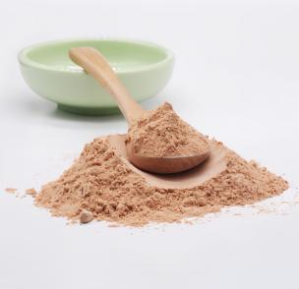
Weight Loss
Metabolism Support | Herbal Weight Loss | Fat Burners
Acai berry Extract | Atractylodes macrocephala Extract | Acetyl L-Carnitine
African mango Extract | Cassia seed Extract | Green tea Extract
White kidney bean Extract | Bitter melon Extract | Capsaicin
5-HTP | Lotus leaf Extract | Conjugated linoleic Acid
L-Tryptophan | Poria Extract | Forskolin
Cassia seed Extract | Dandelion Extract | Fenugreek seed Extract
Rosemary Extract | Flammulina velutipes Extract | Artichoke Extract
E-mail: info@flifenergy.cn
WhatsApp:+86 18192562267
Website:www.flifenergy.com

Slide 16
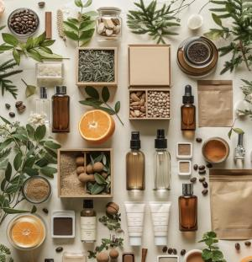
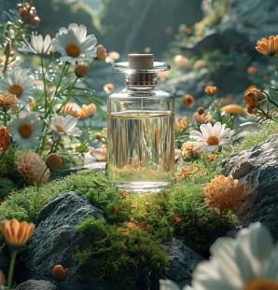
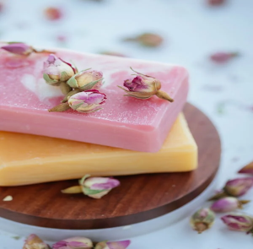
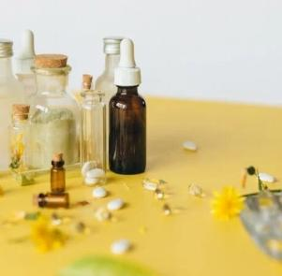
Cosmetics
Antioxidation | Natural anti-inflammatory | Improve the skin
Green tea Extract | Vitamin C | Resveratrol
Grape seed Extract | Ivy leaf Extract | Niacinamide
Pomegranate Extract | Marigold Extract | Angelica Extract
Rhodiola rosea Extract | Calendula Extract | Plantain Extract
Centella asiatica Extract | Aloe vera Extract | Cranberry Extract
Ginkgo biloba Extract | Bacopa monnieri Extract | Sodium Hyaluronate
Haematococcus pluvialis Extract | Astragalus root Extract | Stephania tetrandra Extract
E-mail: info@flifenergy.cn
WhatsApp:+86 18192562267
Website:www.flifenergy.com

