Slide 1

股票代码：839073
广东亿鑫丰智能装备股份有限公司
Guangdong Yixinfeng intelligent equipment Co., LTD
方形铝壳锂电池解决方案
Company and product profile

Slide 2
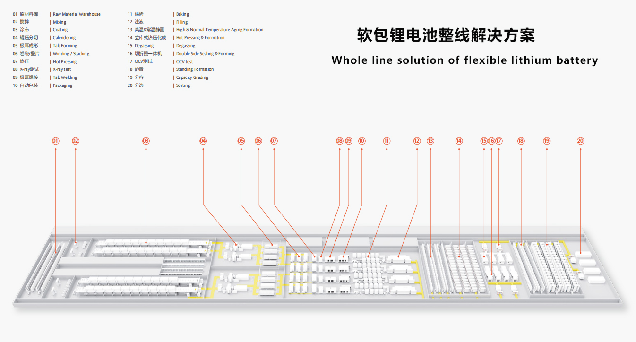
产品系列分布
（Product family distribution）

Slide 3
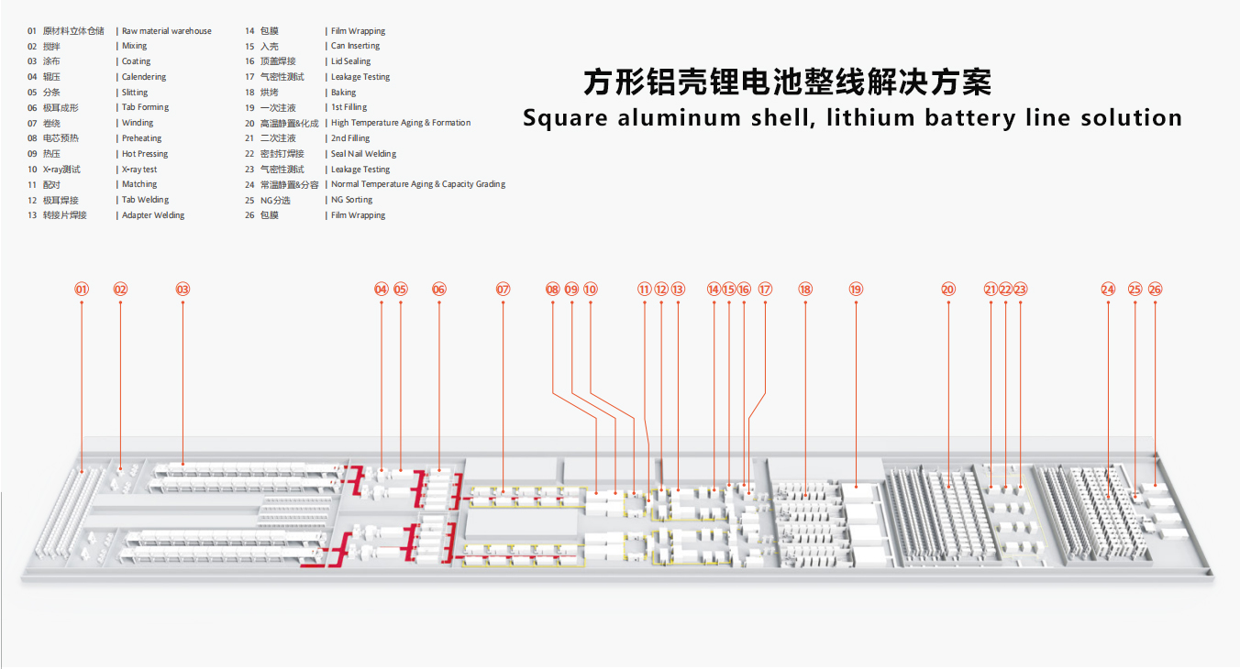
产品系列分布
（Product family distribution）

Slide 4
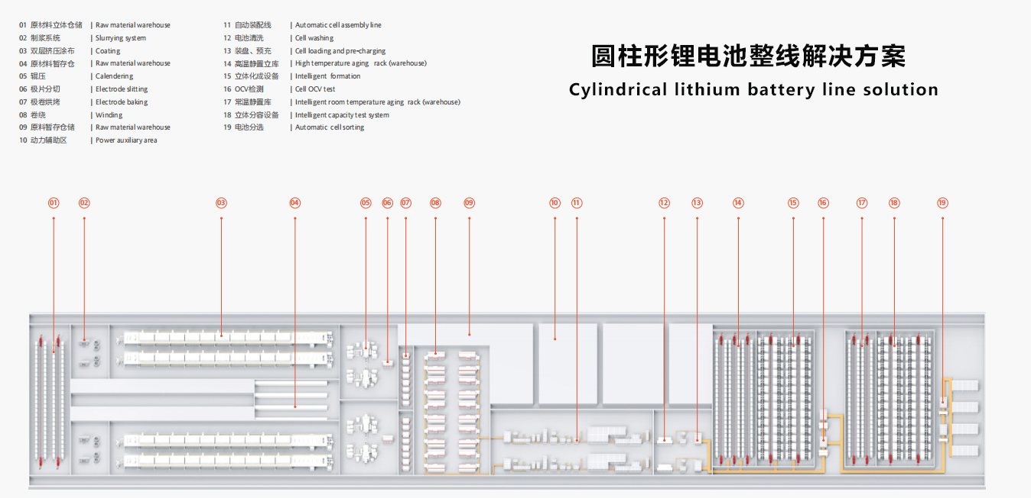
产品系列分布
（Product family distribution）

Slide 5

股票代码：839073
01
PART
配料
Filling
专业诚信 务实高效
Challenges and opportunities coexist

Slide 6
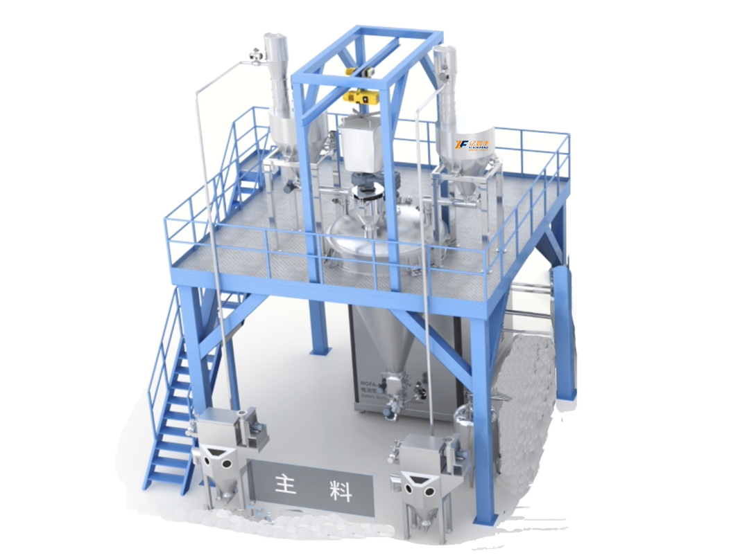
新型制浆系统（连续式）
NEW TYPE MIXING SYSTEM
原理与应用 Principle and application | 适用于合浆300L/h-1500L/h搅拌机，整机设备布局紧凑，配备高性能控制系统与传感器，稳定性强。制浆效率高，能耗低，厂房空间占用小，清洁、维护方便，节省长期运行成本，分散效果好，可实现连续化、大批量生产。 Suitable for mixing 300L/ H-1500L /h mixer, the whole equipment layout is compact, equipped with high-performance control system and sensor, strong stability. High pulping efficiency, low energy consumption, small workshop space occupation, clean, easy maintenance, saving long-term operating costs, good dispersion effect, can achieve continuous, mass production.
可选规格 Optional | 300L/h-1500L/h 制浆系统可选/Pulping system is optional
 | 300L/h-1500L/h
主料投料精度 Main Material Feeding Accuracy | 当投料量≥150kg，投料精度±0.1% 投料量＜150kg，投料精度±150g when feeding quantity ≥150kg, accuracy: ± 0.1% when feeding quantity <150kg, accuracy: ± 150g
辅料投料精度 Auxiliary Material Feeding Accuracy | 投料量≥30kg，投料精度±0.1% 投料量＜30kg，投料精度±30g when feeding quantity ≥30kg, accuracy: ± 0.1% when feeding quantity <30kg, accuracy: ± 30g
设备优势 Equipment advantage | ●节能降耗，采用新工艺，节约运行成本 ●密闭环境运行，对环境要求低，避免环境因素对制浆过程、制浆质量的影响 ●系统全自动投料配料输送，降低人工成本 ●整机设备布局紧凑，体形压缩，减少设备占用空间 ●配备高性能控制系统与传感器，稳定性强，可后期对接MES系统 ●连续式生产，给料量小，1小时后即可连续出料 ●Save energy, reduce consumption, and save operating costs ●Confined environment operation, low environmental requirement, to prevent slurrying process and quality from being effected by the environmental factors ●Automatic feeding and distribution system to reduce labor costs ●Compact system layout, compressed equipment shape, reduced footprint ●High-performance control system and sensors, strong stability, connection with MES can be upgraded ●Continuous production, small feeding volume, continuous output after 1 hour

Slide 7
股票代码：839073
02
PART
搅拌
stir
专业诚信 务实高效
Challenges and opportunities coexist

Slide 8
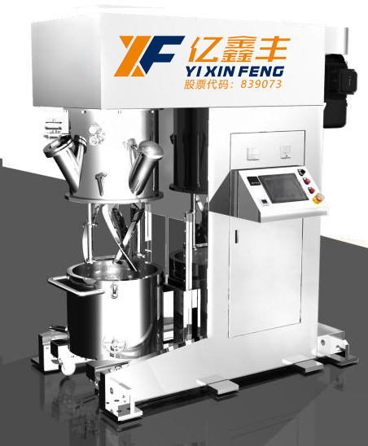
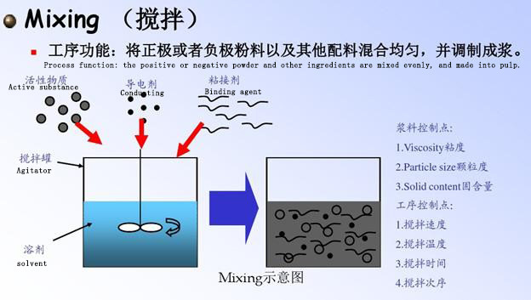
搅拌机
（agitator）
原理与应用 Principle and application | 设备通过控制面板或中控系统智能控制，可按照已编制的搅拌工艺流程自动运行； 配套两个螺旋式搅拌浆和两组锯齿形分散盘，采用双行星结构分别驱动，可满足各类粉体与液体之间的高效混合，经过搅拌、及分散等过程，控制颗粒大小，颗粒分布的均匀性，粘度的一致性；同时搅拌桶具有快速更换及真空密封功能，通过抽真空的方式，可消除浆料中的气泡；从而满足搅拌、成浆工艺要求。 The equipment can operate automatically according to the prepared mixing process by intelligent control panel or central control system; It is equipped with two spiral-type mixing slurry and two groups of zigzag dispersion disks, respectively driven by double planetary structure, which can meet the efficient mixing between various powders and liquids. After stirring, dispersing and other processes, it can control the particle size, the uniformity of particle distribution and the consistency of viscosity; At the same time, the mixing barrel has the function of quick replacement and vacuum sealing, and the bubbles in the slurry can be eliminated by vacuuming; So as to meet the mixing, pulp process requirements.
设备组成 Equipment composition | 该设备由立柱式结构、传动部分、密封容器、升降系统、控制系统等组成。 The equipment is composed of column structure, transmission part, sealed container, lifting system, control system, etc.
适用粉料 Applicable powder | PVDF、CMC、导电剂、磷酸铁锂、钴酸锂、三元、石墨等； PVDF, CMC, conductive agent, lithium iron phosphate, lithium cobalt, ternary, graphite, etc.;
生产浆料粘度 Production of slurry viscosity | 1 千-10 万 MPa.s，固含量适用 30%-70%，及 85%-100%， 1000-100,000 MPa.s, solid content is applicable to 30%-70%, and 85%-100%,
行星箱转 （公转） Planetary rotation（revolution） | 0-35rpm
搅拌桨转速 （自转） Propeller speed（autorotation） | 0-60rpm
分散转速 Dispersion speed | 0~5000 转/分，变频调速 0~5000 RPM, variable frequency speed regulation
混料参数控制 Mixing parameter control | 搅拌和分散的时间、转速及真空、温度PLC自动控制 Mixing and dispersing time, speed and vacuum, temperature PLC automatic control

Slide 9
股票代码：839073
03
PART
涂布
coating
专业诚信 务实高效
Challenges and opportunities coexist

Slide 10
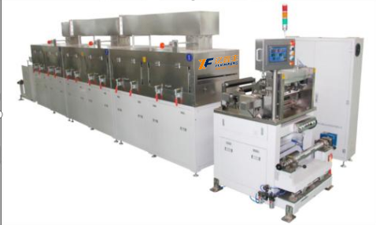
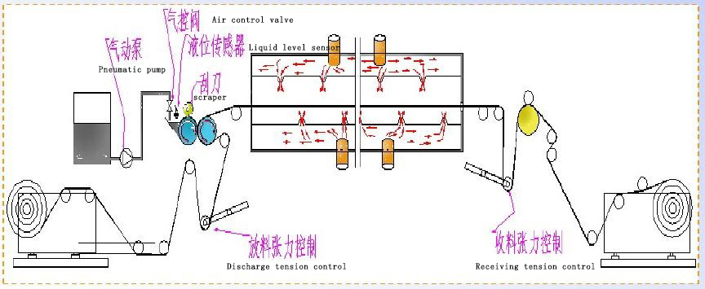
涂布机
（coater）
原理与应用 Principle and application | 设备通过涂辊转动带动浆料，通过调整刮刀间隙来调节浆料转移量，并利用背辊或涂辊的转动将浆料转移到基材上，按工艺要求，控制涂布层的厚度以达到重量要求，同时，通过干燥加热除去平铺于基材上的浆料中的溶剂，固体物质很好地粘结于基材上。 The equipment drives the slurry through the rotation of the coating roller, adjusts the slurry transfer amount by adjusting the blade gap, and transfers the slurry to the substrate by the rotation of the back roller or the coating roller, controls the thickness of the coating layer to meet the weight requirements according to the process requirements, at the same time, the solvent in the slurry laid on the substrate is removed by drying and heating, and the solid matter is well bonded to the substrate.
设备速度 Equipment speed | Max5m/min
涂布方式 Coating method | 连续涂布/转移式间隙涂布 Continuous coating/transfer gap coating
主材 Principal material | 钴酸锂、三元材料、磷酸铁锂、锰酸锂 Lithium cobaltate, ternary material, lithium iron phosphate, lithium manganate
粘度（cps） viscosity | 1500 ~ 30000cps
涂层宽度 Coating width | 100-300mm
单面面密度范围 Single surface density range | 正极100-300g/m2，负极100-250g/m2； Positive electrode 100-300g/m2, negative electrode 100-250g/m2;
涂层干厚度（µm） Dry coating thickness | 50-200um（不含基材）
涂层干厚度误差 Coating dry thickness error | 单面±2μm；双面±3μm（边缘、头尾8mm除外） One side ±2μm; Both sides ±3μm (except edge, head and tail 8mm)
外观要求 Appearance requirement | 无皱褶、无损坏、无波浪边、无划伤、无裂纹、无鼓包、无污染等 No wrinkles, no damage, no wave edge, no scratch, no crack, no bulge, no pollution

Slide 11
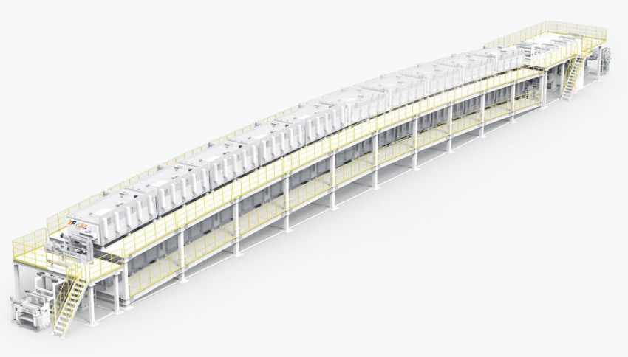
极片涂布机
（ELECTRODE COATING MACHINE）
原理与应用 Principle and application | ●基材、极片湿厚、干厚多重测量系统 ●特殊开发运动控制系统，张力控制精度≤±1%，高速运行时膜片更稳定 ●涂头与背辊间隙微米级精密闭环调节机构，涂头与背辊间隙调节精度 0.1um，重复定位精度≤1µm ●单个风嘴横向风速均匀性≤±1.5%，单节烘箱风速均匀性≤±3% ●单节烘箱温度均匀性≤±1.5% ●Multiple measurement system: wet & dry thickness of foil and electrode; ●Specially developed motion control system, the accuracy of tension control: ≤± 1N, and the foil is more stable at high speed operation; ●Micron-level precision and closed-loop adjustment mechanism for the gap between the coating nozzle and the back roller; ●The uniformity of the lateral wind speed of each single nozzle ≤ ± 1.5%, and the uniformity of the wind speed of each single oven ≤± 3%; ●Temperature uniformity of each single oven≤ ± 1.5%
设备速度 Equipment speed | Max100m/min
涂布方式 Coating method | 狭缝式挤压涂布 Slot die coating
主材 Principal material | 钴酸锂、三元材料、磷酸铁锂、锰酸锂 Lithium cobaltate, ternary material, lithium iron phosphate, lithium manganate
涂层宽度 Coating width | 15mm
单面面密度范围 Single surface density range | 正极100-300g/m2，负极100-250g/m2； Positive electrode 100-300g/m2, negative electrode 100-250g/m2;
涂层干厚度（µm） Dry coating thickness | ≥4um（不含基材）
双面面密度精度 Density accuracy on both sides | ≤±1%
外观要求 Appearance requirement | 无皱褶、无损坏、无波浪边、无划伤、无裂纹、无鼓包、无污染等 No wrinkles, no damage, no wave edge, no scratch, no crack, no bulge, no pollution

Slide 12
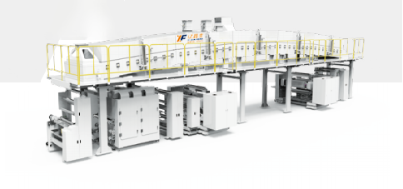
隔膜涂布机
（SEPARATOR COATING MACHINE）
原理与应用 Principle and application | ●涂辊快拆设计 ●特殊开发运动控制系统，张力控制精度 ≤±1%，高速运行时膜片更稳定 ●单个风嘴横向风速均匀性≤±2.5%，单节 烘箱风速均匀性≤±3% ●单节烘箱温度均匀性≤±1.5% ●Quick release of coating roller; ●Specially developed motion control system, the accuracy of tension control: ≤±1%, and the separator is more stable at high speed operation; ●The uniformity of the lateral wind speed of each single nozzle ≤±2.5%, and the uniformity of the wind speed of each single oven ≤±3%; ●Temperature uniformity of single-station oven ≤ ±1.5%
设备速度 Equipment speed | Max120m/min
涂布方式 Coating method | 微凹版涂布 micro gravure coating
主材 Principal material | 钴酸锂、三元材料、磷酸铁锂、锰酸锂 Lithium cobaltate, ternary material, lithium iron phosphate, lithium manganate
粘度（cps） viscosity | 1500 ~ 30000cps
涂层宽度 Coating width | 1200mm
涂层干厚度（µm） Dry coating thickness | 50-200um（不含基材）
涂层干厚度误差 Coating dry thickness error | 单面±0.5μm； One side ±0.5μm;
外观要求 Appearance requirement | 无皱褶、无损坏、无波浪边、无划伤、无裂纹、无鼓包、无污染等 No wrinkles, no damage, no wave edge, no scratch, no crack, no bulge, no pollution

Slide 13
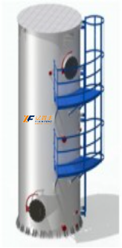
高效水凝塔式NMP回收
（Efficient water condensate tower NMP recovery）
原理与应用 Principle and application | 本系列NMP回收机组利用NMP水溶性高的特点对NMP废气进行处理，水吸附的方式可以把废气中的NMP基本上完全吸收，使NMP的回收率达到99%以上。机组外形美观，占地面积小，性能优越，操作简便。可广泛应用于锂电生产线的涂布环节，在环境相对湿度30-95%范围内，温度≤38℃时正常工作。 This series of NMP recovery unit uses the characteristics of high water solubility of NMP to treat NMP waste gas, and the water adsorption method can basically absorb NMP in the waste gas, so that the recovery rate of NMP can reach more than 99%. The unit has beautiful appearance, small footprint, superior performance and easy operation. It can be widely used in the coating process of lithium electric production line, and it works normally when the relative humidity of the environment is 30-95% and the temperature is less than 38℃.
回收率 rate of recovery | ＞99%
湿度范围 Humidity range | 30-95%
温度 temperature | ≤38℃

Slide 14
股票代码：839073
04
PART
制片
Electrode making
专业诚信 务实高效
Challenges and opportunities coexist

Slide 15
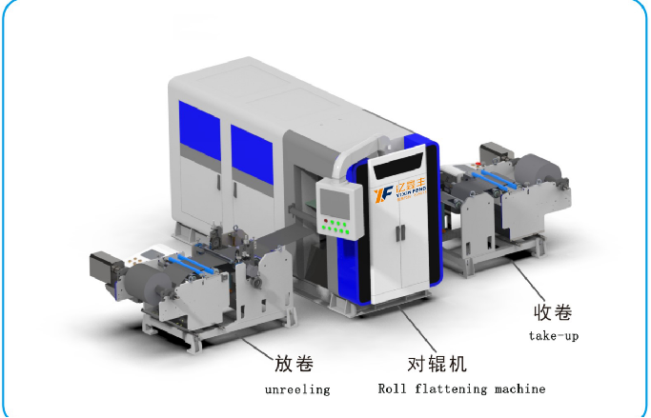
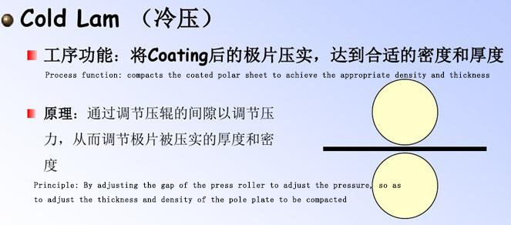
辊压机
（Roller press）
原理与应用 Principle and application | 设备通过包括放卷，前后张力控制，前后纠偏控制，拉伸机构，预热（仅正极）、辊压，测厚，收卷等组成，极片经辊压后涂覆层密度增加，厚度精度提高，满足恒张力放卷到恒压力碾压再到收卷自动完成，历史数据查询导出，关键参数实时显示、问题报警及原因追溯等功能。 The equipment is composed of unwinding, front and rear tension control, front and rear correction control, stretching mechanism, preheating (only positive electrode), roll pressing, thickness measurement, winding and so on. After rolling the pole sheet, the coating layer density increases and the thickness accuracy improves, which can meet the requirement of constant tension unwinding to constant pressure rolling and then to automatic winding, and historical data query and export. Key parameter real-time display, problem alarm and cause tracing functions.
设备速度 Equipment speed | 10m/min（Max 15m/min）
箔材厚度 Foil thickness | 正：10～30um 负：6～20um
极片厚度 Pole plate thickness | 50～300 µm
箔材宽度W1 Foil width W1 | ≤400mm
辊压极片厚度精度 Roll plate thickness accuracy | ±2μm（正常区Normal area），CPK≥1.33 ±3μm（削薄区Thinned zone），CPK≥1.33
压实密度 Compaction density | 正极压实（Positive electrode compaction） 3.4 g/cm3~3.6 g/cm3（三元ternary），2.2g/cm3~2.6 g/cm3（铁锂Lithium iron）；负极压实（Negative electrode compaction） 1.5 g/cm3~1.7 g/cm3
收卷对齐度 Winding alignment | ±0.5mm
外观要求 Appearance requirement | 无皱褶、无损坏、无波浪边，无划伤、无裂纹、无鼓包、无污染等 No wrinkles, no damage, no wave edge, no scratch, no crack, no bulge, no pollution, etc

Slide 16
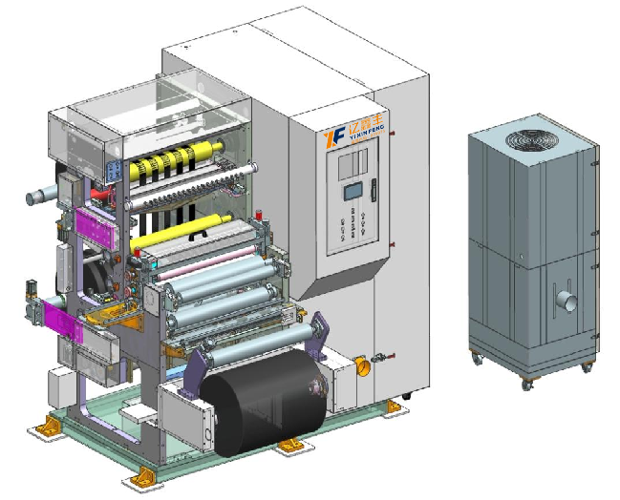
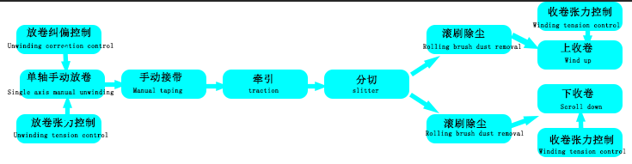
分切机
（Slitting machine）
原理与应用 Principle and application | 该设备的工作原理是采用磁粉被动放料，通过自动控制系统控制极片放卷张力，使极片经过环形分条刀时自动分切成需要的规格，工序完成后极片根据用户设定的张力值恒张力 The working principle of the equipment is to use magnetic powder passive discharge, through the automatic control system to control the tension of the pole sheet, so that the pole sheet through the ring slitter knife automatically cut into the required specifications, after the completion of the process, the pole sheet according to the tension value set by the user constant tension
生产速度 Production rate | 5～80m/min；
分切方式 slitting | 五金分切，一分二.一分四.一分六~等 Hardware cut, one for two. Four for one. Six for one. Wait
厚度（含基材） Thickness (including substrate) | 正极Positive electrode50～200 µm（基材Base material：10～30μm） 负极Negative electrode50～200 µm（基材Base material：4.5～20μm）
分切宽度偏差 Slitting width deviation | ±0.3mm
分切涂层纵向毛刺 Cut the coating longitudinal burrs | ≤10μm （垂直凸出极片表面的毛刺Burrs protruding vertically from the surface of the pole plate）
分切涂层横向毛刺 Slitting the coating transverse burrs | ≤12μm（平行凸出切口边缘的毛刺Burrs protruding parallel to the edge of the incision）
极片边缘切口质量 Electrode edge notch quality | 无卷边、裂口、波浪、褶皱、拉伸、露箔、明显的锯齿状等质量缺陷 No quality defects such as rolling, cracks, waves, folds, stretching, exposed foil, obvious serrated, etc

Slide 17
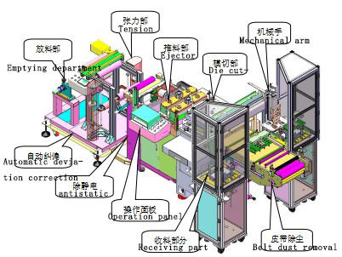
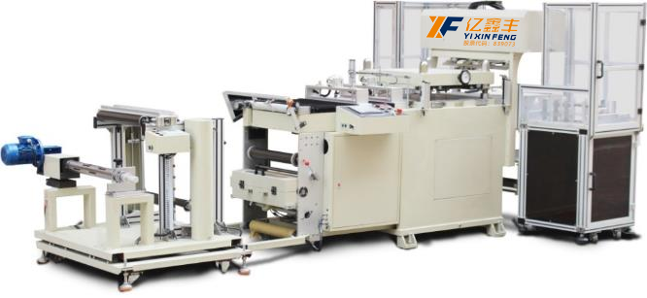
全自动极片模切机
（Automatic pole die cutting machine）
原理与应用 Principle and application | 设备通过触摸屏操作，程序控制，可根据产品进行设定合理数据，操作方便快捷，通过人工上料光电感应自动纠偏由伺服电机加精密丝杠推送至模切位置，可进行一出多片模切、生产效率高、刀模成本低、换型快捷方便，模切成型后自动送出，通过机械手将极片抓放到收料盘内， The equipment is operated by touch screen and controlled by program, reasonable data can be set according to the product, convenient and quick operation, automatic correction by manual feeding photoelectric induction is pushed to the die cutting position by servo motor and precision screw, which can carry out a multi-piece die cutting, high production efficiency, low die cost, fast and convenient changing, and automatically sent out after die cutting. Grab the pole piece into the receiving tray by the manipulator,
模切速度 Die cutting speed | 20-80-冲次/分（根据过料长度而定） 20-80- strokes/min (depending on the length of the charge)
刀模类型 Die type | 激光胶板刀模（成本低换型快） Laser rubber die (low cost and fast change)
来料宽度 Incoming width | ≤350mm（包含极耳） ≤350mm (including pole ear)
来料厚度 Incoming thickness | 0.08～0.3mm
有效模切面积 Effective die cutting area | 320*150mm
来料收卷整齐度涂布宽度误差 Incoming coiling uniformity coating width error | ≤±0.5 mm
涂布方式及破损要求 Coating method and breakage requirements | 连续涂布,单侧出极耳,且极耳破损小于0.5mm Continuous coating, unilateral out of the pole ear, and the pole ear damage is less than 0.5mm
收片方式 Receiving mode | 机械手自动收片 The manipulator automatically picks up the film

Slide 18
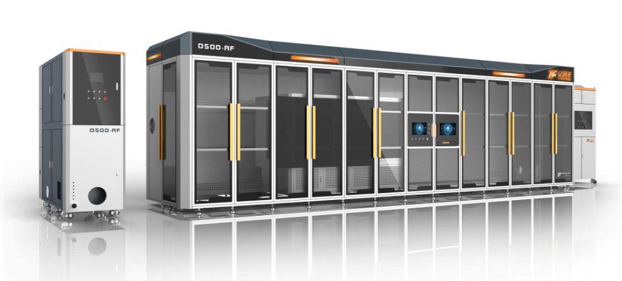
柔性模切机（卷对片、纯圆角）
Flexble die cutting machine（roll to film，pure fillet）
原理与应用 Principle and application | 国内首创，采用纯圆角设计，减少尖角放电，降低电池短路风险。 柔性小模具结构，多型号一键换型，模具寿命提高3倍，使用成本降低10倍，单次寿命达300万次，总寿命达5000万次以上。 自动闭环操作系统，实现了在线实时纠错功能，保障良品率。 It is the first of its kind in China. It adopts pure rounded corner design to reduce sharp Angle discharge and short circuit risk of battery. Flexible small mold structure, multi-model one-key change, mold life increased by 3 times, use cost reduced by 10 times, single life up to 3 million times, total life up to 50 million times. The automatic closed-loop operating system realizes the on-line real-time error correction function and guarantees the yield.
最大料宽 Material width | 700mm
速度 speed | ≥300ppm
成型精度 Molding accuracy | ±0.2mm
毛刺精度 Burr accuracy | ≤12μm

Slide 19
激光模切裁片一体机
Laser die-cutting integrated machine
原理与应用 Principle and application | 高速激光切割效率高于240PPM，无模具生产，成本低，极耳间距精度≤±0.2mm； 各区域除尘系统及监控系统，实现设备内部粉尘达到万级标准； 激光变频控制，避免过切或切不断，有效控制毛刺及热影响区熔珠大小，一体化设计，场地、人力成本降低3~5倍。 High speed laser cutting efficiency is higher than 240PPM, no mold production, low cost, pole ear spacing accuracy ≤±0.2mm; Dust removal system and monitoring system in each area, to achieve the dust inside the equipment to reach 10,000 level standards; Laser frequency conversion control, avoid over-cutting or continuous cutting, effectively control burr and heat affected zone bead size, integrated design, site and labor costs reduced 3~5 times.
最大料宽 Material width | 700mm
速度 speed | ≥240ppm
成型精度 Molding accuracy | ±0.2mm
毛刺精度 Burr accuracy | ≤100μm

Slide 20
激光模切分条一体机
Laser die cuuting strip in one machine
原理与应用 Principle and application | 高速激光切割效率60m/min -200m/min，极耳间距精度≤±0.2mm； 各区域除尘系统及监控系统，实现设备内部粉尘达到万级标准； 激光变频控制，避免过切或切不断，有效控制毛刺及热影响区熔珠大小，一体化设计，场地、人力成本降低3~5倍。 High-speed laser cutting efficiency 60m/ min-200m /min, ear spacing accuracy ≤±0.2mm; Dust removal system and monitoring system in each area, to achieve the dust inside the equipment to reach 10,000 level standards; Laser frequency conversion control, avoid over-cutting or continuous cutting, effectively control burr and heat affected zone bead size, integrated design, site and labor costs reduced 3~5 times.
最大料宽 Material width | 700mm
速度 speed | 60-200m/min
成型精度 Molding accuracy | ±0.2mm
毛刺精度 Burr accuracy | ≤100μm

Slide 21
股票代码：839073
05
PART
组装
assemble
专业诚信 务实高效
Challenges and opportunities coexist

Slide 22
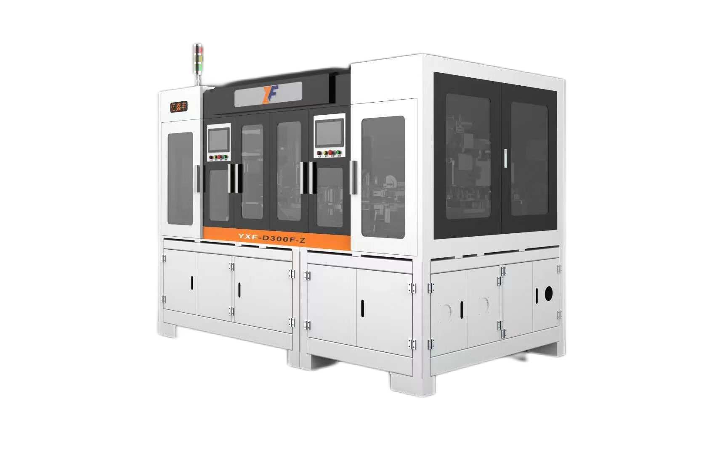
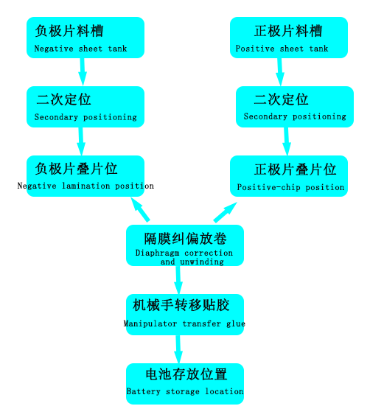
叠片机
（laminator）
原理与应用 Principle and application | 设备采用Z字形叠片方式。隔膜经过张力机构、纠偏机构，引入叠片台，叠片台带动隔膜左右往复移动，以放置极片，两套机械手吸盘机构分别将正负极片从料盒取出，经过二次定位平台精确定位后叠放在叠片台上，叠片完成后，通过电芯移载机构转移电芯、切断隔膜、自动贴胶， The device adopts the Z-shaped laminated mode. The diaphragm is introduced into the lamination table through the tension mechanism and the correction mechanism, and the lamination table drives the diaphragm to move around and around to place the pole piece. The positive and negative pole pieces are removed from the material box respectively by the suction mechanism of the manipulator, and are accurately positioned on the lamination table after the secondary positioning platform. After the lamination is completed, the battery cell is transferred by the battery cell load shifting mechanism, the diaphragm is cut off, and the adhesive is automatically affixed.
叠片速度（S/片） Lamination speed (S/ piece) | 1.0～1.2
正负极定位 Positive-negative positioning | 可以实现纵向、横向数控调节，调节范围0-20mm、精度±0.05mm It can realize vertical and horizontal CNC adjustment, the adjustment range is 0-20mm, the accuracy is ±0.05mm
定位台检测 Station detection | 超声波传感器检测极片防止多片、少片、漏片并报警停机；机械定位，极片四角和极耳折角检测并报警停机 Ultrasonic sensor to detect the pole plate to prevent multiple pieces, less pieces, missing pieces and alarm stop; Mechanical positioning, pole plate corners and pole ear Angle detection and alarm stop
隔膜 diaphragm | 主动放卷；张力控制；隔膜纠偏；隔膜除静电；隔膜端面对位精度：±0.3mm（头尾对齐度±0.5mm）； Active unwinding; Tension control; Diaphragm correction; Remove static electricity from diaphragm; Diaphragm end alignment accuracy: ±0.3mm (head and tail alignment ±0.5mm);
叠片数量 Number of lamination | 在厚度适应范围内可设定 It can be set within the thickness adaptation range
高精度 High precision | 通过极片的精确定位，保证极片在叠片中整体精度达到±0.5mm（其中相邻极片对齐精度：±0.3mm）；极片与隔膜间对位精度：中心偏差±0.3mm。 Through the precise positioning of the pole pieces, the overall accuracy of the pole pieces in the stack is guaranteed to reach ±0.5mm (the alignment accuracy of the adjacent pole pieces is ±0.3mm). Alignment accuracy between pole plate and diaphragm: center deviation ±0.3mm.
控制 Controls | 0.5微米的粉尘颗粒,不低于1千级(测量位置)，现场无腐蚀性气体、液体、爆炸性气体。 0.5 micron dust particles, not less than 1000 (measurement position), no corrosive gas, liquid, explosive gas on site.
合格率（来料不良除外） Qualified rate (except bad incoming materials) | 99% 以上（来料不良除外） More than 99% (except bad incoming materials)

Slide 23
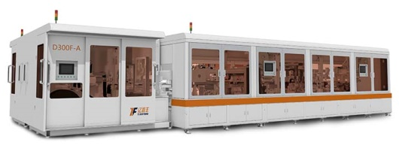
模切叠片一体机（刀片电池多片叠）
all-in-one machine（blade battery multi-laminating）
原理与应用 Principle and application | 一次性多片叠，单叠台可实现300个PPM，周转次数少，效率高，极片损伤减少，一体化设计，场地、人力成本降低3~5倍。 极片尺寸大，最大可以做到1000*500mm One-time multi-piece stack, single stack can achieve 300 PPM, less turnover times, high efficiency, pole piece damage reduction, integrated design, site, labor costs reduced 3~5 times. The pole size is large, the maximum can be 1000*500mm
对位精度 Counterpoint accuracy | ±0.3mm
叠片效率Lamination efficiency | ≥300PPM
叠片头/工位Stack head/station | 1/8

Slide 24
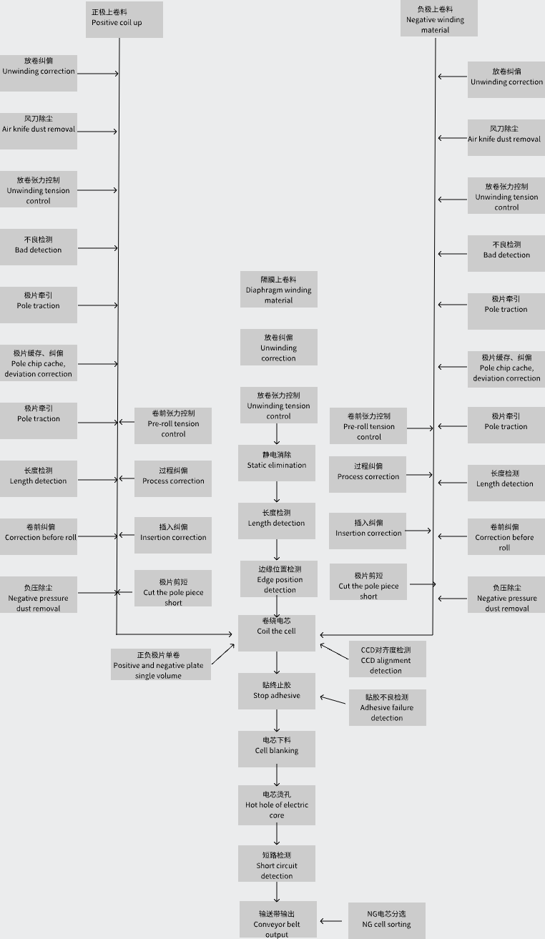
卷绕机（大圆柱）
（coiler）（Large cylinder）
原理与应用 Principle and application | 设备为圆柱形电芯的全自动激光切卷一体机，主要用于圆柱形电芯的生产。根据电芯生产工艺的要求，把正、负极片进行激光模切极耳形状（或全极耳），然后再与隔膜一起通过卷绕装置自动卷绕成产品。在卷绕的过程中通过纠偏控制系统和张力控制系统对电芯对齐度和极片、隔膜的张力进行控制，卷绕完成的电芯经过收尾贴胶、烫孔、电芯两端面预整形后（视工艺而定），短路测试，外观尺寸检测，不良品剔除，扫码上传等工序，最后通过输送带下料。 The equipment is a full automatic laser coiling machine for cylindrical electric cell, mainly used in the production of cylindrical electric cell. According to the requirements of the cell production process, the positive and negative electrode sheets are laser die-cut to the shape of the pole ear (or the full pole ear), and then the membrane is automatically wound into the product through the winding device. In the process of winding, the alignment degree of the battery cell and the tension of the pole and diaphragm are controlled by the correction control system and tension control system. After the winding of the battery cell, it goes through the finishing glue, hot holes, pre-shaping of the two ends of the battery cell (depending on the process), short circuit test, appearance and size detection, bad product removal, code scanning and uploading, and finally unloading through the conveyor belt.
正负极片宽度 Positive and negative electrode width | 55-140mm
隔膜宽度 Diaphragm width | 55-140mm
终止胶带 Stop tape | 10-70mm，长度（Length）80-200mm，宽度（breadth）10-20mm
电芯 cell | 高度（Altitude）60-140mm，直径（diameter）30-50mm，
极耳高度 Pole ear height | 5-10mm
生产效率 Production efficiency | 46800电芯，15PPM
对齐度 alignment | ≤0.3mm
稼动率 Utilization rate | ≥95%
合格率（来料不良除外） Qualified rate (except bad incoming materials) | 99% 以上（来料不良除外） More than 99% (except bad incoming materials)

Slide 25
卷绕机（方形）
（coiler）（quadrate）
原理与应用 Principle and application | 本设备主要用于方形锂离子电池裸电芯的自动卷绕，满足全极耳、多极耳卷绕的生产, 同时适应多种规格电芯尺寸。设备采三工位卷绕、单侧抽针的结构，正负极极片和隔膜主动放卷、自动纠偏，极片夹紧送料机构引入卷绕部分，与隔膜一同按规定工艺要求进行自动卷绕，卷绕完成后自动换工位,一工位卷绕，二工位贴收尾胶带，三工位自动下料，完成裸电芯的预压功能，皮带转运电芯至出料口，人工取走或由下工序机械手取走。 This equipment is mainly used for automatic winding of square lithium-ion battery bare cell, which can meet the production of all-pole ear and multi-pole ear winding, and adapt to various specifications of cell sizes. The equipment adopts three-station winding and single-side needle extraction structure, positive and negative pole sheet and diaphragm active unwinding and automatic correction, the pole sheet clamping feeding mechanism introduces the winding part, and carries out automatic winding together with the diaphragm according to the specified process requirements, automatically changing stations after the winding is completed, the winding of one station, the finishing tape of two stations, and the automatic unloading of three stations, completing the preloading function of the bare cell. The belt transfers the core to the discharge port, which is removed manually or by the robot in the next process.
产能速度 Capacity rate | 极片长度≤12米，6pmm；极片长度≤17米，4pmm；极片长度≤22米，3pmm； Pole length ≤12 m, 6pmm; Pole length ≤17 m, 4pmm; Pole length ≤22 m, 3pmm;
对齐度 alignment | ±0.5~0.3mm
毛刺 burr | ＜7μm
精度 precision | ±0.5~0.3mm
卷绕极组尺寸 Winding pole group size | 高（high）70~220mm，宽（wide）70~220mm，厚（thick）10~35mm
终止胶带 Stop tape | 长70~220mm，宽15~30mm
稼动率 Utilization rate | ≥98%
合格率（来料不良除外） Qualified rate (except bad incoming materials) | 99% 以上（来料不良除外） More than 99% (except bad incoming materials)

Slide 26
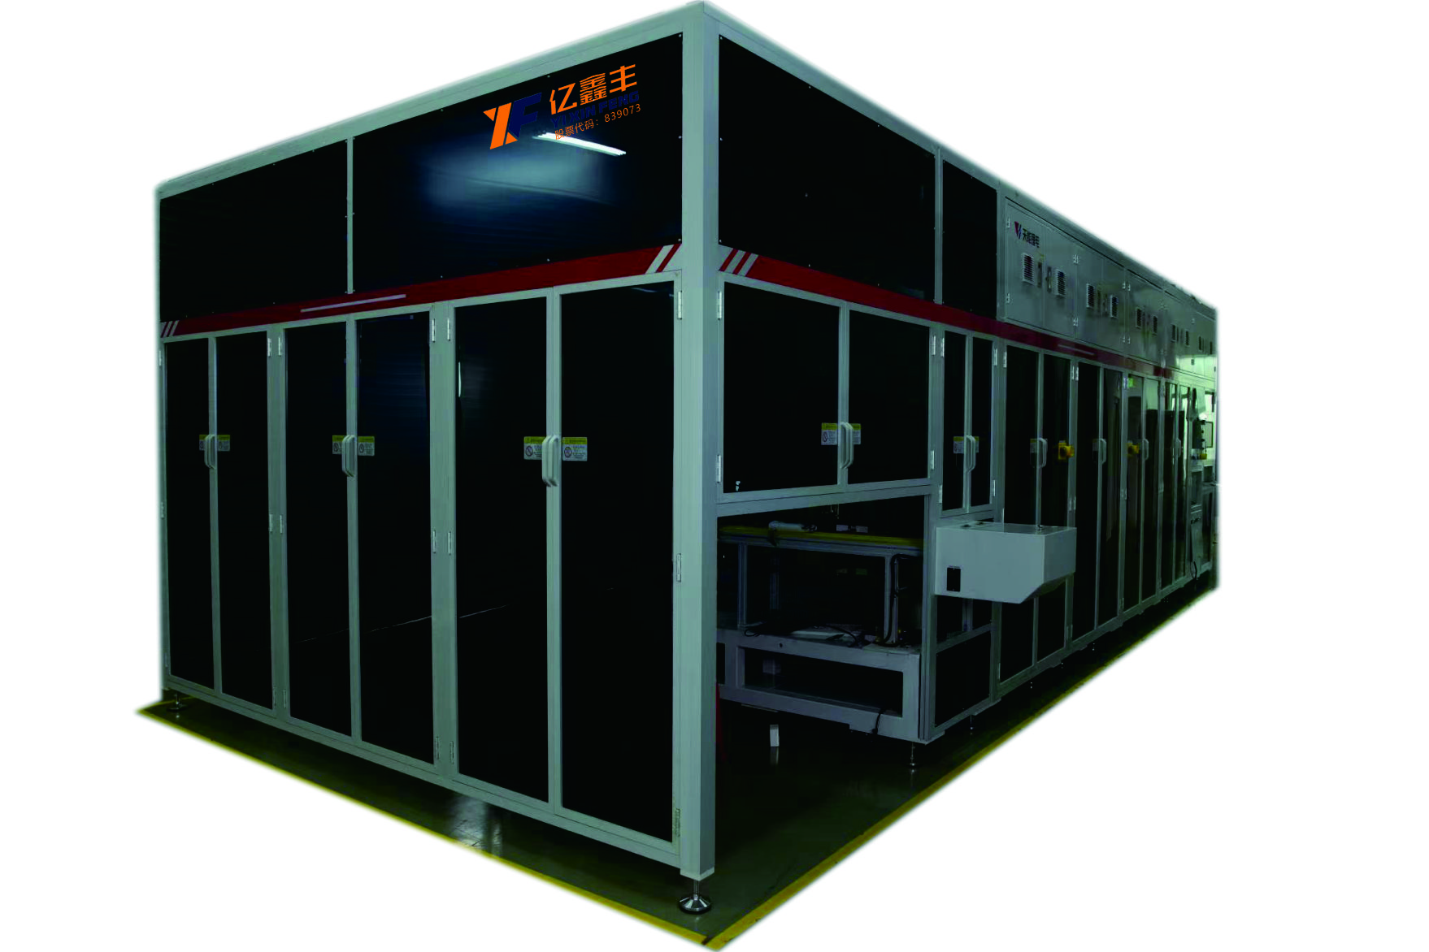
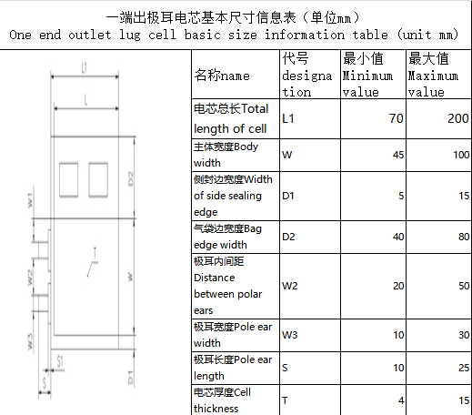
热压机
（Hot press）
原理与应用 Principle and application | 首先将设备电源打开，让设备自行加热，到所要求的温度后，将所要平压的物料平放在下压板上， 设定所需要压合的时间和需要的压力，用双手按下启动操作按钮，下热板在步进马达的驱动下，进入到热压位，上热压增压缸动作，上热压板下降，与下热压板压合，对电芯进行热压，待压合时间到后，上热压板自动上升，两压板分开，下热压板自动退回到上料位，人工取出压好的物料 First of all, turn on the power supply of the device and let the device heat itself. After reaching the required temperature, place the material to be pressed flat on the lower pressure plate, set the required pressing time and pressure, press the start operation button with both hands, the lower hot plate enters the hot pressure position under the drive of the stepping motor, the upper hot pressure booster cylinder moves, the upper hot pressure plate drops, and the lower hot pressure plate is pressed together. When the pressing time is up, the upper hot pressing plate automatically rises, the two pressing plates are separated, the lower hot pressing plate automatically returns to the loading position, and the pressed material is taken out manually
设备配置 Equipment configuration | （1）配数显压力传感器 （2）上、下铁加热板 ，上、下工作平板厚度不低于30MM （3）采用欧姆龙温度控制器 （4）具备安全光幕和双按钮启动等多重保护功能，防止机械伤人 （5）须配替罪羊装置，防止维修与清洁设备时加热板压手 （6）热压板光滑防锈，不粘连电芯 （7）发热装置拆装位置留有余量，便于更换维护，热压板温度分布应均匀 (1) Pressure sensor with digital display (2) The upper and lower iron heating plates, the thickness of the upper and lower working plates is not less than 30MM (3) Using Omron temperature controller (4) It has multiple protection functions such as safety light curtain and double button start to prevent mechanical injury (5) A scapegoat device must be equipped to prevent the heating plate from pressing the hand during maintenance and cleaning of the equipment (6) The hot press plate is smooth and anti-rust, and does not stick to the battery core (7) There is a margin in the disassembly position of the heating device to facilitate replacement and maintenance, and the temperature distribution of the hot press plate should be uniform
设备关键参数要求 Requirements for key device parameters | （1）平压最大压力不低于10吨，压力可调。压力控制精度≤ ±3% （2）上、下热板的平行度 ≤0.01mm （3）温控范围：室内温度~200°可调，温度误差：±2° （4）热板涂TEFLON 层 （5）温度上升速度：15分钟达到需要的温度 （6）热压时间继电器控制，时间0-999.9秒可调 (1) The maximum flat pressure is not less than 10 tons, and the pressure is adjustable. Pressure control accuracy ≤ ±3% (2) Parallelism of the upper and lower hot plates ≤0.01mm (3) Temperature control range: indoor temperature ~200° adjustable, temperature error: ±2° (4) Hot plate coated with TEFLON layer (5) Temperature rise rate: 15 minutes to reach the required temperature (6) Hot pressing time relay control, time 0-999.9 seconds adjustable

Slide 27
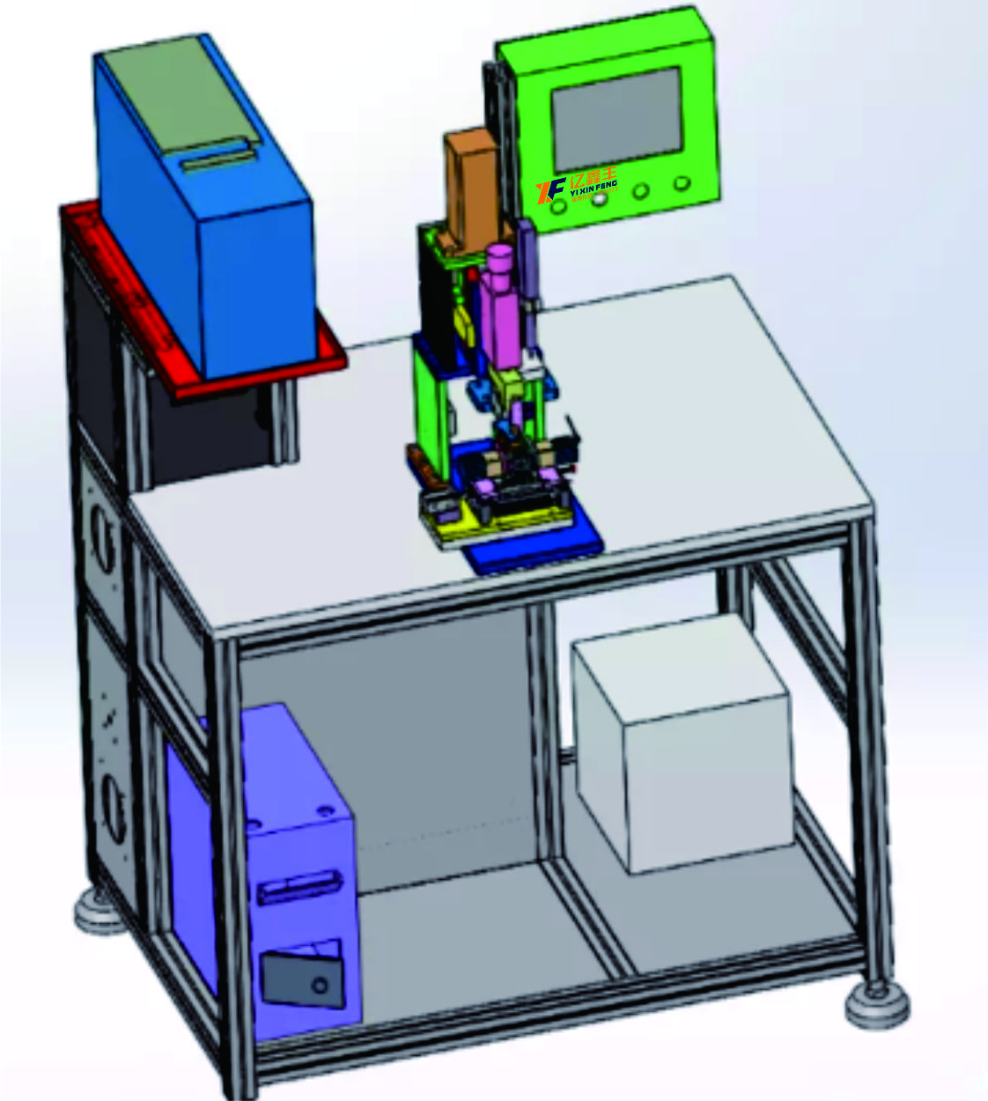
焊接机
（Welding machine）
原理与应用 Principle and application | 该金属焊接机主要由超声波发生器,换能器,上下声极,气动部件,机架等组成，电路方式选用全数字电路大功率方式，性能稳定，输出强劲，焊接前首先选择工作模式调整振幅和时间再把电芯放入限位模具然后进行焊接，上下声极材料选用新型的钢材材料,耐磨性好 The metal welding machine is mainly composed of ultrasonic generator, transducer, upper and lower poles, pneumatic components, rack, etc. The circuit mode is full digital circuit high-power mode, stable performance and strong output. Before welding, the working mode is first selected to adjust the amplitude and time, and then the cell is put into the limit mold and then welded
电芯方式 Cell system | 叠片可焊接能力范围（铜箔或铝箔3-50层） Laminate weldable range (copper foil or aluminum foil 3-50 layers)
基材厚度 Substrate thickness | （1）正极：A、铝箔0.016mm。 B、纯铝带0.2mm （2）负极：A、铜箔0.008mm。 B、纯铜镀镍带0.2mm。 (1) Positive electrode: A, aluminum foil 0.016mm. B, pure aluminum with 0.2mm (2) negative electrode: A, copper foil 0.008mm. B, pure copper nickel-plated tape 0.2mm.
焊头设计方向 Welding head design direction | 横向设计：（2-4个面设计），长度受限或有位阻情况下只能够设计二个面，在排除位阻以及长度允许的范围内可设计四个面，根据具体情况而定 Horizontal design: (2-4 face design), only two faces can be designed when the length is limited or there is a resistance, and four faces can be designed within the range of the exclusion of steric resistance and length, depending on the specific situation
焊接参数 Welding parameter | （1）焊接时间：0.1-0.8S以内（程序0-60S可调），可调精度：0.01S。 （2）焊接压力：0.1～0.6Mpa以内，可调精度0.02Mpa （3）共振频率：20KHz±100Hz。 (1) Welding time: within 0.1-0.8S (program 0-60S adjustable), adjustable accuracy: 0.01S. (2) Welding pressure: 0.1 ~ 0.6Mpa, adjustable precision 0.02Mpa (3) resonance frequency: 20KHz±100Hz.
换能器 Energy transducer | 换能器超声波频率：20KHZ±100Hz（自动跟踪）。 Transducer ultrasonic frequency: 20KHZ±100Hz (automatic tracking).
电功率参数 Electric power parameter | 焊接模式：时间模式、能量模式，分段模式均可调节。 Welding mode: time mode, energy mode, segment mode can be adjusted.
焊接品质 Welding quality | 无虚焊、焊穿、漏接，焊接牢固，层层渗透。焊接合格率：99.9%。一次合格率为99.9% No virtual welding, welding through, leakage, solid welding, layer penetration. Welding pass rate: 99.9%. The pass rate was 99.9%
选择工作模式
Select work mode
调整振幅和时间
Adjust amplitude and time
焊接
weld
电芯放入限位模具
The cell is put into the limit mold

Slide 28
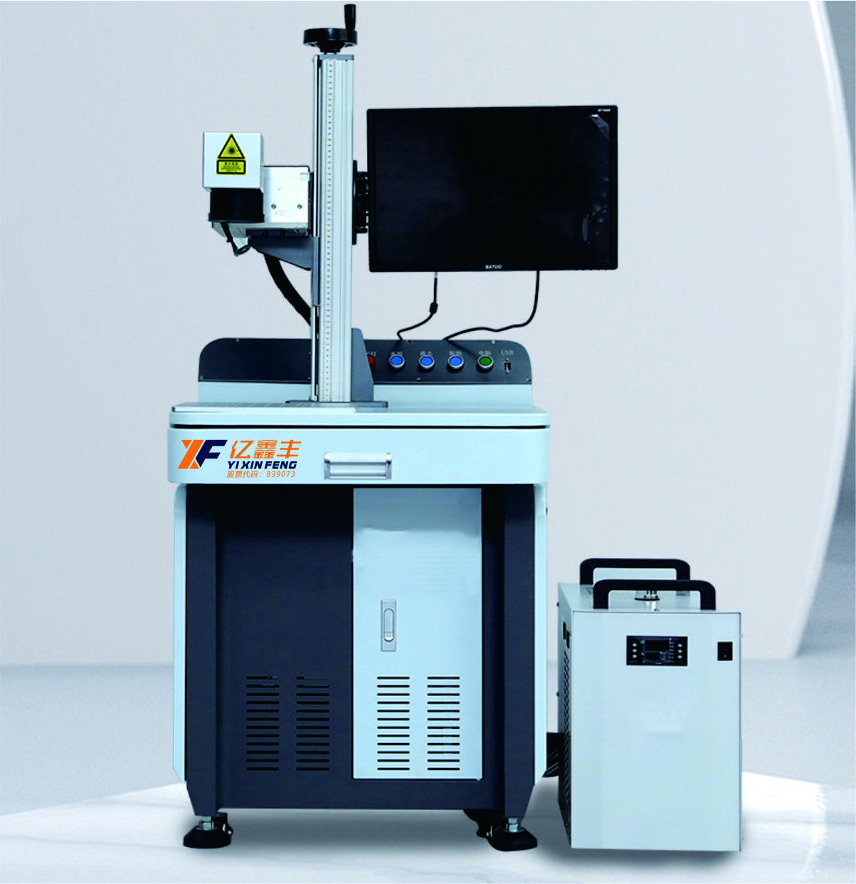
盖板激光刻码
（Laser coding of cover plate）
原理与应用 Principle and application | 将高能量的激光束投射到材料表面，利用激光产生的热效应，在材料表面产生清晰图案的激光加工过程，它是激光加工方式中的一种一般说来，激光二维码雕刻加工按加工效果一般分为激光雕刻线条加工激光雕刻填充加工激光雕刻镂空加工 。 The high-energy laser beam is projected onto the surface of the material, the use of the thermal effect produced by the laser, the laser processing process that produces a clear pattern on the surface of the material, it is one of the laser processing methods in general, laser two-dimensional code engraving processing according to the processing effect is generally divided into laser engraving line processing laser engraving filling processing laser engraving hollowing processing.
打标线速 Marking line speed | ≤12000mm/s
功率稳定性 Power stability | ±0.003mm
最小线宽 Minimum line width | ≥0.01mm
冷却方式 Cooling mode | 风冷/水冷 Air/water cooled
工作环境 Working environment | 温度：15-35℃，湿度10%-80%不结露 Temperature: 15-35℃, humidity 10%-80% no condensation
整机外形 Overall appearance | 650mm*850mm*1400mm
软件功能 Software function | 支持编辑任意曲线文本，图形绘制，中英文数字输入功能，一维码二维码生产功能，矢量文件/位图文件/变量文件，多国语言支持，可配合旋转打标功能，飞行打标，软件二次开发。 Support editing any curve text, graphic drawing, Chinese and English digital input function, one-dimensional code two-dimensional code production function, vector file/bitmap file/variable file, multi-language support, can cooperate with rotary marking function, flight marking, software secondary development.

Slide 29
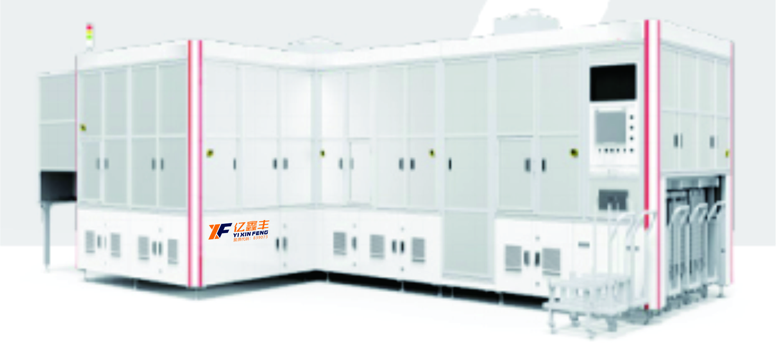
转接片焊接机
（Adapter laser weiding machine）
原理与应用 Principle and application | ● 激光焊接位同轴除尘 ●打码分度盘DD马达驱动，调试方便，柔性好 ●焊接过程多重保护功能 ●八工位转盘结构，布局紧凑合理，可实现不停机加料 ●焊接转盘功能集成化，减少抓取次数，位移小，不良率低 ●产品兼容性广，可实现产品快速换型 ● Coaxial dust removal at the laser welding position ● DD motor to drive coded indexing disk, flexible and convenient for maintenance ● Multiple protection during welding ● Eight-station turntable, compact and reasonable layout, realizing non-stop loading ● Integrated welding turntable, reducing times of gripping, small displacement, and low NG rate ● High compatibility, quick model changeover
单机产能 Capacity | Max15ppm
适用电芯尺寸 JR Size | 140-180mm（W），85-220mm（H），20-80mm（T）
焊接位置精度 Accuracy of welding position | ≤±0.3mm
合芯后错位 Displacement after tabs welding | ≤±0.5mm
激光焊接速度 Laser welding speed | ≥130mm/s

Slide 30
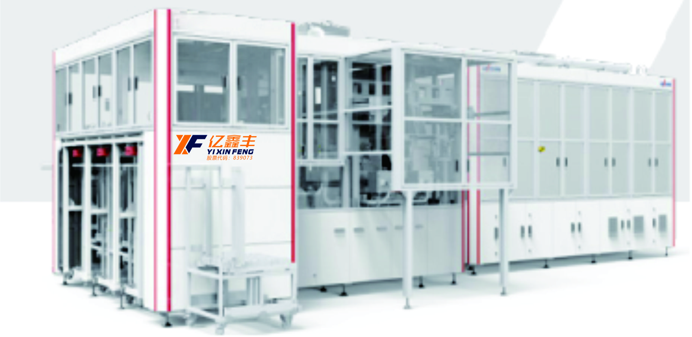
入壳机
（Can Insertion machine）
原理与应用 Principle and application | ● 入壳推电芯压力实时监控 ● 电芯与顶盖对中度自动校正 ● 电芯入壳壳口全遮掩，形成 “JR” 防护 ● 顶盖端面与铝壳壳口台阶检测功能 ● 分2阶段入壳，第一阶段入壳后Hi-Pot检测 ● Real-time monitoring for pressure to push cell into the can ● Automatic correction for the alignment of cell and top cover ● Opening to be completely covered after cell insertion, forming protection ● Step detection for top cover end surface and can opening ● Two steps to insert cells, Hi-Pot detection after the first step
单机产能 Capacity | 15ppm
适用电芯尺寸 JR Size | 140-180mm（W）
 | 90-220mm（H）
 | 20-80mm（T）
顶盖端面与铝壳壳口台阶高度 Step height between the end surface of the top cover and the can opening | ≤0.25mm
顶盖与铝壳内面缝隙 Gap between the top cover and the inner surface of the can | ≤0.08mm（1/10铝壳厚度Thickness of aluminum shell）
预焊位置精度 Position accuracy of pre-welding | ≤0.1mm

Slide 31
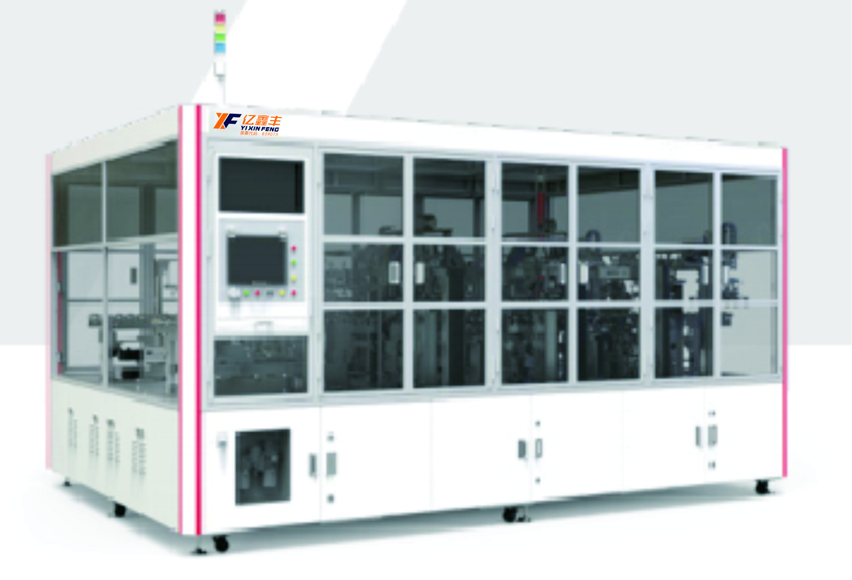
盒盖预焊机
（COVERING & PRE-WELDING MACHINE）
原理与应用 Principle and application | ●设备自动折极耳合盖 ●焊接头由伺服控制，定位精准 ●焊接工位带有保护镜片，同轴保护气和除尘 ●产品兼容性广，可实现产品快速换型 ●Auto tab folding & covering ●Welding horn controlled by servo ●Protection lens for welding position, offer protection gas & dust removing ●Compatible for various kinds, fast-change design
单机产能 Throughput | 50PPM（电池直径(dia)35mm以下，高度(height)190mm以下）
适用电芯尺寸 JR Size | 直径(dia)20-70mm，高度(height)100-300mm
焊接头重复定位精度 Welding Repeat Positioning Accuracy | ±0.05mm
离焦量调节范围 Defocusing Amount | -5~5mm
调节精度 Accuracy | 0.05mm

Slide 32
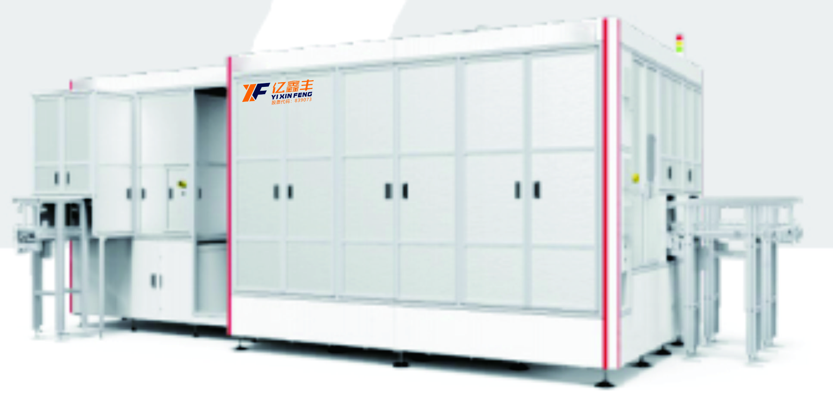
顶盖激光焊接机
（Lid Laser Sealing Machine）
原理与应用 Principle and application | ● 采用环形光斑焊接工艺，焊接速度快，良品率高 ● 采用大理石直线电机焊接平台，精度高，运行稳定 ● 激光传感器测量焊接焦距 ● 改进的涡轮式同轴吸尘装置，除尘效果好 ● 电池在线扫码，不良品跟踪，分类NG槽 ● Ring-shaped spot welding technology, fast welding speed and high yield rate ● Marble linear motor welding platform, high precision and stable operation ● Laser sensor to measure welding focal length ● Improved turbo-type coaxial vacuum cleaner, better dust removal ● On-line cells scanning, tracking of NG cells, and classification of NG tank
单机产能 Capacity | 15PPM
适用电芯尺寸 Applicable cell dimensions | 120-400mm（W），60-250mm（H），20-90mm （T）
焊接速度 Welding speed | 200-300mm/s（激光焊接直线速度Laser welding linear speed）
熔深 Depth of penetration | 0.7~1.2mm
离焦量 Defocus distance | 2mm

Slide 33
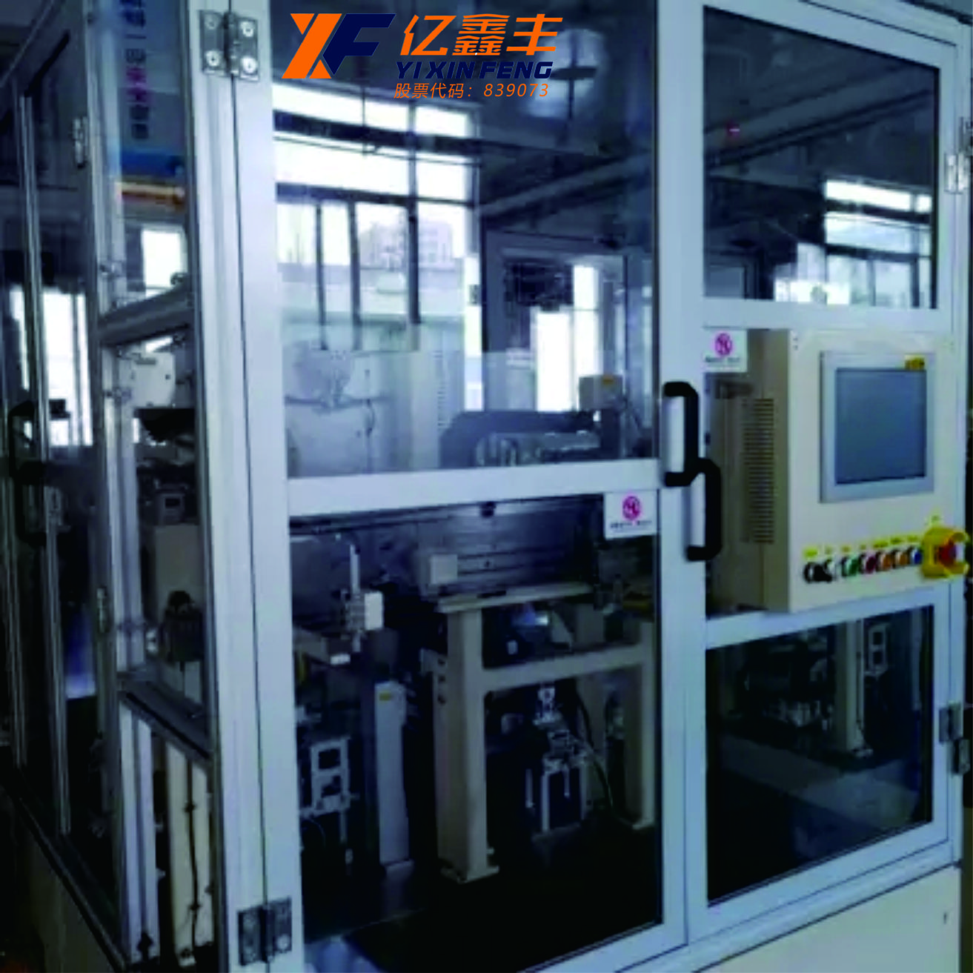
合芯包Mylar机
（Core wrap Mylar machine）
原理与应用 Principle and application | 该设备实现软包装锂电池自动贴mylar功能，采用机电一体化系统，完成软包装锂电池自动上料、卷膜自动出膜切断、电池自动定位、膜放置到包膜工位、自动包膜，不划伤电池。该设备机械调节适应本规格书电芯厚度，进行相应调节、触摸屏设置及更换相应的膜可适应电芯的长宽规格，能完成本规格书的不同规格电芯的自动包膜。 The device implements the mylar function of flexible packaging lithium battery automatically. It adopts the mechatronics system to complete the automatic loading of flexible packaging lithium battery, automatic rolling film cutting, automatic positioning of battery, film placement to the coating station, automatic coating without scratching the battery. The device is mechanically adjusted to the thickness of the battery cell in this specification, and the corresponding adjustment, touch screen setting and replacement of the corresponding film can adapt to the length and width specifications of the battery cell, and can complete the automatic coating of the different specifications of the battery cell in this specification.
产品规格 Product specification | 宽（width）：35-100MM，长（longth）：50-180MM，厚（thickness）：2-10MM；
产品合格率 Product qualification rate | ≥98%；
贴膜精度 Film precision | ±0.5MM ；
设备产能 Equipment capacity | 20PPM；
设备故障率 Equipment failure rate | ≤5%
真空 vacuum | -84Kpa — -50Kpa；
压缩空气 Compressed air | 压力为0.5 — 0.7Mpa； The pressure is 0.5-0.7mpa;

Slide 34
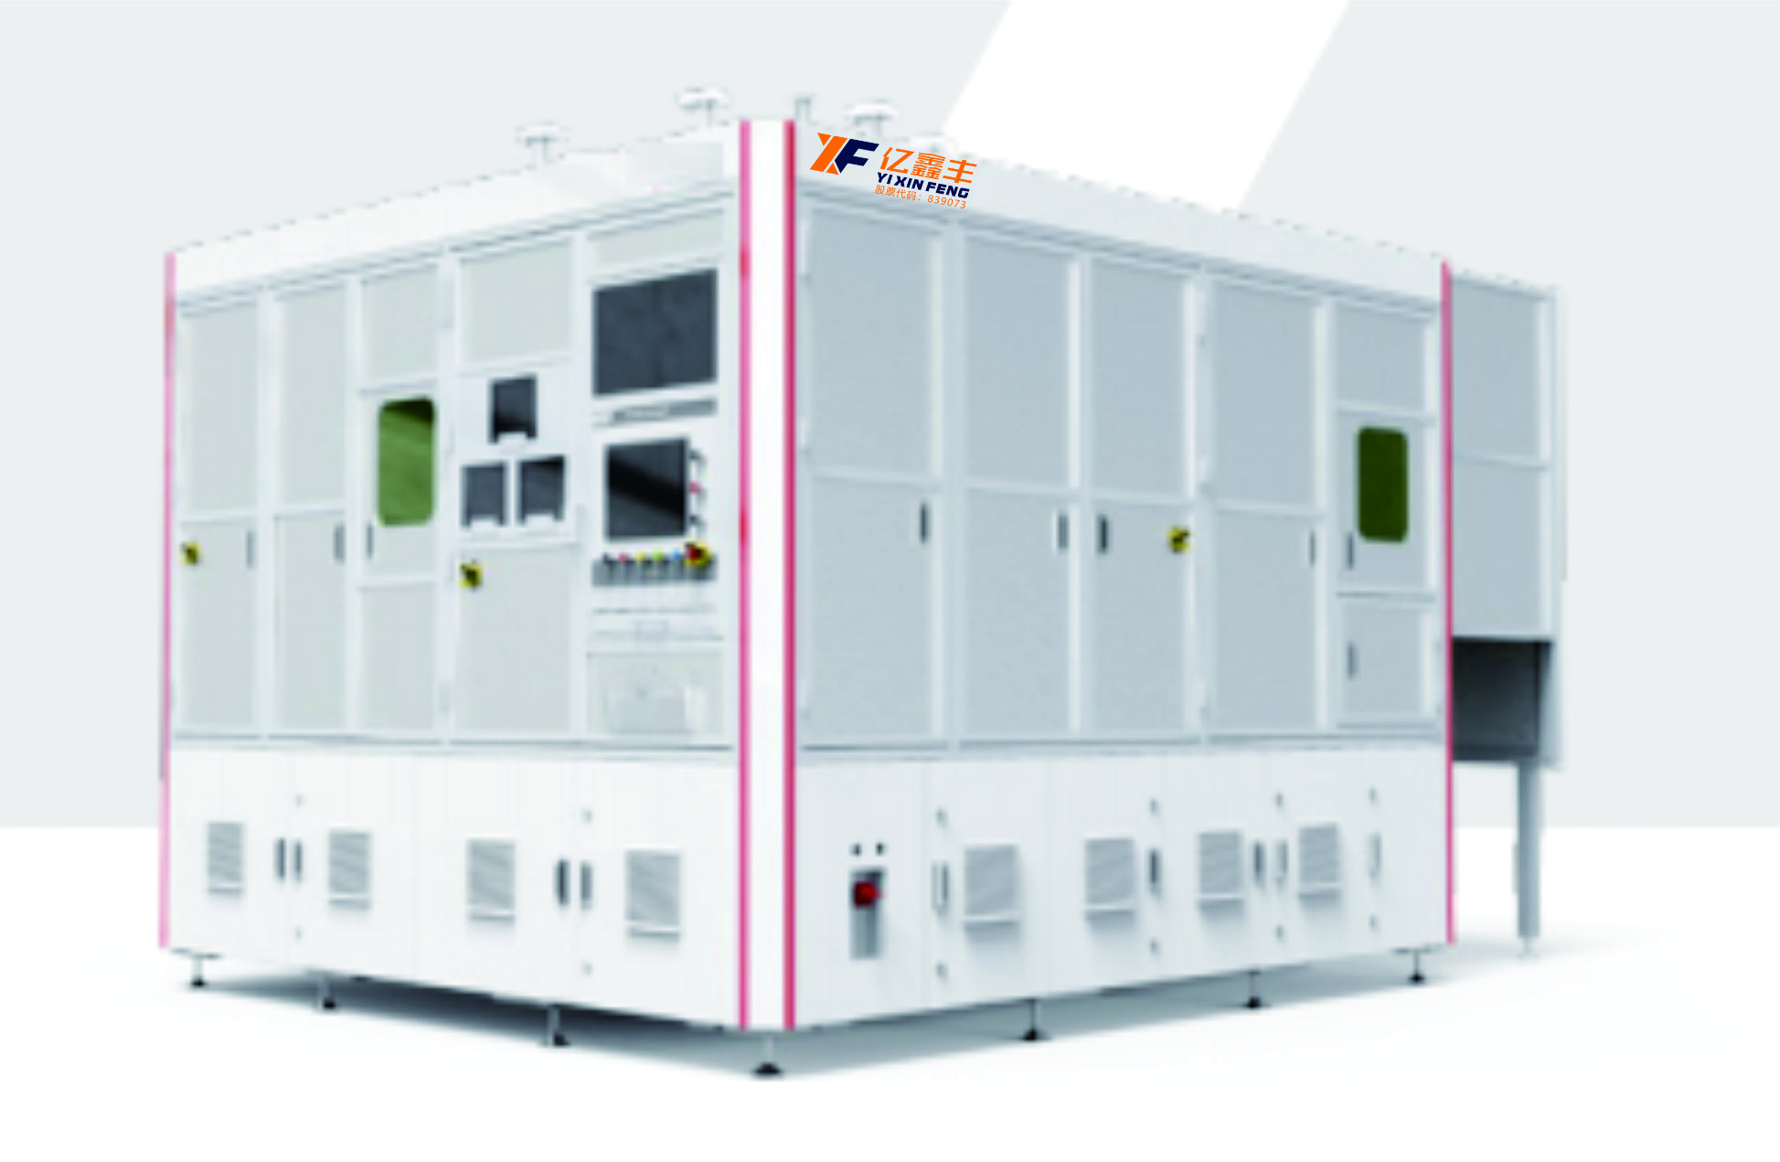
密封钉焊接机
（Seal nail welding machine）
原理与应用 Principle and application | ●焊接前激光清洗，去除氧化层和脏污，提升焊接品质 ●密封钉插入、密封钉焊接工位带有CCD补正功能 ●焊接头XYZ 方向可调，三轴位置程序控制，可设参数，离焦量可通过触摸屏控制 ●焊接工位带有保护镜片，同轴保护气和除尘 ●产品兼容性广，可实现产品快速换型 ●Laser cleaning before welding, remove oxide layer and dirt, improve welding quality ●Sealing nail insertion, sealing nail welding station with CCD correction function ●The X, Y, and Z directions of the welding head are adjustable, program controls three-axis position, parameters can be set, and the amount of defocus can be controlled through the touch screen ●Welding station has protective lens, coaxial protective gas and dust removal ●Compatible for various kinds, fast-change design
单机产能 Throughput | 15PPM（电池直径35mm以下，高度190mm以下） 15PPM (dia≤35mm , height ≤190mm)
适用电芯尺寸 JR size | 直径(dia)20-70mm，高度(height)100-300mm
焊接重复定位精度 Welding repeat positioning accuracy | ±0.05mm
离焦量调节范围 Defocusing amount | -5~5mm
调节精度 Accuracy | 0.05mm

Slide 35
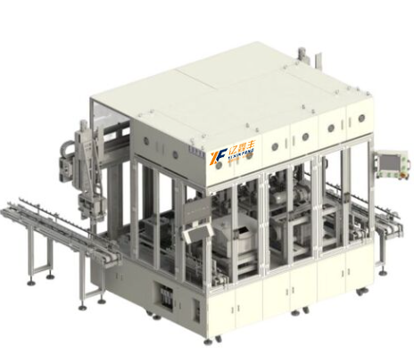
氦检机
（Helium detector）
原理与应用 Principle and application | 该设备实现顶盖激光密封焊接后至烘烤除水的扫码、及 完成电芯正压氦检工作。主要包括：电芯进站扫码 、信息绑定NG 电芯缓存、正压氦检， 一次氦检NG缓存、自动复测等。 The equipment can scan the code from laser seal welding to baking and complete the positive pressure helium test of the battery. It mainly includes: code scanning at station, information binding NG battery cache, positive pressure helium detection, one-time helium detection NG cache, automatic retest and so on.
产能 | ≥12ppm
检测时密封腔体内真空度 | ≤40Pa;
真空泵 | 极限真空度≤5Pa，抽速≥250L/min，抽真空时间≤8s; Limit vacuum ≤5Pa, pumping speed ≥250L/min, pumping time ≤8s;
最小可检漏率 | 5.0×10-13 Pa·m³/s;
漏率显示范围 | 5.0×10-13 Pa·m³/s～1.0×10-3 Pa·m³/s;
响应时间 | ≤1s
氦质谱仪启动时间 | ≤2min;
检漏口最高压力 | 1500Pa;

Slide 36
股票代码：839073
06
PART
后段
Back section
专业诚信 务实高效
Challenges and opportunities coexist

Slide 37
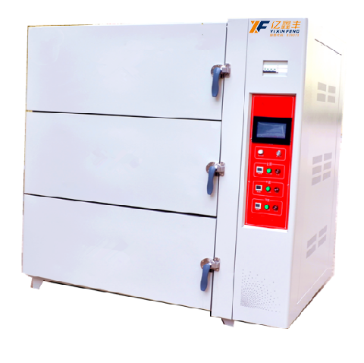
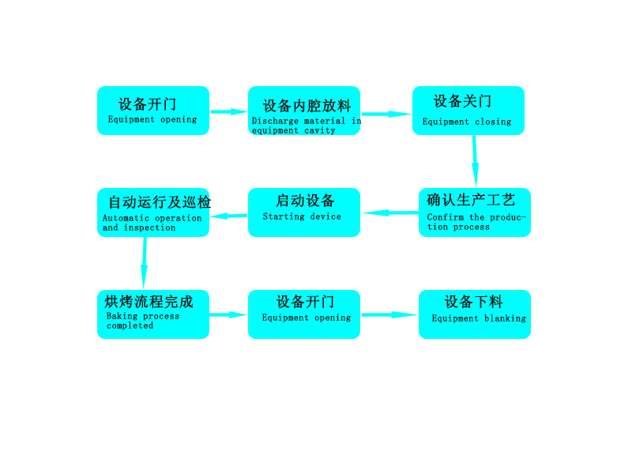
真空烤箱
（Vacuum oven）
原理与应用 Principle and application | 烤箱可用于锂电池电芯、极片烘烤及老化，采用的反射板均匀及来行运风技术。智能工艺控制和问题追溯在高温、恒温、真空保持、升降温速度方面有明显提升。 程序设可设置循环0-99次可调、加热时间0-999分可调、真空时间0-999分、静置时间0-999分、充氮气时间0-999分、热风循环时间0-999分 The oven can be used for baking and aging of lithium battery cells and pole pieces, and the reflective plate is uniform and the air flow technology is used. Intelligent process control and problem tracing have significantly improved in terms of high temperature, constant temperature, vacuum maintenance, rising and cooling speed. The program can be set cycle 0-99 times adjustable, heating time 0-999 minutes adjustable, vacuum time 0-999 minutes, standing time 0-999 minutes, nitrogen filling time 0-999 minutes, hot air cycle time 0-999 minutes
控制方式 Control mode | 跟椐现场生产工艺进行参数设置（如加热、真空、静制烘烤、充氮、热风循环、降温冷却等。），设置完成后启动程序，烤箱将自动运行所设置工艺动作流程 Set parameters according to the on-site production process (such as heating, vacuum, static baking, nitrogen filling, hot air circulation, cooling and cooling, etc.). After the setting is completed, start the program, and the oven will automatically run the set process
气源压力 Air source pressure | 压缩气：0.4~0.6Mpa，最大流量值：1L/s 真空源：0.5~5Pa，最小抽速值：500m³/H 干燥气:0.5~0.2MPa，最大流量值：5m³/H Compressed gas: 0.4~0.6Mpa, maximum flow value: 1L/s Vacuum source: 0.5~5Pa, minimum pumping speed: 500m³/H Dry gas :0.5~0.2MPa, maximum flow value: 5m³/H
基本加热原理 Basic heating principle | 内外双循环、内循环前后交叉运风加热控制 Internal and external double circulation, internal circulation before and after cross air heating control
烤箱温度 Oven temperature | 常温~150℃可设定，仪表可调补偿值 Normal temperature ~150℃ can be set, the instrument can adjust the compensation value
加热速度 Heating rate | 空载非真空状态：85℃≦45min 满载非真空状态：85℃≦90min No-load non-vacuum condition: 85℃≦45min Full load non-vacuum condition: 85℃≦90min
冷却方式 Cooling mode | 烤相带自动冷却功能与冷风机对接，冷风机对烤箱外层强制冷却。 The oven phase with automatic cooling function is connected to the chiller, and the chiller forces the outer layer of the oven to cool.
真空泵口极限压力 Vacuum pump port limit pressure | 真空泵；SV300B+JRP1000罗茨抽速：1000L/min:极限压力；≦5pa. Vacuum pump; SV300B+JRP1000 Roots pumping speed: 1000L/min: limit pressure; ≦5pa.
内胆满载空达压力值 Full load empty reach pressure value of tank | 10pa~100pa左右：具体真空值与抽真空时间有关，高真空必须长时间抽才有效。实际真空值为渐变值，具体与时间和物体量相关联。如果真空度越接近空载真空值，则表示除水效果更彻底。 About 10pa~100pa: The specific vacuum value is related to the vacuum time, and the high vacuum must be pumped for a long time to be effective. The actual vacuum value is a gradual value, which is related to time and volume of objects. If the vacuum degree is closer to the no-load vacuum value, it means that the water removal effect is more thorough.

Slide 38
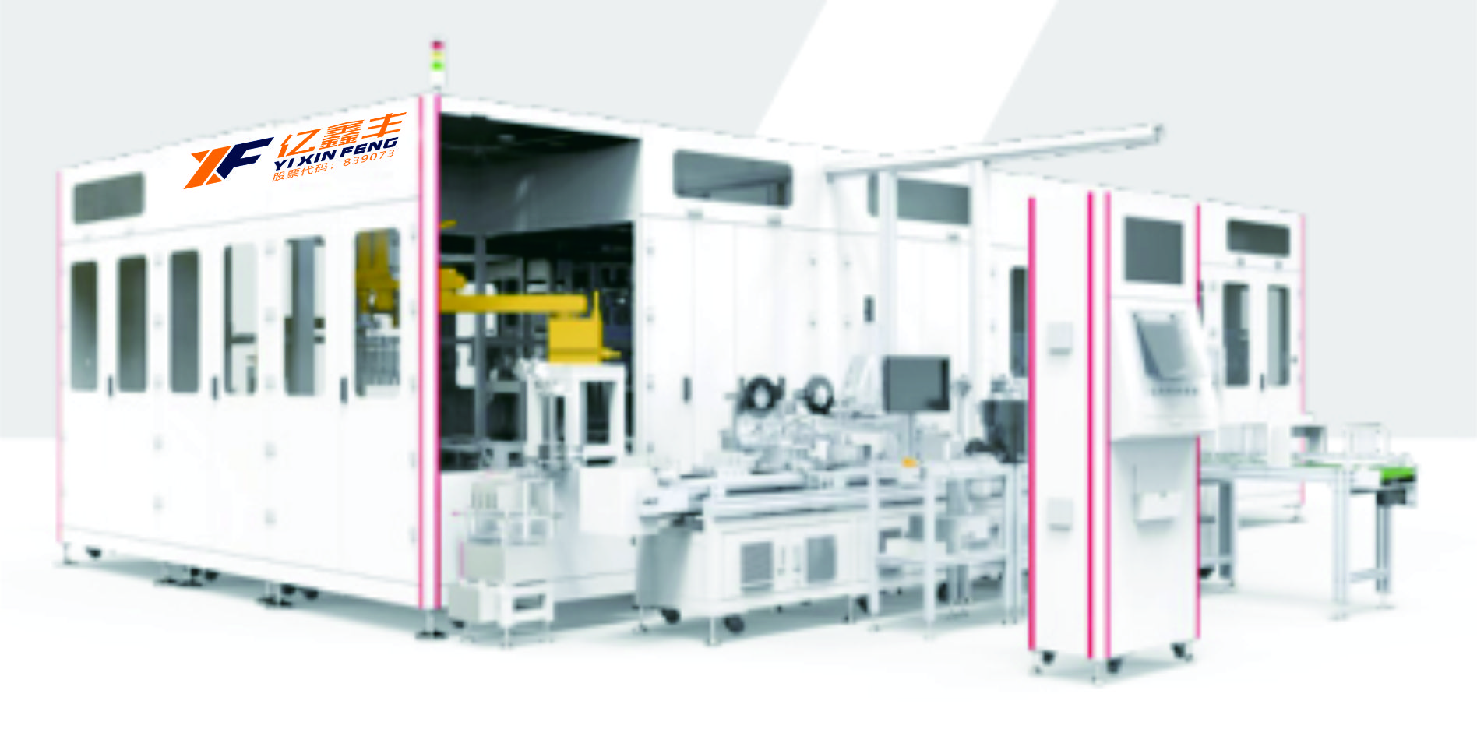
注液机
（ELECTROLYTE FILLING MACHINE）
原理与应用 Principle and application | ● 高精度注液泵真空加压注液，高精度电子秤称重 ● 电芯五面全包裹式夹具，有效防止电芯注液变形 ● 电解液多级过滤 ● 注液管路自动清洗功能，提高良品率 ● 机器人搬运电芯上下转盘，柔性好，调试方便 ● High-precision electrolyte filling pump, vacuum filling, high-precision weighing ● Five-sided & full-wrapped fixtures for cells, effectively preventing the deformation of cells when filling ● Multi-stage filtration for electrolyte ● Automatic cleaning of electrolyte pipeline, to improve yield ● Robot to transfer cells, flexible and convenient for commissioning
单机产能 Capacity | 15PPM
适用电芯尺寸 Applicable cell dimensions | 140-180mm（W），85-220mm（H），20-86mm（T）
浸润时间 Infiltration time | 5~30min
注液精度 Filling accuracy | 注液量≥200g时，注液精度＜±1% When injection volume is ≥200g, injection accuracy is ＜ ±1%
 | 注液量＜200g以内时，注液精度±1g When the injection volume ＜200g, the injection accuracy is ±1g
称重精度 Weighing accuracy | 0.01g

Slide 39

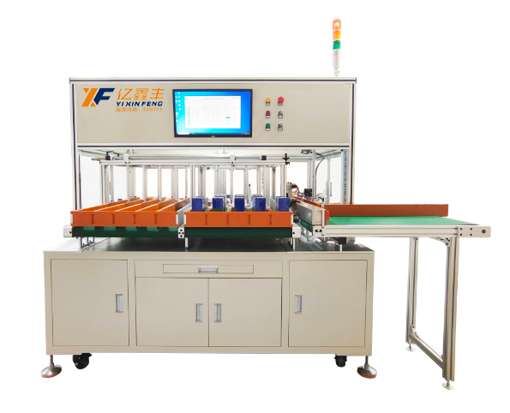
OCV测试分选设备
（OCV Detecting Machine）
设备功能特点：
1、设备包括品牌电脑、软件系统、精密电压内阻测量仪、扫码机构以及批量上料装置、自动分档、 自动下料等装置。
2、根据方形电池的交流内阻、开路电压等参数，将电池按各项的性能参数精确分档配组，最多一 次性分档配对数为 10 组，提高 pack 电池品质和配对电芯性能的一致性。
3、交流内阻和开路电压的采集可采用本设备自带的高精度内阻仪自动采集，分选 工艺流程自动控制，操作简便，保证了测试参数的精度和配对过程的可靠性， 提高和保证 pack 产品的性能品质。
4、设备采用基恩士 SR1000 扫码枪，自动对焦，支持条码和二维码。
5、自动化程度高、操作简捷，简便操作，能有效提高生产效率，降低生产成本。
6、系统测试的电芯性能数据实行数据库管理模式，长期保存，可追溯性强。配合软件的数据分析 功能，对产品性能品质进行长期监控分析，来指导改进研发配方，改善生产工艺流程。
7、由工控电脑采集数据，并自动生成曲线图和条形图，系统具备数据库功能，可追溯历史数据 并导出。
Equipment features:
1, the equipment includes brand computer, software system, precision voltage internal resistance measuring instrument, code scanning mechanism and batch feeding device, automatic grading, automatic feeding device.
2, according to the AC internal resistance, open circuit voltage and other parameters of the square battery, the battery is accurately graded according to the performance parameters, and the maximum number of one-time grade pairing is 10 groups, improving the consistency of pack battery quality and pairing cell performance.
3, the AC internal resistance and open circuit voltage can be collected automatically by the high-precision internal resistance meter of the equipment, the sorting process is automatically controlled, the operation is simple, to ensure the accuracy of the test parameters and the reliability of the pairing process, and to improve and guarantee the performance quality of pack products.
4, the equipment adopts Keynes SR1000 scanning code gun, automatic focus, support bar code and two-dimensional code.
5, high degree of automation, simple operation, simple operation, can effectively improve production efficiency, reduce production costs.
6, the performance data of the battery cell tested by the system is implemented in the database management mode, long-term storage, and strong traceability. With the data analysis function of the software, long-term monitoring and analysis of product performance and quality are carried out to guide the improvement of R&D formula and production process.
7, by the industrial control computer to collect data, and automatically generate curves and bar charts, the system has the database function, can trace historical data and export.

Slide 40
OCV检测设备
（OCV Detecting）
设备参数指标（Equipment parameter index）
基本参数 Basic parameter | 参数值 Parameter values
电压测试精度 Voltage test accuracy | 测试精度：仪器单机±A(0.0035%Set+0.0005%FS)Temperature coefficient: (±0.0005%rdg.±0.0001% FS/℃)
 | 硬壳＆软包＆圆柱电压测试精度：±0.3mV（可支持±0.1mV） Voltage test accuracy: ±0.3mv (±0.1mvavailable)
内阻测试精度 Internal resistance testing precision | 测试精度：仪器单机±(0.5%rdg.+10dgt.) Test precision: ±(0.5%rdg.+10dgt.)
 | 测试频率：1KHz±0.2Hzf) Testing frequency:1KHz±0.2Hz
 | 软包内阻测试精度 ±0.05mΩ PouchcellInternaltestprecision:±0.05mΩ
 | 硬壳内阻测试精度 ±0.006mΩ PrismaticcellInternaltestprecision:±0.006mΩ
 | 圆柱内阻测试精度 ±0.3mΩ CylindricalcellInternaltestprecision:±0.3mΩ

Slide 41
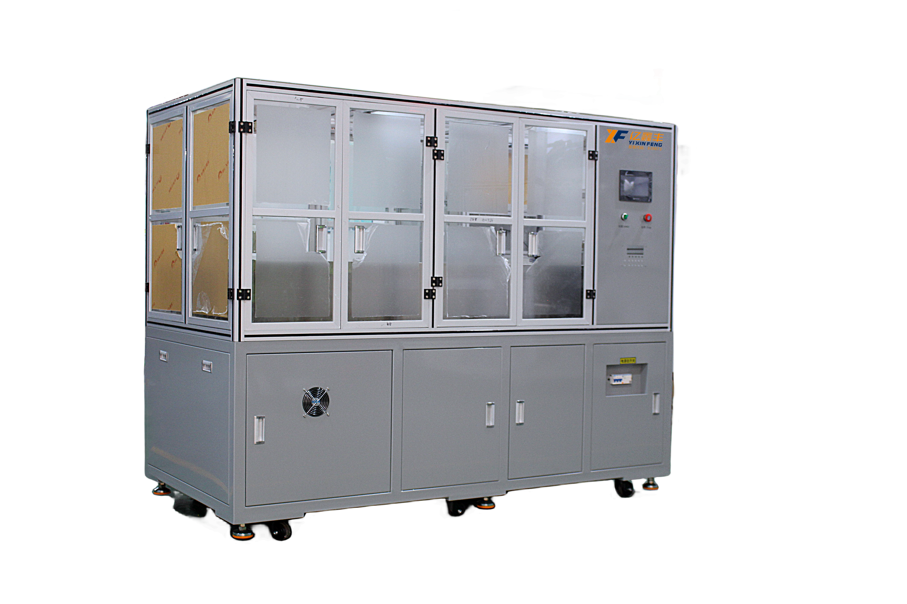
化成机
（Forming machine）
原理与应用 Principle and application | 设备的工艺动作流程：启动---柜门手动打开---夹具打开---电芯上柜---夹具加紧---柜门关闭---化成启动---化成完成---柜门打开---夹具打开---电芯下柜 Equipment of process action process: start - open cupboard door manually - clamp open strategy - batteries - fixture tightening - cupboard door closed - to start - into a complete cupboard door open - - - clamp open - batteries under the cabinet
夹具主要功能 Main functions of fixture | 1.提供压紧电芯所需的压力,可在压力允许范围内任意设置，压力设置若超出压力设置范围将报警提示； 2.压紧电极，确保电极至整机间电路的可靠连接。 3.保证电池化成时为竖立状态，气袋朝上 1. Provide the pressure required to compress the battery cell, which can be set arbitrarily within the allowable range of pressure. If the pressure setting exceeds the pressure setting range, the alarm will be alerted; 2. Press the electrode to ensure a reliable connection between the electrode and the circuit. 3. Ensure that the battery is upright when it is formed, and the air bag is facing up
配置电源 Configure power supply | 电压AC380±10%，电源充放电功率15kW，最大加热功率19kW（从室温启动加热至目标温度过程），保温时加热功率6.5kW。 Voltage AC380±10%, power supply charging and discharging power 15kW, maximum heating power 19kW (starting from room temperature heating to the target temperature process), heating power 6.5kW during insulation.
压力控制 Pressure control | 由伺服电机配合压力传感器实现多段压力控制，单个夹具可调压力范围200kg.f～2000kg.f；压力≥1000kg.f时；压力精度±1%，压力≤1000kg.f时，压力精度±10kg.f。 The servo motor with the pressure sensor to achieve multi-stage pressure control, a single fixture can adjust the pressure range of 200kg.f ~ 2000kg.f; Pressure ≥1000kg.f; Pressure accuracy ±1%, pressure ≤1000kg.f, pressure accuracy ±10kg.f.
漏电流保护 Leakage current protection | 工作状态巡检到有大于200mA的漏电流三次以上，关闭开关电源的输入电源 If the leakage current exceeds 200mA for more than three times, turn off the input power supply of the switching power supply
充电过压保护 Charge overvoltage protection | 电池充电过程中系统巡检电池时，当电池电压高于上限电压时，电池停止充电 When the system inspects the battery during battery charging, the battery stops charging when the battery voltage is higher than the upper limit
设备掉电保护 Device power failure protection | 当出现长时间通讯中断或PC机故障时，设备将会自动进入等待状态，待通讯恢复后继续当前流程步 If the communication is interrupted for a long time or the PC is faulty, the device automatically enters the waiting state. After the communication is restored, the current process continues
化成数据存储 Formation data store | 软件能保存相应数据储存30天以上，软件扫描频率＜30S，每2分钟取扫描值保存，取值时间可以自行设定，软件根据电压、电流显示曲线，软件可以查看电池详细数据，电池在不同状态软件点位显示不同颜色 The software can store the corresponding data for more than 30 days, the software scanning frequency is less than 30S, and the scan value is saved every 2 minutes. The value time can be set by itself. The software displays the curve according to the voltage and current, and the software can view the detailed data of the battery

Slide 42
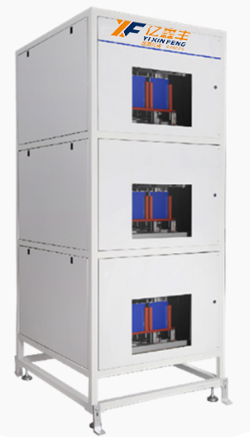
分容机
（Volumetric separator）
原理与应用 Principle and application | 分容机是锂离子电池生产过程中必不可少的设备之一，主要用于电池的分容和化成。在电池生产过程中，分容机的作用是对电池进行充放电测试，以确定其容量和其他电性能参数，并进行分级。而化成机则主要用于将注液封装后的电芯进行充电活化。 The capacity divider is one of the essential equipment in the production process of lithium-ion battery, which is mainly used for the capacity divider and formation of battery. In the battery production process, the role of the separator is to charge and discharge the battery to determine its capacity and other electrical performance parameters, and to perform classification. The forming machine is mainly used to charge and activate the battery cell after injection
输入电源 Input power supply | 220V±10% /50HZ
电流输出范围 Current output range | ±2000mA
电压测量范围 Voltage measuring range | 0.1-5V
功率 power | 8300W
电流测量精度 Current measurement accuracy | ±（0.2% 读数+0.2% 量程） ± (0.2% reading +0.2% range)
电压测量精度 Voltage measurement accuracy | ±（0.2% 读数+0.2% 量程） ± (0.2% reading +0.2% range)
定时范围 Timing range | 0-9999分钟/工步 0-9999 minutes/work step
夹具可调范围 Clamp adjustable range | 最大80mm，夹具间距34mm Max. 80mm, fixture spacing 34mm

Slide 43
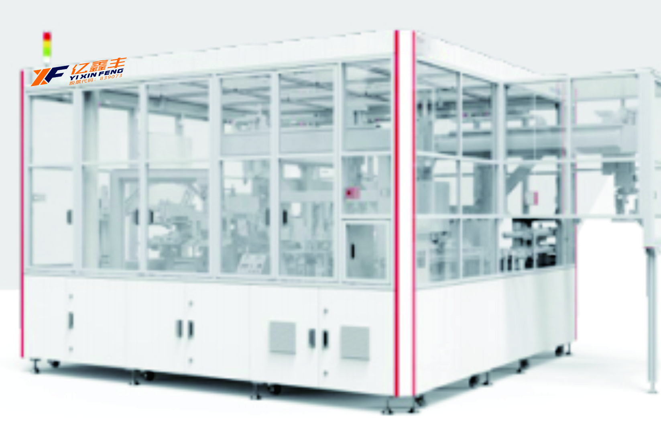
包膜机
（Film Wrapping Machine）
原理与应用 Principle and application | ●采用多轴联动翻转包膜设计，包膜边缘位置精度高，膜边沿相 对顶盖位置精度可达±0.5 ●贴胶时膜与电芯接触紧密，不易产生胶带翘边、侧边开口空鼓 现象 ●Mylar和低托片可以不停机上料，上料间隔可达2h ●多工位转台或者直线循环设计，布局紧凑，可实现多产能兼容 ●四轴机械手电芯、绝缘片一体取放，减少抓取次数，位移小 ●产品兼容性广，可实现产品快速换型 ●焊印面积比≥50%，单个焊印抗拉力≥10N ●The flips wrapping is accomplished via multiple linkages, High Precision in the locations of the wrapping edges, the maximum location tolerance of the film edge relative to the lid is ±0.5 ●The film is in close contact with the cells when taping, and not easy to cause the phenomenon of tape warping and side opening & empty drum ●Both Mylar and the Bottom Insulator can be replenished without stopping the machine, the feeding interval can up to 2 hours ●Machine Design could be comprised of multiple turntable or linear circulation line, compacted layout, be able to accommodate various performance demands ●Four-axis robotic to transfer both cells and insulators, to reduce the times of gripping and small displacement ●High compatibility for quick model changeover ●Welding dent area ratio ≥50%, tensile strength of single welding dent≥10N
单机产能 Capacity | Max 15PPM
适用电芯尺寸 Applicable cell dimensions | 140-180mm（W），85-220mm（H），20-80mm（T）
焊接位置精度 Accuracy of welding position | ≤±0.3mm
合芯后错位 Displacement after tabs welding | ≤±0.5mm
激光焊接速度 Laser welding speed | ≥130mm/s

Slide 44
股票代码：839073
亿鑫丰欢迎您!
MIZHI
SALES
REPOTRE
Welcome to Yixin Feng!
Notes:
感谢各位的聆听

