Slide 1

股票代码：839073
广东亿鑫丰智能装备股份有限公司
Guangdong Yixinfeng intelligent equipment Co., LTD
方形铝壳锂电池解决方案
Company and product profile

Slide 2
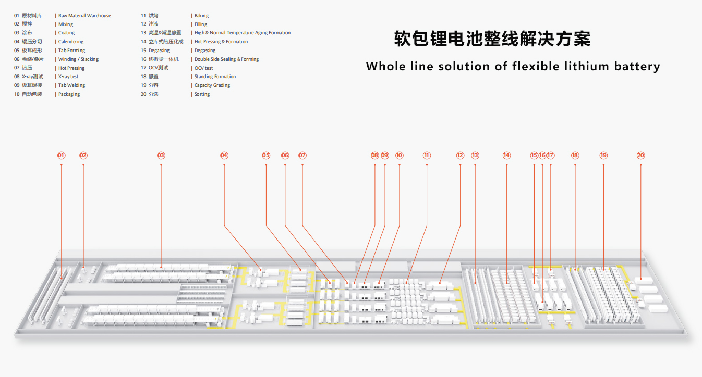
产品系列分布
（Product family distribution）

Slide 3
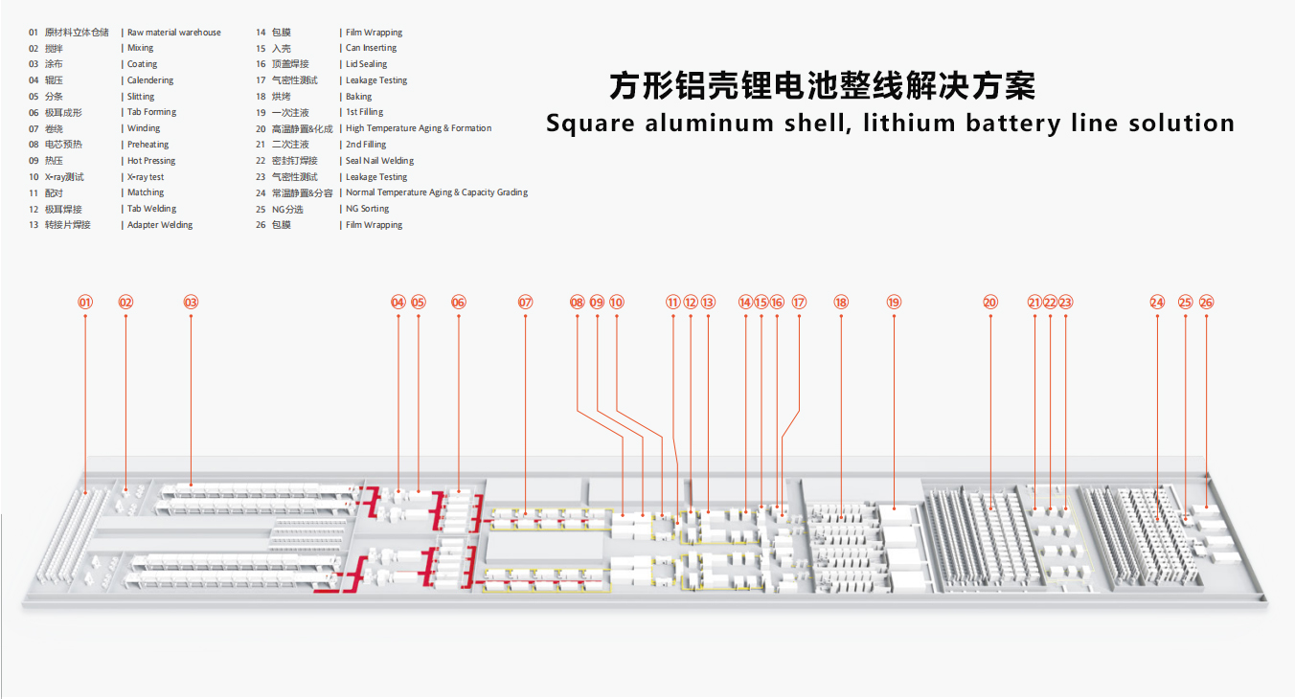
产品系列分布
（Product family distribution）

Slide 4
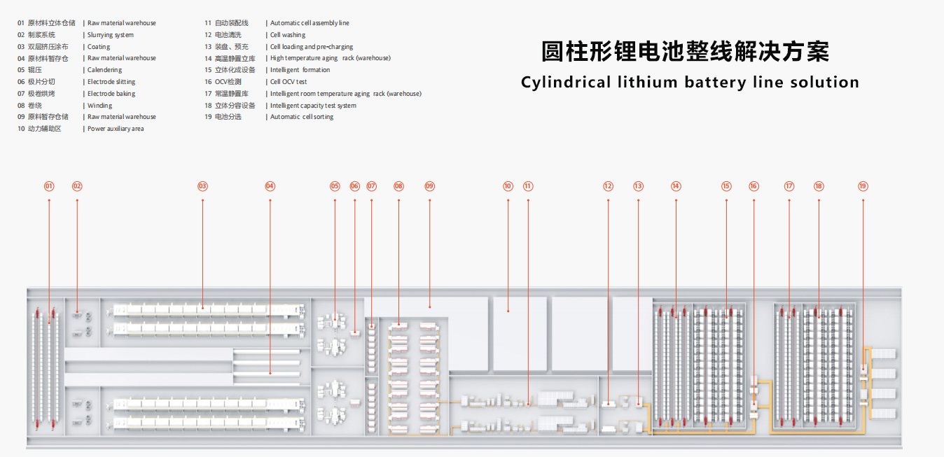
产品系列分布
（Product family distribution）

Slide 5

股票代码：839073
01
PART
配料
Filling
专业诚信 务实高效
Challenges and opportunities coexist

Slide 6
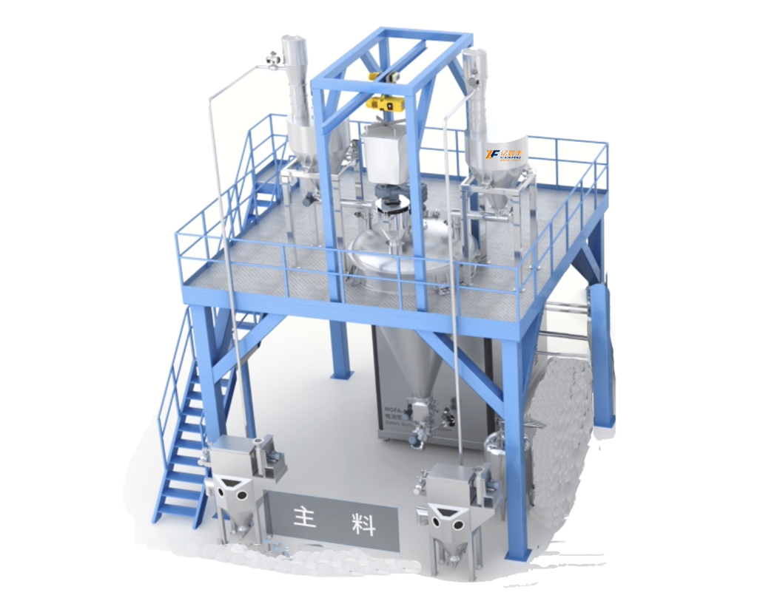
新型制浆系统（连续式）
NEW TYPE MIXING SYSTEM
原理与应用 Principle and application | 适用于合浆300L/h-1500L/h搅拌机，整机设备布局紧凑，配备高性能控制系统与传感器，稳定性强。制浆效率高，能耗低，厂房空间占用小，清洁、维护方便，节省长期运行成本，分散效果好，可实现连续化、大批量生产。 Suitable for mixing 300L/ H-1500L /h mixer, the whole equipment layout is compact, equipped with high-performance control system and sensor, strong stability. High pulping efficiency, low energy consumption, small workshop space occupation, clean, easy maintenance, saving long-term operating costs, good dispersion effect, can achieve continuous, mass production.
可选规格 Optional | 300L/h-1500L/h 制浆系统可选/Pulping system is optional
 | 300L/h-1500L/h
主料投料精度 Main Material Feeding Accuracy | 当投料量≥150kg，投料精度±0.1% 投料量＜150kg，投料精度±150g when feeding quantity ≥150kg, accuracy: ± 0.1% when feeding quantity <150kg, accuracy: ± 150g
辅料投料精度 Auxiliary Material Feeding Accuracy | 投料量≥30kg，投料精度±0.1% 投料量＜30kg，投料精度±30g when feeding quantity ≥30kg, accuracy: ± 0.1% when feeding quantity <30kg, accuracy: ± 30g
设备优势 Equipment advantage | ●节能降耗，采用新工艺，节约运行成本 ●密闭环境运行，对环境要求低，避免环境因素对制浆过程、制浆质量的影响 ●系统全自动投料配料输送，降低人工成本 ●整机设备布局紧凑，体形压缩，减少设备占用空间 ●配备高性能控制系统与传感器，稳定性强，可后期对接MES系统 ●连续式生产，给料量小，1小时后即可连续出料 ●Save energy, reduce consumption, and save operating costs ●Confined environment operation, low environmental requirement, to prevent slurrying process and quality from being effected by the environmental factors ●Automatic feeding and distribution system to reduce labor costs ●Compact system layout, compressed equipment shape, reduced footprint ●High-performance control system and sensors, strong stability, connection with MES can be upgraded ●Continuous production, small feeding volume, continuous output after 1 hour

Slide 7
股票代码：839073
02
PART
搅拌
stir
专业诚信 务实高效
Challenges and opportunities coexist

Slide 8
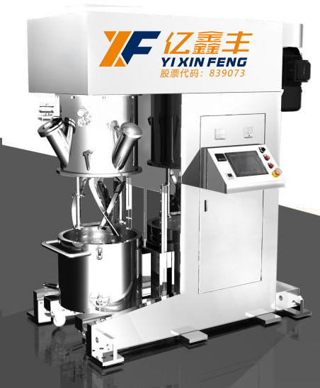
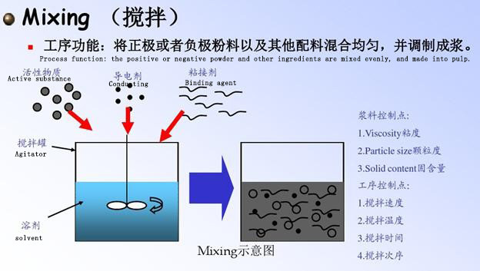
搅拌机
（agitator）
原理与应用 Principle and application | 设备通过控制面板或中控系统智能控制，可按照已编制的搅拌工艺流程自动运行； 配套两个螺旋式搅拌浆和两组锯齿形分散盘，采用双行星结构分别驱动，可满足各类粉体与液体之间的高效混合，经过搅拌、及分散等过程，控制颗粒大小，颗粒分布的均匀性，粘度的一致性；同时搅拌桶具有快速更换及真空密封功能，通过抽真空的方式，可消除浆料中的气泡；从而满足搅拌、成浆工艺要求。 The equipment can operate automatically according to the prepared mixing process by intelligent control panel or central control system; It is equipped with two spiral-type mixing slurry and two groups of zigzag dispersion disks, respectively driven by double planetary structure, which can meet the efficient mixing between various powders and liquids. After stirring, dispersing and other processes, it can control the particle size, the uniformity of particle distribution and the consistency of viscosity; At the same time, the mixing barrel has the function of quick replacement and vacuum sealing, and the bubbles in the slurry can be eliminated by vacuuming; So as to meet the mixing, pulp process requirements.
设备组成 Equipment composition | 该设备由立柱式结构、传动部分、密封容器、升降系统、控制系统等组成。 The equipment is composed of column structure, transmission part, sealed container, lifting system, control system, etc.
适用粉料 Applicable powder | PVDF、CMC、导电剂、磷酸铁锂、钴酸锂、三元、石墨等； PVDF, CMC, conductive agent, lithium iron phosphate, lithium cobalt, ternary, graphite, etc.;
生产浆料粘度 Production of slurry viscosity | 1 千-10 万 MPa.s，固含量适用 30%-70%，及 85%-100%， 1000-100,000 MPa.s, solid content is applicable to 30%-70%, and 85%-100%,
行星箱转 （公转） Planetary rotation（revolution） | 0-35rpm
搅拌桨转速 （自转） Propeller speed（autorotation） | 0-60rpm
分散转速 Dispersion speed | 0~5000 转/分，变频调速 0~5000 RPM, variable frequency speed regulation
混料参数控制 Mixing parameter control | 搅拌和分散的时间、转速及真空、温度PLC自动控制 Mixing and dispersing time, speed and vacuum, temperature PLC automatic control

Slide 9
股票代码：839073
03
PART
涂布
coating
专业诚信 务实高效
Challenges and opportunities coexist

Slide 10
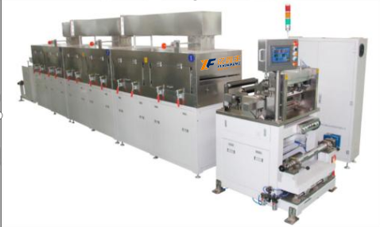
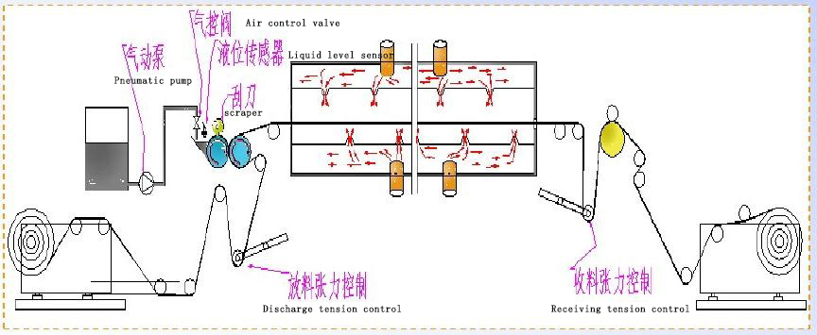
涂布机
（coater）
原理与应用 Principle and application | 设备通过涂辊转动带动浆料，通过调整刮刀间隙来调节浆料转移量，并利用背辊或涂辊的转动将浆料转移到基材上，按工艺要求，控制涂布层的厚度以达到重量要求，同时，通过干燥加热除去平铺于基材上的浆料中的溶剂，固体物质很好地粘结于基材上。 The equipment drives the slurry through the rotation of the coating roller, adjusts the slurry transfer amount by adjusting the blade gap, and transfers the slurry to the substrate by the rotation of the back roller or the coating roller, controls the thickness of the coating layer to meet the weight requirements according to the process requirements, at the same time, the solvent in the slurry laid on the substrate is removed by drying and heating, and the solid matter is well bonded to the substrate.
设备速度 Equipment speed | Max5m/min
涂布方式 Coating method | 连续涂布/转移式间隙涂布 Continuous coating/transfer gap coating
主材 Principal material | 钴酸锂、三元材料、磷酸铁锂、锰酸锂 Lithium cobaltate, ternary material, lithium iron phosphate, lithium manganate
粘度（cps） viscosity | 1500 ~ 30000cps
涂层宽度 Coating width | 100-300mm
单面面密度范围 Single surface density range | 正极100-300g/m2，负极100-250g/m2； Positive electrode 100-300g/m2, negative electrode 100-250g/m2;
涂层干厚度（µm） Dry coating thickness | 50-200um（不含基材）
涂层干厚度误差 Coating dry thickness error | 单面±2μm；双面±3μm（边缘、头尾8mm除外） One side ±2μm; Both sides ±3μm (except edge, head and tail 8mm)
外观要求 Appearance requirement | 无皱褶、无损坏、无波浪边、无划伤、无裂纹、无鼓包、无污染等 No wrinkles, no damage, no wave edge, no scratch, no crack, no bulge, no pollution

Slide 11
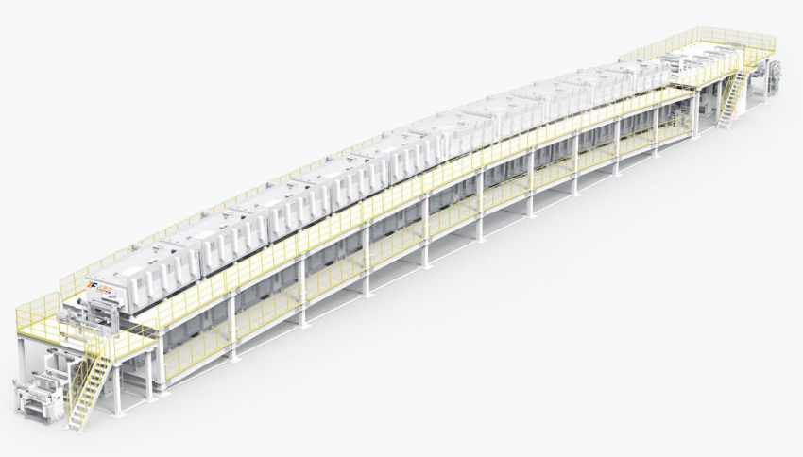
极片涂布机
（ELECTRODE COATING MACHINE）
原理与应用 Principle and application | ●基材、极片湿厚、干厚多重测量系统 ●特殊开发运动控制系统，张力控制精度≤±1%，高速运行时膜片更稳定 ●涂头与背辊间隙微米级精密闭环调节机构，涂头与背辊间隙调节精度 0.1um，重复定位精度≤1µm ●单个风嘴横向风速均匀性≤±1.5%，单节烘箱风速均匀性≤±3% ●单节烘箱温度均匀性≤±1.5% ●Multiple measurement system: wet & dry thickness of foil and electrode; ●Specially developed motion control system, the accuracy of tension control: ≤± 1N, and the foil is more stable at high speed operation; ●Micron-level precision and closed-loop adjustment mechanism for the gap between the coating nozzle and the back roller; ●The uniformity of the lateral wind speed of each single nozzle ≤ ± 1.5%, and the uniformity of the wind speed of each single oven ≤± 3%; ●Temperature uniformity of each single oven≤ ± 1.5%
设备速度 Equipment speed | Max100m/min
涂布方式 Coating method | 狭缝式挤压涂布 Slot die coating
主材 Principal material | 钴酸锂、三元材料、磷酸铁锂、锰酸锂 Lithium cobaltate, ternary material, lithium iron phosphate, lithium manganate
涂层宽度 Coating width | 15mm
单面面密度范围 Single surface density range | 正极100-300g/m2，负极100-250g/m2； Positive electrode 100-300g/m2, negative electrode 100-250g/m2;
涂层干厚度（µm） Dry coating thickness | ≥4um（不含基材）
双面面密度精度 Density accuracy on both sides | ≤±1%
外观要求 Appearance requirement | 无皱褶、无损坏、无波浪边、无划伤、无裂纹、无鼓包、无污染等 No wrinkles, no damage, no wave edge, no scratch, no crack, no bulge, no pollution

Slide 12
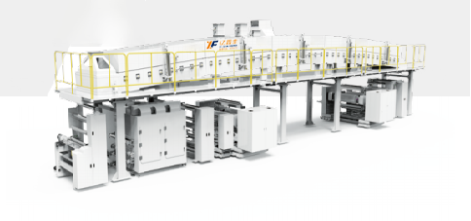
隔膜涂布机
（SEPARATOR COATING MACHINE）
原理与应用 Principle and application | ●涂辊快拆设计 ●特殊开发运动控制系统，张力控制精度 ≤±1%，高速运行时膜片更稳定 ●单个风嘴横向风速均匀性≤±2.5%，单节 烘箱风速均匀性≤±3% ●单节烘箱温度均匀性≤±1.5% ●Quick release of coating roller; ●Specially developed motion control system, the accuracy of tension control: ≤±1%, and the separator is more stable at high speed operation; ●The uniformity of the lateral wind speed of each single nozzle ≤±2.5%, and the uniformity of the wind speed of each single oven ≤±3%; ●Temperature uniformity of single-station oven ≤ ±1.5%
设备速度 Equipment speed | Max120m/min
涂布方式 Coating method | 微凹版涂布 micro gravure coating
主材 Principal material | 钴酸锂、三元材料、磷酸铁锂、锰酸锂 Lithium cobaltate, ternary material, lithium iron phosphate, lithium manganate
粘度（cps） viscosity | 1500 ~ 30000cps
涂层宽度 Coating width | 1200mm
涂层干厚度（µm） Dry coating thickness | 50-200um（不含基材）
涂层干厚度误差 Coating dry thickness error | 单面±0.5μm； One side ±0.5μm;
外观要求 Appearance requirement | 无皱褶、无损坏、无波浪边、无划伤、无裂纹、无鼓包、无污染等 No wrinkles, no damage, no wave edge, no scratch, no crack, no bulge, no pollution

Slide 13
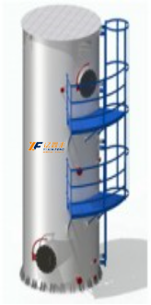
高效水凝塔式NMP回收
（Efficient water condensate tower NMP recovery）
原理与应用 Principle and application | 本系列NMP回收机组利用NMP水溶性高的特点对NMP废气进行处理，水吸附的方式可以把废气中的NMP基本上完全吸收，使NMP的回收率达到99%以上。机组外形美观，占地面积小，性能优越，操作简便。可广泛应用于锂电生产线的涂布环节，在环境相对湿度30-95%范围内，温度≤38℃时正常工作。 This series of NMP recovery unit uses the characteristics of high water solubility of NMP to treat NMP waste gas, and the water adsorption method can basically absorb NMP in the waste gas, so that the recovery rate of NMP can reach more than 99%. The unit has beautiful appearance, small footprint, superior performance and easy operation. It can be widely used in the coating process of lithium electric production line, and it works normally when the relative humidity of the environment is 30-95% and the temperature is less than 38℃.
回收率 rate of recovery | ＞99%
湿度范围 Humidity range | 30-95%
温度 temperature | ≤38℃

Slide 14
股票代码：839073
04
PART
制片
Electrode making
专业诚信 务实高效
Challenges and opportunities coexist

Slide 15
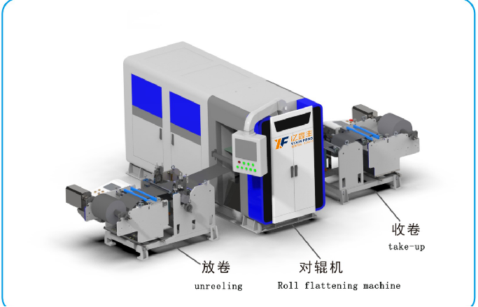
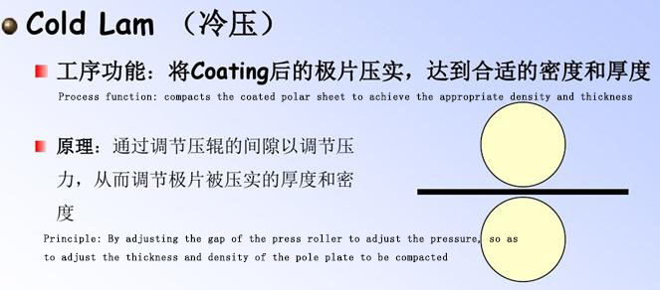
辊压机
（Roller press）
原理与应用 Principle and application | 设备通过包括放卷，前后张力控制，前后纠偏控制，拉伸机构，预热（仅正极）、辊压，测厚，收卷等组成，极片经辊压后涂覆层密度增加，厚度精度提高，满足恒张力放卷到恒压力碾压再到收卷自动完成，历史数据查询导出，关键参数实时显示、问题报警及原因追溯等功能。 The equipment is composed of unwinding, front and rear tension control, front and rear correction control, stretching mechanism, preheating (only positive electrode), roll pressing, thickness measurement, winding and so on. After rolling the pole sheet, the coating layer density increases and the thickness accuracy improves, which can meet the requirement of constant tension unwinding to constant pressure rolling and then to automatic winding, and historical data query and export. Key parameter real-time display, problem alarm and cause tracing functions.
设备速度 Equipment speed | 10m/min（Max 15m/min）
箔材厚度 Foil thickness | 正：10～30um 负：6～20um
极片厚度 Pole plate thickness | 50～300 µm
箔材宽度W1 Foil width W1 | ≤400mm
辊压极片厚度精度 Roll plate thickness accuracy | ±2μm（正常区Normal area），CPK≥1.33 ±3μm（削薄区Thinned zone），CPK≥1.33
压实密度 Compaction density | 正极压实（Positive electrode compaction） 3.4 g/cm3~3.6 g/cm3（三元ternary），2.2g/cm3~2.6 g/cm3（铁锂Lithium iron）；负极压实（Negative electrode compaction） 1.5 g/cm3~1.7 g/cm3
收卷对齐度 Winding alignment | ±0.5mm
外观要求 Appearance requirement | 无皱褶、无损坏、无波浪边，无划伤、无裂纹、无鼓包、无污染等 No wrinkles, no damage, no wave edge, no scratch, no crack, no bulge, no pollution, etc

Slide 16
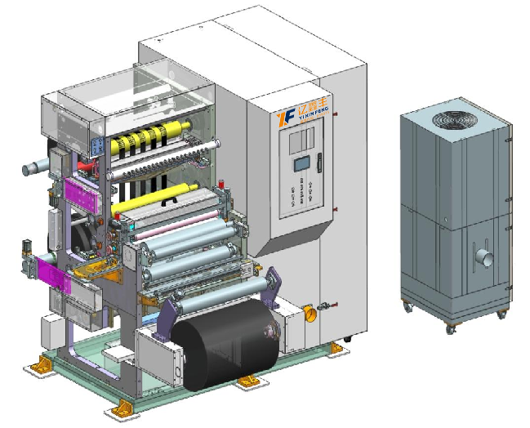
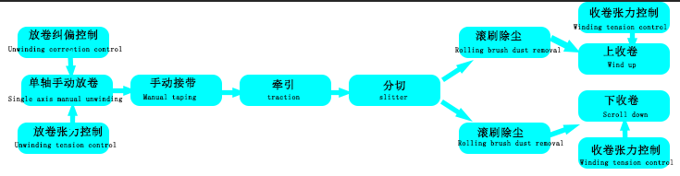
分切机
（Slitting machine）
原理与应用 Principle and application | 该设备的工作原理是采用磁粉被动放料，通过自动控制系统控制极片放卷张力，使极片经过环形分条刀时自动分切成需要的规格，工序完成后极片根据用户设定的张力值恒张力 The working principle of the equipment is to use magnetic powder passive discharge, through the automatic control system to control the tension of the pole sheet, so that the pole sheet through the ring slitter knife automatically cut into the required specifications, after the completion of the process, the pole sheet according to the tension value set by the user constant tension
生产速度 Production rate | 5～80m/min；
分切方式 slitting | 五金分切，一分二.一分四.一分六~等 Hardware cut, one for two. Four for one. Six for one. Wait
厚度（含基材） Thickness (including substrate) | 正极Positive electrode50～200 µm（基材Base material：10～30μm） 负极Negative electrode50～200 µm（基材Base material：4.5～20μm）
分切宽度偏差 Slitting width deviation | ±0.3mm
分切涂层纵向毛刺 Cut the coating longitudinal burrs | ≤10μm （垂直凸出极片表面的毛刺Burrs protruding vertically from the surface of the pole plate）
分切涂层横向毛刺 Slitting the coating transverse burrs | ≤12μm（平行凸出切口边缘的毛刺Burrs protruding parallel to the edge of the incision）
极片边缘切口质量 Electrode edge notch quality | 无卷边、裂口、波浪、褶皱、拉伸、露箔、明显的锯齿状等质量缺陷 No quality defects such as rolling, cracks, waves, folds, stretching, exposed foil, obvious serrated, etc

Slide 17
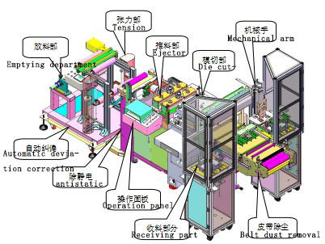
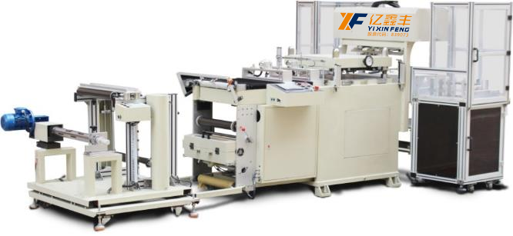
全自动极片模切机
（Automatic pole die cutting machine）
原理与应用 Principle and application | 设备通过触摸屏操作，程序控制，可根据产品进行设定合理数据，操作方便快捷，通过人工上料光电感应自动纠偏由伺服电机加精密丝杠推送至模切位置，可进行一出多片模切、生产效率高、刀模成本低、换型快捷方便，模切成型后自动送出，通过机械手将极片抓放到收料盘内， The equipment is operated by touch screen and controlled by program, reasonable data can be set according to the product, convenient and quick operation, automatic correction by manual feeding photoelectric induction is pushed to the die cutting position by servo motor and precision screw, which can carry out a multi-piece die cutting, high production efficiency, low die cost, fast and convenient changing, and automatically sent out after die cutting. Grab the pole piece into the receiving tray by the manipulator,
模切速度 Die cutting speed | 20-80-冲次/分（根据过料长度而定） 20-80- strokes/min (depending on the length of the charge)
刀模类型 Die type | 激光胶板刀模（成本低换型快） Laser rubber die (low cost and fast change)
来料宽度 Incoming width | ≤350mm（包含极耳） ≤350mm (including pole ear)
来料厚度 Incoming thickness | 0.08～0.3mm
有效模切面积 Effective die cutting area | 320*150mm
来料收卷整齐度涂布宽度误差 Incoming coiling uniformity coating width error | ≤±0.5 mm
涂布方式及破损要求 Coating method and breakage requirements | 连续涂布,单侧出极耳,且极耳破损小于0.5mm Continuous coating, unilateral out of the pole ear, and the pole ear damage is less than 0.5mm
收片方式 Receiving mode | 机械手自动收片 The manipulator automatically picks up the film

Slide 18
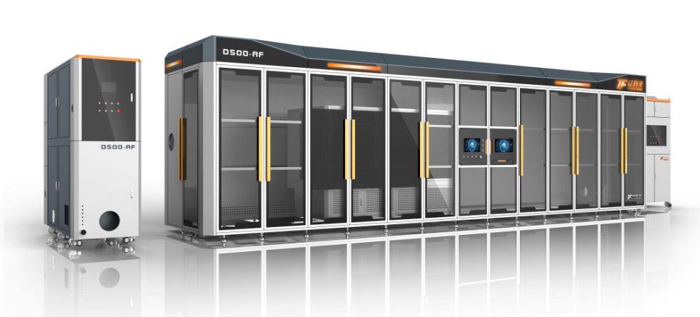
柔性模切机（卷对片、纯圆角）
Flexble die cutting machine（roll to film，pure fillet）
原理与应用 Principle and application | 国内首创，采用纯圆角设计，减少尖角放电，降低电池短路风险。 柔性小模具结构，多型号一键换型，模具寿命提高3倍，使用成本降低10倍，单次寿命达300万次，总寿命达5000万次以上。 自动闭环操作系统，实现了在线实时纠错功能，保障良品率。 It is the first of its kind in China. It adopts pure rounded corner design to reduce sharp Angle discharge and short circuit risk of battery. Flexible small mold structure, multi-model one-key change, mold life increased by 3 times, use cost reduced by 10 times, single life up to 3 million times, total life up to 50 million times. The automatic closed-loop operating system realizes the on-line real-time error correction function and guarantees the yield.
最大料宽 Material width | 700mm
速度 speed | ≥300ppm
成型精度 Molding accuracy | ±0.2mm
毛刺精度 Burr accuracy | ≤12μm

Slide 19
激光模切裁片一体机
Laser die-cutting integrated machine
原理与应用 Principle and application | 高速激光切割效率高于240PPM，无模具生产，成本低，极耳间距精度≤±0.2mm； 各区域除尘系统及监控系统，实现设备内部粉尘达到万级标准； 激光变频控制，避免过切或切不断，有效控制毛刺及热影响区熔珠大小，一体化设计，场地、人力成本降低3~5倍。 High speed laser cutting efficiency is higher than 240PPM, no mold production, low cost, pole ear spacing accuracy ≤±0.2mm; Dust removal system and monitoring system in each area, to achieve the dust inside the equipment to reach 10,000 level standards; Laser frequency conversion control, avoid over-cutting or continuous cutting, effectively control burr and heat affected zone bead size, integrated design, site and labor costs reduced 3~5 times.
最大料宽 Material width | 700mm
速度 speed | ≥240ppm
成型精度 Molding accuracy | ±0.2mm
毛刺精度 Burr accuracy | ≤100μm

Slide 20
激光模切分条一体机
Laser die cuuting strip in one machine
原理与应用 Principle and application | 高速激光切割效率60m/min -200m/min，极耳间距精度≤±0.2mm； 各区域除尘系统及监控系统，实现设备内部粉尘达到万级标准； 激光变频控制，避免过切或切不断，有效控制毛刺及热影响区熔珠大小，一体化设计，场地、人力成本降低3~5倍。 High-speed laser cutting efficiency 60m/ min-200m /min, ear spacing accuracy ≤±0.2mm; Dust removal system and monitoring system in each area, to achieve the dust inside the equipment to reach 10,000 level standards; Laser frequency conversion control, avoid over-cutting or continuous cutting, effectively control burr and heat affected zone bead size, integrated design, site and labor costs reduced 3~5 times.
最大料宽 Material width | 700mm
速度 speed | 60-200m/min
成型精度 Molding accuracy | ±0.2mm
毛刺精度 Burr accuracy | ≤100μm

Slide 21
股票代码：839073
05
PART
组装
assemble
专业诚信 务实高效
Challenges and opportunities coexist

Slide 22
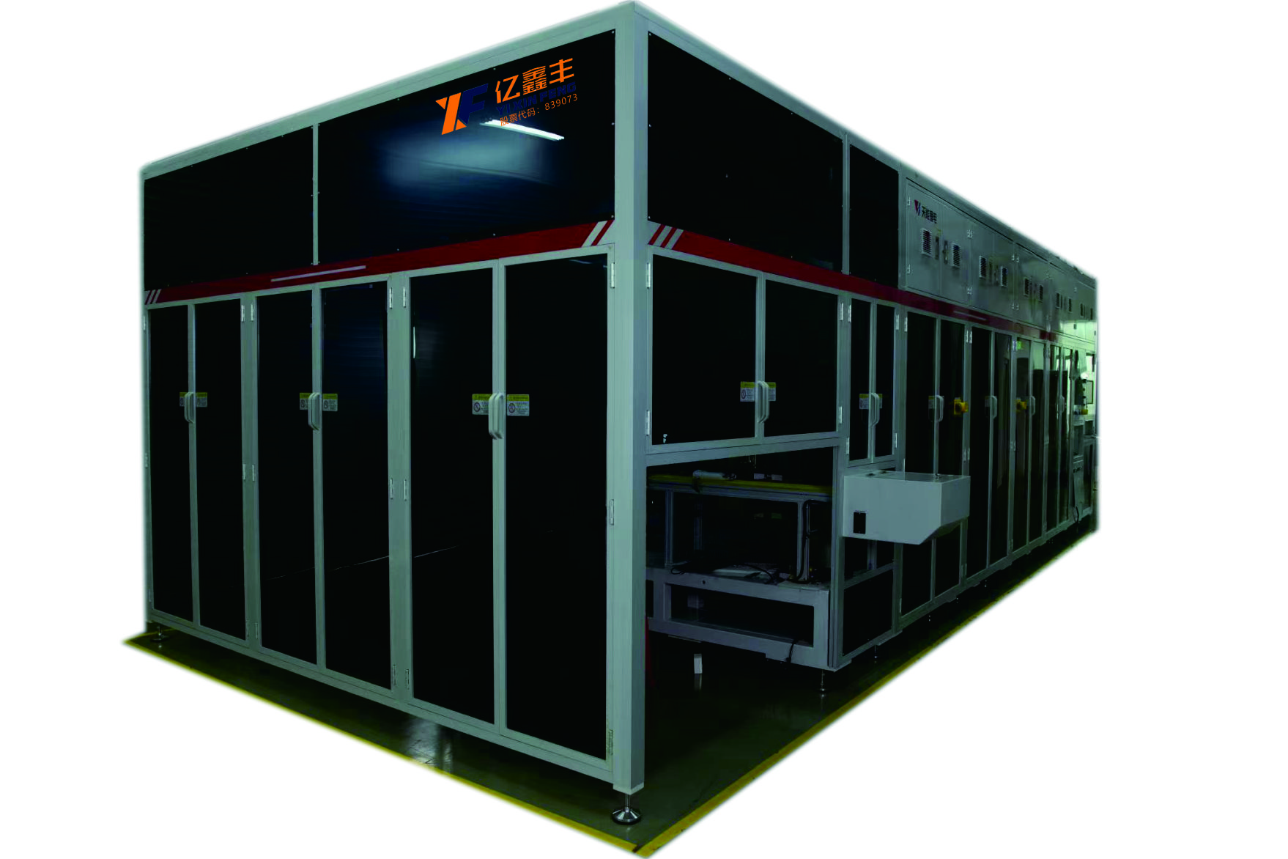
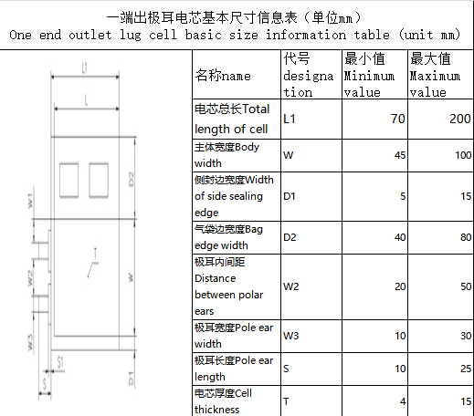
热压机
（Hot press）
原理与应用 Principle and application | 首先将设备电源打开，让设备自行加热，到所要求的温度后，将所要平压的物料平放在下压板上， 设定所需要压合的时间和需要的压力，用双手按下启动操作按钮，下热板在步进马达的驱动下，进入到热压位，上热压增压缸动作，上热压板下降，与下热压板压合，对电芯进行热压，待压合时间到后，上热压板自动上升，两压板分开，下热压板自动退回到上料位，人工取出压好的物料 First of all, turn on the power supply of the device and let the device heat itself. After reaching the required temperature, place the material to be pressed flat on the lower pressure plate, set the required pressing time and pressure, press the start operation button with both hands, the lower hot plate enters the hot pressure position under the drive of the stepping motor, the upper hot pressure booster cylinder moves, the upper hot pressure plate drops, and the lower hot pressure plate is pressed together. When the pressing time is up, the upper hot pressing plate automatically rises, the two pressing plates are separated, the lower hot pressing plate automatically returns to the loading position, and the pressed material is taken out manually
设备配置 Equipment configuration | （1）配数显压力传感器 （2）上、下铁加热板 ，上、下工作平板厚度不低于30MM （3）采用欧姆龙温度控制器 （4）具备安全光幕和双按钮启动等多重保护功能，防止机械伤人 （5）须配替罪羊装置，防止维修与清洁设备时加热板压手 （6）热压板光滑防锈，不粘连电芯 （7）发热装置拆装位置留有余量，便于更换维护，热压板温度分布应均匀 (1) Pressure sensor with digital display (2) The upper and lower iron heating plates, the thickness of the upper and lower working plates is not less than 30MM (3) Using Omron temperature controller (4) It has multiple protection functions such as safety light curtain and double button start to prevent mechanical injury (5) A scapegoat device must be equipped to prevent the heating plate from pressing the hand during maintenance and cleaning of the equipment (6) The hot press plate is smooth and anti-rust, and does not stick to the battery core (7) There is a margin in the disassembly position of the heating device to facilitate replacement and maintenance, and the temperature distribution of the hot press plate should be uniform
设备关键参数要求 Requirements for key device parameters | （1）平压最大压力不低于10吨，压力可调。压力控制精度≤ ±3% （2）上、下热板的平行度 ≤0.01mm （3）温控范围：室内温度~200°可调，温度误差：±2° （4）热板涂TEFLON 层 （5）温度上升速度：15分钟达到需要的温度 （6）热压时间继电器控制，时间0-999.9秒可调 (1) The maximum flat pressure is not less than 10 tons, and the pressure is adjustable. Pressure control accuracy ≤ ±3% (2) Parallelism of the upper and lower hot plates ≤0.01mm (3) Temperature control range: indoor temperature ~200° adjustable, temperature error: ±2° (4) Hot plate coated with TEFLON layer (5) Temperature rise rate: 15 minutes to reach the required temperature (6) Hot pressing time relay control, time 0-999.9 seconds adjustable

Slide 23
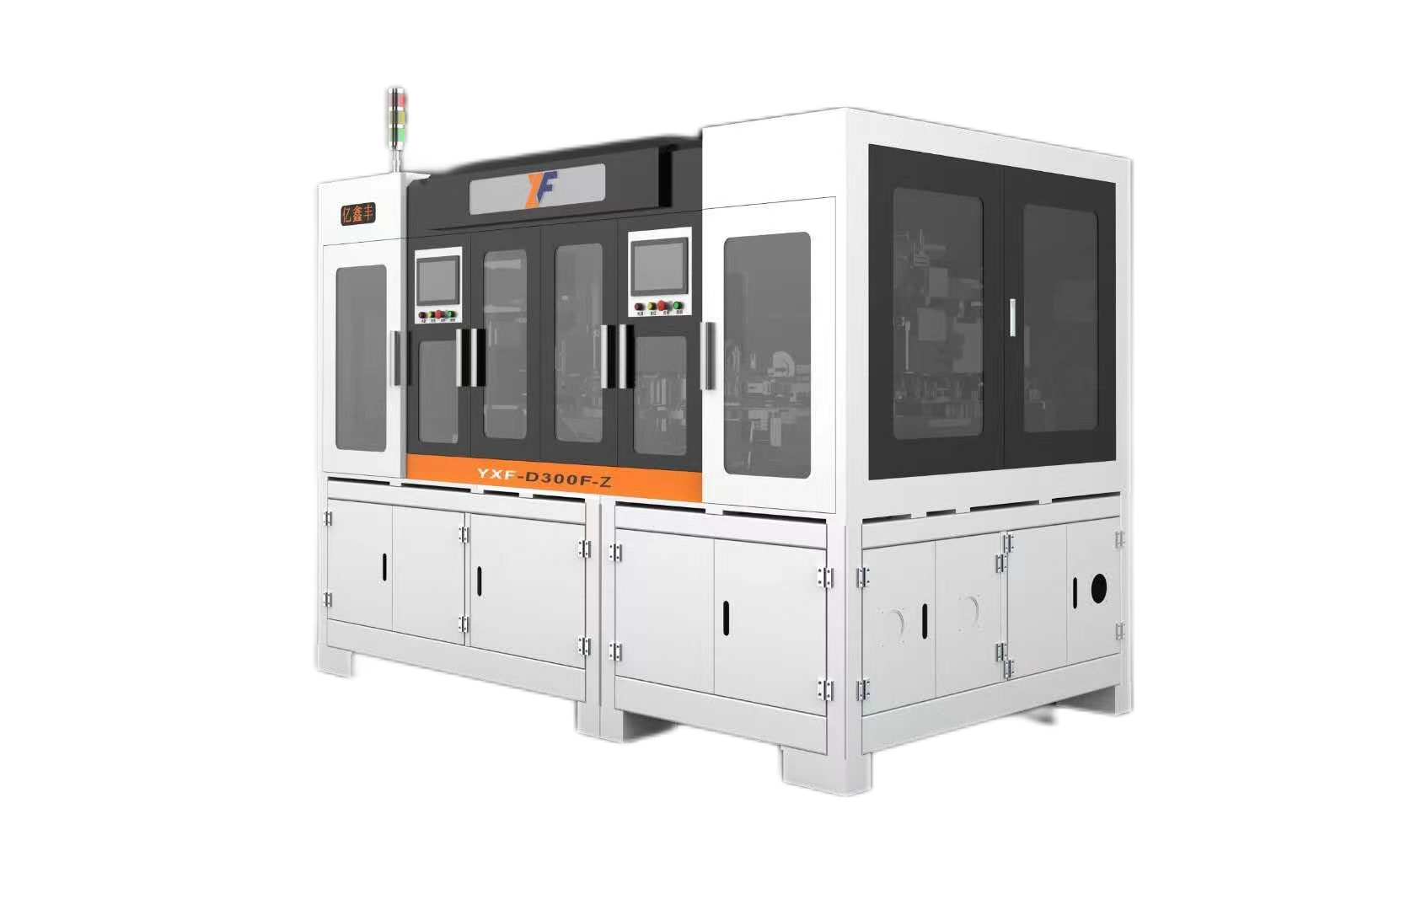
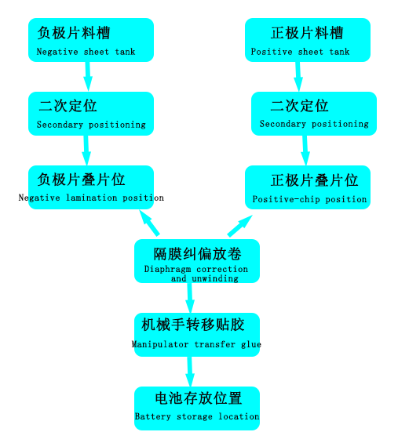
叠片机
（laminator）
原理与应用 Principle and application | 设备采用Z字形叠片方式。隔膜经过张力机构、纠偏机构，引入叠片台，叠片台带动隔膜左右往复移动，以放置极片，两套机械手吸盘机构分别将正负极片从料盒取出，经过二次定位平台精确定位后叠放在叠片台上，叠片完成后，通过电芯移载机构转移电芯、切断隔膜、自动贴胶， The device adopts the Z-shaped laminated mode. The diaphragm is introduced into the lamination table through the tension mechanism and the correction mechanism, and the lamination table drives the diaphragm to move around and around to place the pole piece. The positive and negative pole pieces are removed from the material box respectively by the suction mechanism of the manipulator, and are accurately positioned on the lamination table after the secondary positioning platform. After the lamination is completed, the battery cell is transferred by the battery cell load shifting mechanism, the diaphragm is cut off, and the adhesive is automatically affixed.
叠片速度（S/片） Lamination speed (S/ piece) | 1.0～1.2
正负极定位 Positive-negative positioning | 可以实现纵向、横向数控调节，调节范围0-20mm、精度±0.05mm It can realize vertical and horizontal CNC adjustment, the adjustment range is 0-20mm, the accuracy is ±0.05mm
定位台检测 Station detection | 超声波传感器检测极片防止多片、少片、漏片并报警停机；机械定位，极片四角和极耳折角检测并报警停机 Ultrasonic sensor to detect the pole plate to prevent multiple pieces, less pieces, missing pieces and alarm stop; Mechanical positioning, pole plate corners and pole ear Angle detection and alarm stop
隔膜 diaphragm | 主动放卷；张力控制；隔膜纠偏；隔膜除静电；隔膜端面对位精度：±0.3mm（头尾对齐度±0.5mm）； Active unwinding; Tension control; Diaphragm correction; Remove static electricity from diaphragm; Diaphragm end alignment accuracy: ±0.3mm (head and tail alignment ±0.5mm);
叠片数量 Number of lamination | 在厚度适应范围内可设定 It can be set within the thickness adaptation range
高精度 High precision | 通过极片的精确定位，保证极片在叠片中整体精度达到±0.5mm（其中相邻极片对齐精度：±0.3mm）；极片与隔膜间对位精度：中心偏差±0.3mm。 Through the precise positioning of the pole pieces, the overall accuracy of the pole pieces in the stack is guaranteed to reach ±0.5mm (the alignment accuracy of the adjacent pole pieces is ±0.3mm). Alignment accuracy between pole plate and diaphragm: center deviation ±0.3mm.
控制 Controls | 0.5微米的粉尘颗粒,不低于1千级(测量位置)，现场无腐蚀性气体、液体、爆炸性气体。 0.5 micron dust particles, not less than 1000 (measurement position), no corrosive gas, liquid, explosive gas on site.
合格率（来料不良除外） Qualified rate (except bad incoming materials) | 99% 以上（来料不良除外） More than 99% (except bad incoming materials)

Slide 24
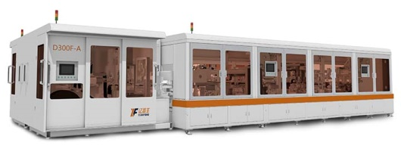
模切叠片一体机（刀片电池多片叠）
all-in-one machine（blade battery multi-laminating）
原理与应用 Principle and application | 一次性多片叠，单叠台可实现300个PPM，周转次数少，效率高，极片损伤减少，一体化设计，场地、人力成本降低3~5倍。 极片尺寸大，最大可以做到1000*500mm One-time multi-piece stack, single stack can achieve 300 PPM, less turnover times, high efficiency, pole piece damage reduction, integrated design, site, labor costs reduced 3~5 times. The pole size is large, the maximum can be 1000*500mm
对位精度 Counterpoint accuracy | ±0.3mm
叠片效率Lamination efficiency | ≥300PPM
叠片头/工位Stack head/station | 1/8

Slide 25
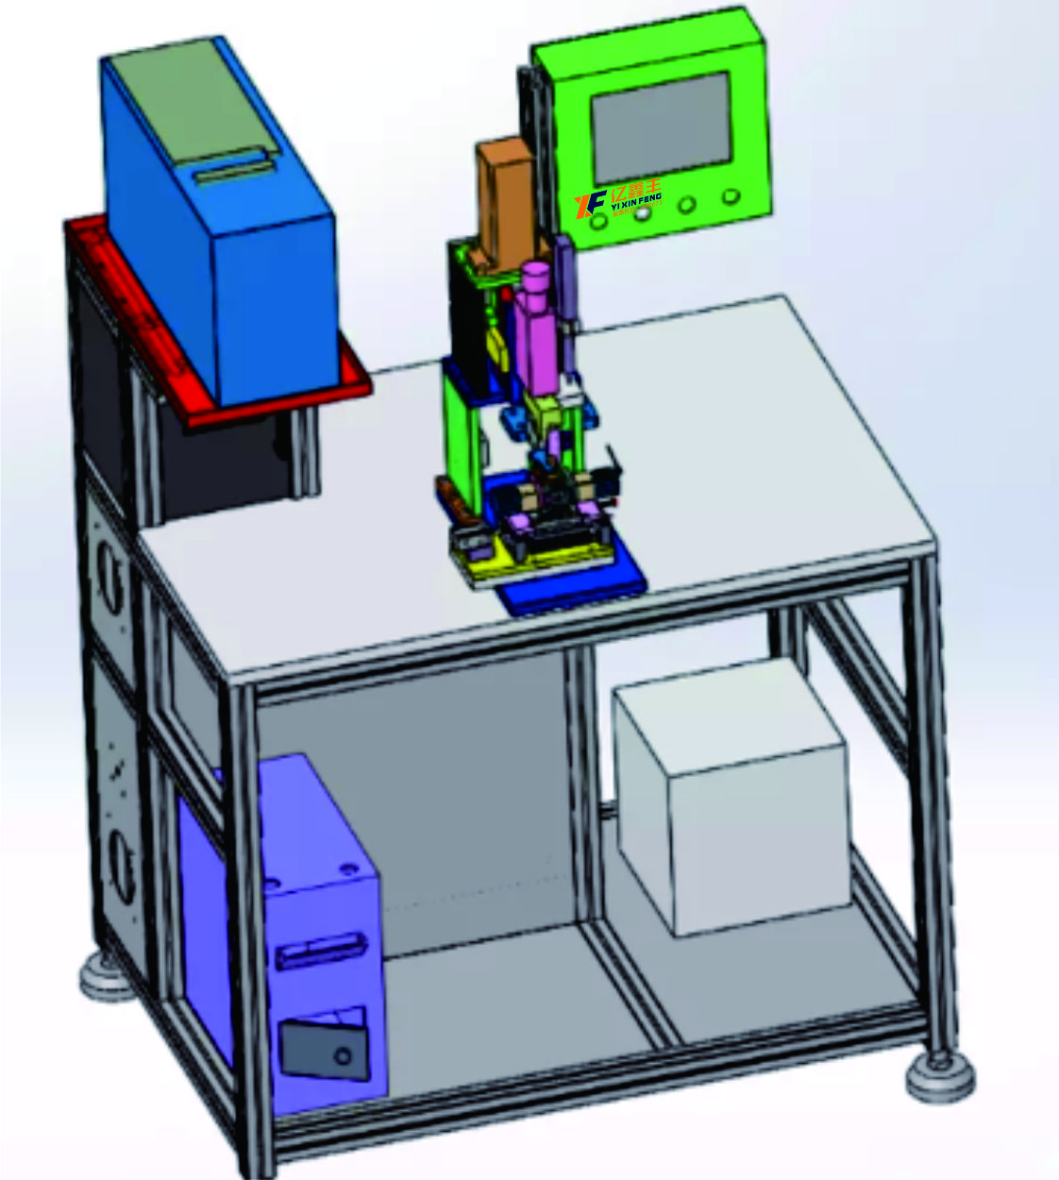
焊接机
（Welding machine）
原理与应用 Principle and application | 该金属焊接机主要由超声波发生器,换能器,上下声极,气动部件,机架等组成，电路方式选用全数字电路大功率方式，性能稳定，输出强劲，焊接前首先选择工作模式调整振幅和时间再把电芯放入限位模具然后进行焊接，上下声极材料选用新型的钢材材料,耐磨性好 The metal welding machine is mainly composed of ultrasonic generator, transducer, upper and lower poles, pneumatic components, rack, etc. The circuit mode is full digital circuit high-power mode, stable performance and strong output. Before welding, the working mode is first selected to adjust the amplitude and time, and then the cell is put into the limit mold and then welded
电芯方式 Cell system | 叠片可焊接能力范围（铜箔或铝箔3-50层） Laminate weldable range (copper foil or aluminum foil 3-50 layers)
基材厚度 Substrate thickness | （1）正极：A、铝箔0.016mm。 B、纯铝带0.2mm （2）负极：A、铜箔0.008mm。 B、纯铜镀镍带0.2mm。 (1) Positive electrode: A, aluminum foil 0.016mm. B, pure aluminum with 0.2mm (2) negative electrode: A, copper foil 0.008mm. B, pure copper nickel-plated tape 0.2mm.
焊头设计方向 Welding head design direction | 横向设计：（2-4个面设计），长度受限或有位阻情况下只能够设计二个面，在排除位阻以及长度允许的范围内可设计四个面，根据具体情况而定 Horizontal design: (2-4 face design), only two faces can be designed when the length is limited or there is a resistance, and four faces can be designed within the range of the exclusion of steric resistance and length, depending on the specific situation
焊接参数 Welding parameter | （1）焊接时间：0.1-0.8S以内（程序0-60S可调），可调精度：0.01S。 （2）焊接压力：0.1～0.6Mpa以内，可调精度0.02Mpa （3）共振频率：20KHz±100Hz。 (1) Welding time: within 0.1-0.8S (program 0-60S adjustable), adjustable accuracy: 0.01S. (2) Welding pressure: 0.1 ~ 0.6Mpa, adjustable precision 0.02Mpa (3) resonance frequency: 20KHz±100Hz.
换能器 Energy transducer | 换能器超声波频率：20KHZ±100Hz（自动跟踪）。 Transducer ultrasonic frequency: 20KHZ±100Hz (automatic tracking).
电功率参数 Electric power parameter | 焊接模式：时间模式、能量模式，分段模式均可调节。 Welding mode: time mode, energy mode, segment mode can be adjusted.
焊接品质 Welding quality | 无虚焊、焊穿、漏接，焊接牢固，层层渗透。焊接合格率：99.9%。一次合格率为99.9% No virtual welding, welding through, leakage, solid welding, layer penetration. Welding pass rate: 99.9%. The pass rate was 99.9%
选择工作模式
Select work mode
调整振幅和时间
Adjust amplitude and time
焊接
weld
电芯放入限位模具
The cell is put into the limit mold

Slide 26
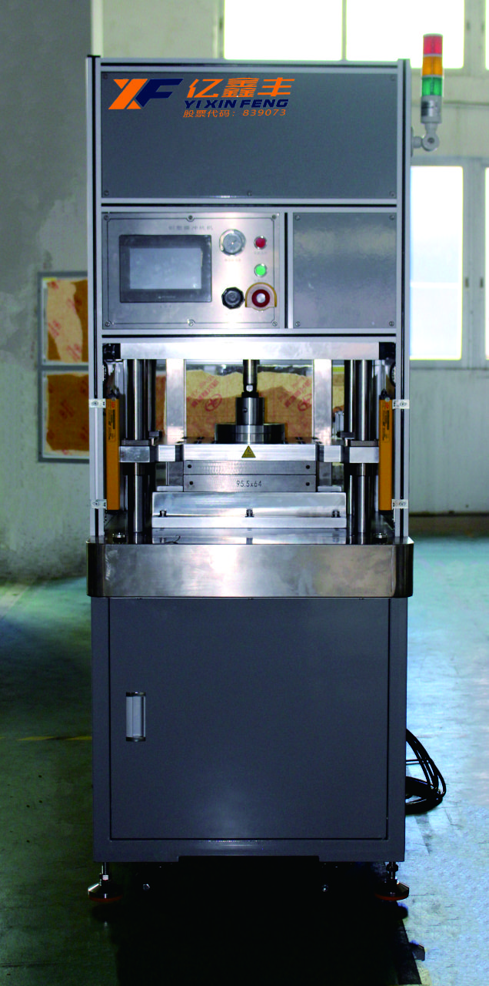
冲坑机
（Laser coding of cover plate）
原理与应用 Principle and application | 该设备用于锂离子电池铝塑包装膜的自动成型，设备可实现从包装膜卷材到冲压成型的自动化操作。 1、机器要包括三个部分：自动送料、冲压成型、断切。 2、送料系统采用伺服马达驱动，以适应较宽范围的产品尺寸，且保证准确的送料断切长度。 3、冲压成型部分选用气液增力缸，成型部份采用倍力缸，拉深深度调整方便精度。 4、生产不同尺寸的产品只需更换凸凹模及压料板。 5、断切部分采用气缸带动切断刀，整体可做微调，以保证产品断切位置的要求。 The equipment is used for the automatic molding of aluminum-plastic packaging film of lithium ion battery. The equipment can realize the automatic operation from the packaging film coil to the stamping molding. 1, the machine should include three parts: automatic feeding, stamping, cutting. 2. The feeding system is driven by servo motor to adapt to a wide range of product sizes and ensure accurate feeding cutting length. 3, the stamping part of the use of gas-liquid force cylinder, the forming part of the use of double force cylinder, drawing depth adjustment convenient accuracy. 4, the production of different sizes of products only need to replace the mold and the press plate. 5, the cutting part is driven by the cylinder cutting knife, and the whole can be fine-tuned to ensure the requirements of the product cutting position.
供电电源 Power supply | AC220V，功率160W AC220V, power 160W
气压 air pressure | 0.4-0.8Mpa。
尺寸 size | 350*180
生产效率 Production efficiency | 1cs/min~3cs/min。
精度 precision | ±0.05。
增压力 pressurization | 10T
重复性 repeatability | ±0.02

Slide 27
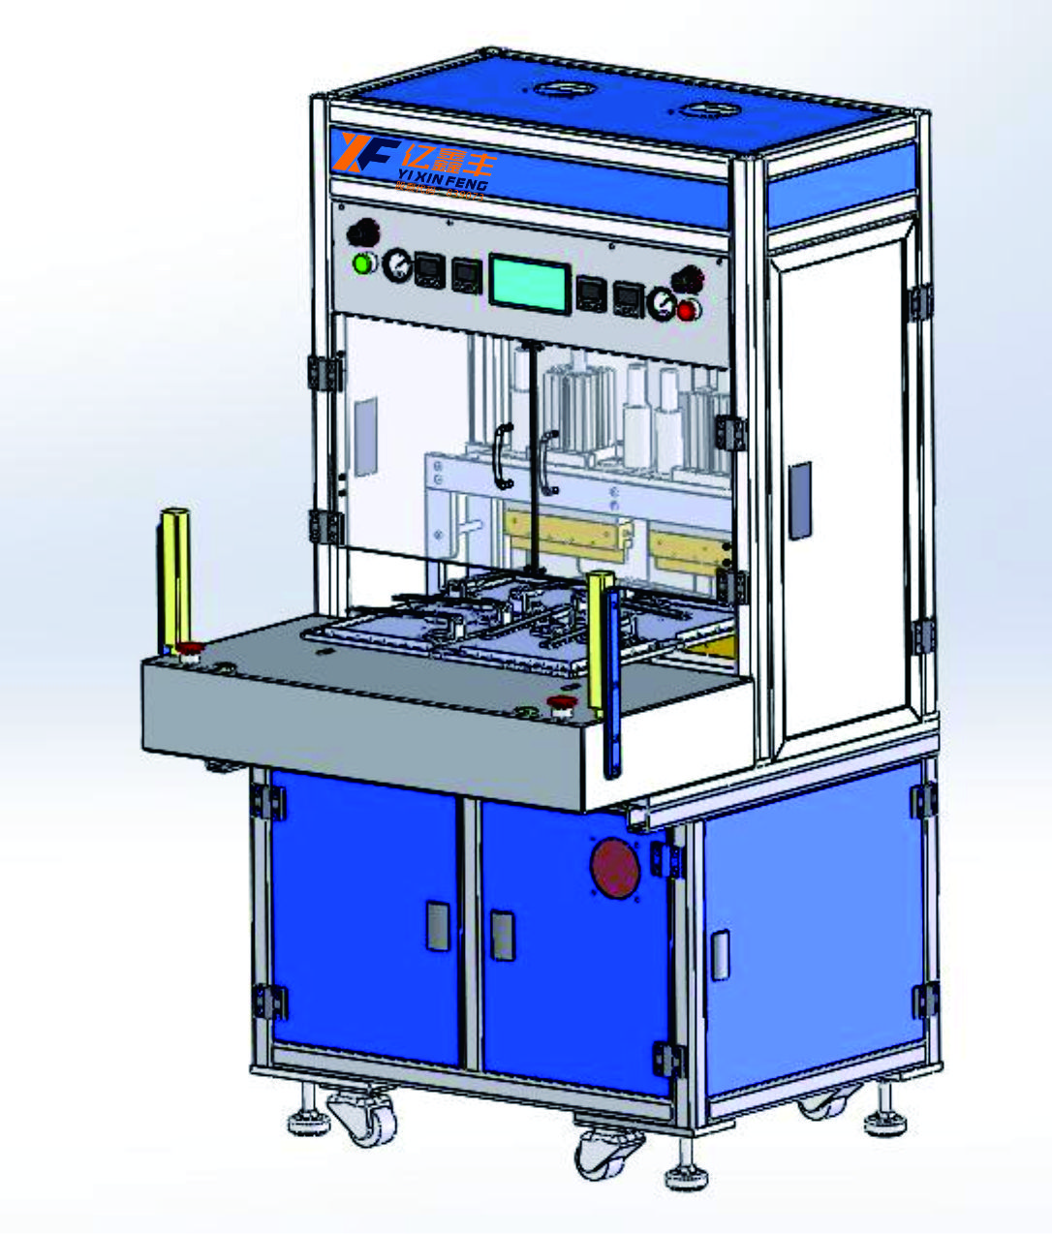
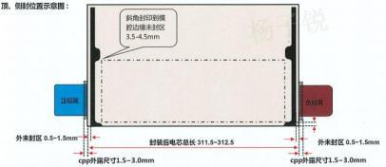
顶侧封机
（Laser coding of cover plate）
原理与应用 Principle and application | 人工将电芯放入夹具铝塑膜坑中并合夹具，启动按钮，伺服电机驱动夹具送入两顶封(或顶封和底封) 工位，电池完成顶封(底封)封装，伺服走位驱动夹具转移至侧封工位，电池完成侧封。 Manually put the battery cell into the jig aluminum-plastic film pit and close the jig, start the button, the servo motor drive jig into the two top seal (or top seal and bottom seal) station, the battery completes the top seal (bottom seal) package, the servo position drive jig is transferred to the side seal station, and the battery completes the side seal.
送料形式 Form of feeding | 人工上铝塑膜与电芯到夹具，伺服电机驱动夹具至各工位 Artificial aluminum-plastic film and battery to the fixture, servo motor drive the fixture to each station
电芯Tab预热单元 Cathode tab preheater | 时间范围：1.5±0.5s ，压力范围：1~10 kgf 温度范围：150~220℃，温度调整分辨率：0.1℃ 温度均匀性：±3℃ Time range: 1.5±0.5s, pressure range: 1~10 kgf Temperature range: 150~220℃, temperature adjustment resolution: 0.1℃ Temperature uniformity: ±3℃
封装拉力 Package tension | 顶封正、负极耳拉力各2pcs、顶封铝塑膜拉力2pcs、侧封铝塑膜拉力各4pcs）：铝塑膜与极耳热封拉力≥15N/(15±0.1) mm 铝塑膜间热封拉≥45N/(15±0.1) mm Top seal positive and negative ear pull 2pcs, top seal aluminum-plastic film pull 2pcs, side seal aluminum-plastic film pull 4pcs) : aluminum-plastic film and pole ear hot seal pull ≥15N/(15±0.1) mm hot seal pull ≥45N/(15±0.1) mm
封装时间 Encapsulation time | 0--99.9s可调 0--99.9s adjustable
设备机械产能 Mechanical capacity of equipment | 封边厚度(不含极耳处厚度)均匀性误差±15.0μm;封头长度小于400mm，封边厚度均匀性误差±10.0μm；极耳处厚度误差±20.0μm The uniformity error of edge thickness (excluding the thickness at the pole ear) is ±15.0μm; The length of the head is less than 400mm, and the uniformity error of edge thickness is ±10.0μm; Thickness error at pole ear ±20.0μm
封边厚度 Thickness of edge sealing | 封印无贯穿、褶皱、虚封等不良，封印密封良好不漏液 The seal has no bad penetration, folding, virtual seal, etc., and the seal is sealed well without leakage
封装品质 Package quality | 人工上铝塑膜与电芯到夹具，伺服电机驱动夹具至各工位 Artificial aluminum-plastic film and battery to the fixture, servo motor drive the fixture to each station

Slide 28
股票代码：839073
06
PART
后段
Back section
专业诚信 务实高效
Challenges and opportunities coexist

Slide 29
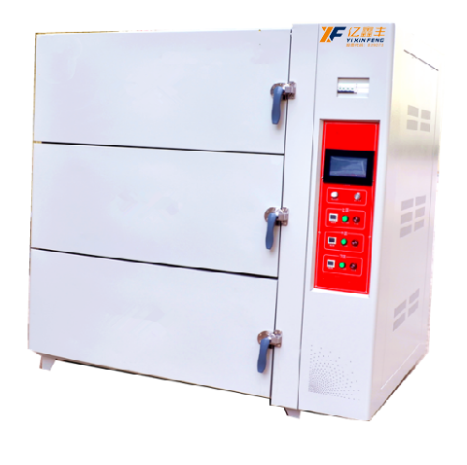
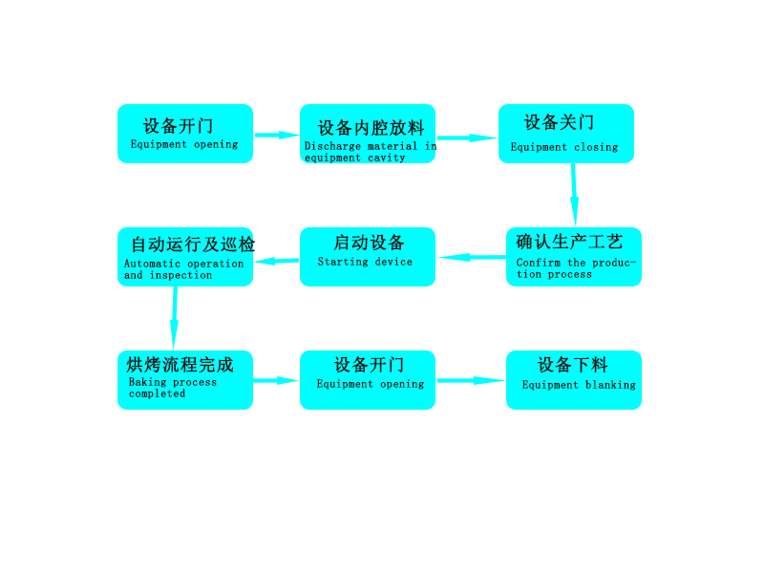
真空烤箱
（Vacuum oven）
原理与应用 Principle and application | 烤箱可用于锂电池电芯、极片烘烤及老化，采用的反射板均匀及来行运风技术。智能工艺控制和问题追溯在高温、恒温、真空保持、升降温速度方面有明显提升。 程序设可设置循环0-99次可调、加热时间0-999分可调、真空时间0-999分、静置时间0-999分、充氮气时间0-999分、热风循环时间0-999分 The oven can be used for baking and aging of lithium battery cells and pole pieces, and the reflective plate is uniform and the air flow technology is used. Intelligent process control and problem tracing have significantly improved in terms of high temperature, constant temperature, vacuum maintenance, rising and cooling speed. The program can be set cycle 0-99 times adjustable, heating time 0-999 minutes adjustable, vacuum time 0-999 minutes, standing time 0-999 minutes, nitrogen filling time 0-999 minutes, hot air cycle time 0-999 minutes
控制方式 Control mode | 跟椐现场生产工艺进行参数设置（如加热、真空、静制烘烤、充氮、热风循环、降温冷却等。），设置完成后启动程序，烤箱将自动运行所设置工艺动作流程 Set parameters according to the on-site production process (such as heating, vacuum, static baking, nitrogen filling, hot air circulation, cooling and cooling, etc.). After the setting is completed, start the program, and the oven will automatically run the set process
气源压力 Air source pressure | 压缩气：0.4~0.6Mpa，最大流量值：1L/s 真空源：0.5~5Pa，最小抽速值：500m³/H 干燥气:0.5~0.2MPa，最大流量值：5m³/H Compressed gas: 0.4~0.6Mpa, maximum flow value: 1L/s Vacuum source: 0.5~5Pa, minimum pumping speed: 500m³/H Dry gas :0.5~0.2MPa, maximum flow value: 5m³/H
基本加热原理 Basic heating principle | 内外双循环、内循环前后交叉运风加热控制 Internal and external double circulation, internal circulation before and after cross air heating control
烤箱温度 Oven temperature | 常温~150℃可设定，仪表可调补偿值 Normal temperature ~150℃ can be set, the instrument can adjust the compensation value
加热速度 Heating rate | 空载非真空状态：85℃≦45min 满载非真空状态：85℃≦90min No-load non-vacuum condition: 85℃≦45min Full load non-vacuum condition: 85℃≦90min
冷却方式 Cooling mode | 烤相带自动冷却功能与冷风机对接，冷风机对烤箱外层强制冷却。 The oven phase with automatic cooling function is connected to the chiller, and the chiller forces the outer layer of the oven to cool.
真空泵口极限压力 Vacuum pump port limit pressure | 真空泵；SV300B+JRP1000罗茨抽速：1000L/min:极限压力；≦5pa. Vacuum pump; SV300B+JRP1000 Roots pumping speed: 1000L/min: limit pressure; ≦5pa.
内胆满载空达压力值 Full load empty reach pressure value of tank | 10pa~100pa左右：具体真空值与抽真空时间有关，高真空必须长时间抽才有效。实际真空值为渐变值，具体与时间和物体量相关联。如果真空度越接近空载真空值，则表示除水效果更彻底。 About 10pa~100pa: The specific vacuum value is related to the vacuum time, and the high vacuum must be pumped for a long time to be effective. The actual vacuum value is a gradual value, which is related to time and volume of objects. If the vacuum degree is closer to the no-load vacuum value, it means that the water removal effect is more thorough.

Slide 30
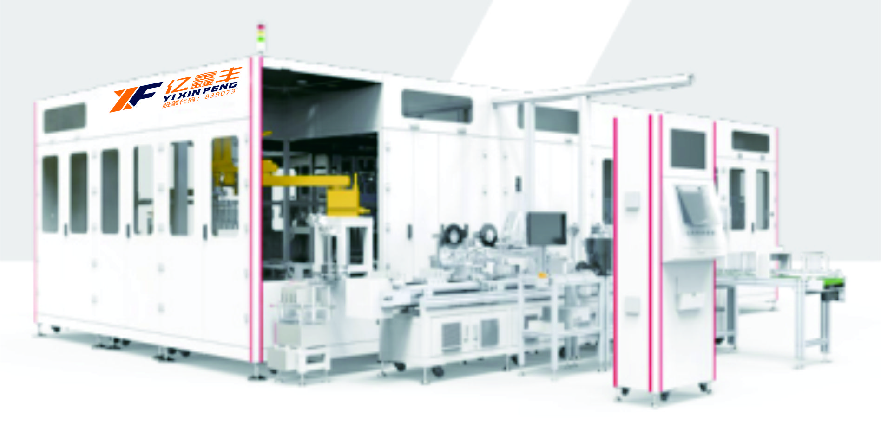
注液机
（ELECTROLYTE FILLING MACHINE）
原理与应用 Principle and application | ● 高精度注液泵真空加压注液，高精度电子秤称重 ● 电芯五面全包裹式夹具，有效防止电芯注液变形 ● 电解液多级过滤 ● 注液管路自动清洗功能，提高良品率 ● 机器人搬运电芯上下转盘，柔性好，调试方便 ● High-precision electrolyte filling pump, vacuum filling, high-precision weighing ● Five-sided & full-wrapped fixtures for cells, effectively preventing the deformation of cells when filling ● Multi-stage filtration for electrolyte ● Automatic cleaning of electrolyte pipeline, to improve yield ● Robot to transfer cells, flexible and convenient for commissioning
单机产能 Capacity | 15PPM
适用电芯尺寸 Applicable cell dimensions | 140-180mm（W），85-220mm（H），20-86mm（T）
浸润时间 Infiltration time | 5~30min
注液精度 Filling accuracy | 注液量≥200g时，注液精度＜±1% When injection volume is ≥200g, injection accuracy is ＜ ±1%
 | 注液量＜200g以内时，注液精度±1g When the injection volume ＜200g, the injection accuracy is ±1g
称重精度 Weighing accuracy | 0.01g

Slide 31
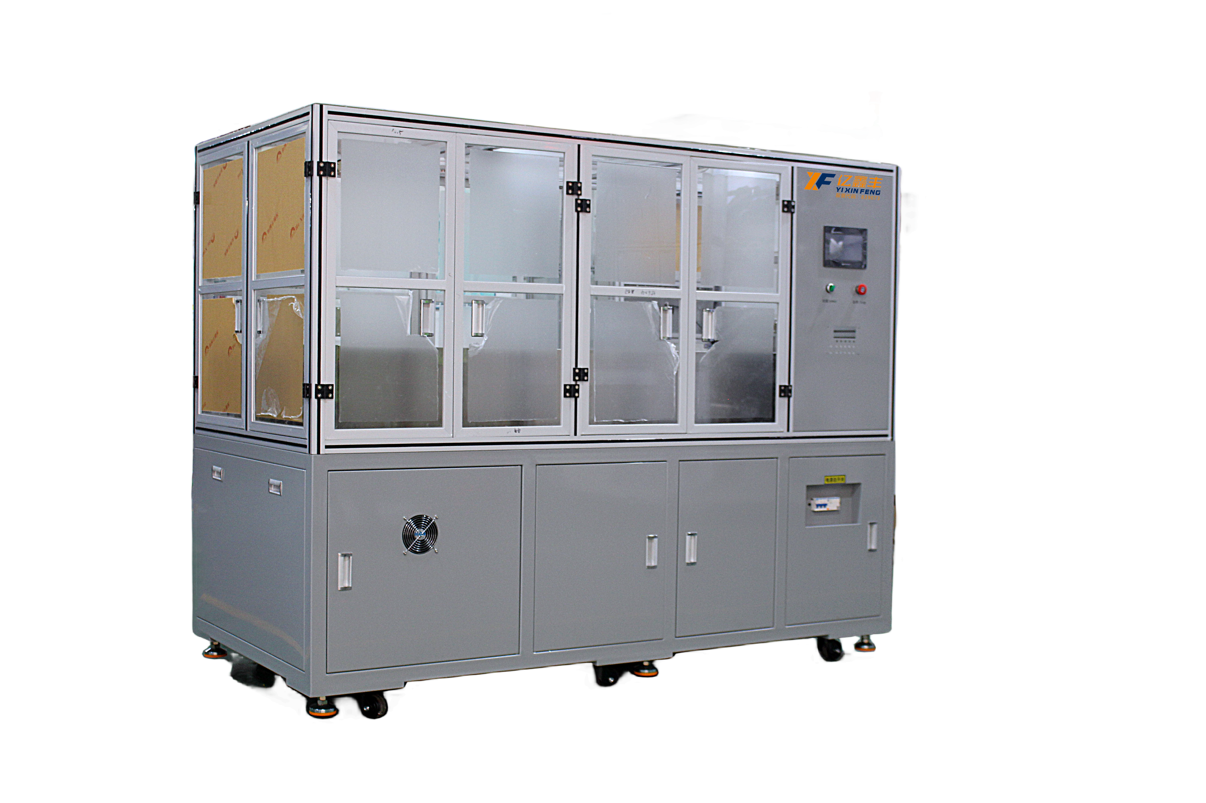
化成机
（Forming machine）
原理与应用 Principle and application | 设备的工艺动作流程：启动---柜门手动打开---夹具打开---电芯上柜---夹具加紧---柜门关闭---化成启动---化成完成---柜门打开---夹具打开---电芯下柜 Equipment of process action process: start - open cupboard door manually - clamp open strategy - batteries - fixture tightening - cupboard door closed - to start - into a complete cupboard door open - - - clamp open - batteries under the cabinet
夹具主要功能 Main functions of fixture | 1.提供压紧电芯所需的压力,可在压力允许范围内任意设置，压力设置若超出压力设置范围将报警提示； 2.压紧电极，确保电极至整机间电路的可靠连接。 3.保证电池化成时为竖立状态，气袋朝上 1. Provide the pressure required to compress the battery cell, which can be set arbitrarily within the allowable range of pressure. If the pressure setting exceeds the pressure setting range, the alarm will be alerted; 2. Press the electrode to ensure a reliable connection between the electrode and the circuit. 3. Ensure that the battery is upright when it is formed, and the air bag is facing up
配置电源 Configure power supply | 电压AC380±10%，电源充放电功率15kW，最大加热功率19kW（从室温启动加热至目标温度过程），保温时加热功率6.5kW。 Voltage AC380±10%, power supply charging and discharging power 15kW, maximum heating power 19kW (starting from room temperature heating to the target temperature process), heating power 6.5kW during insulation.
压力控制 Pressure control | 由伺服电机配合压力传感器实现多段压力控制，单个夹具可调压力范围200kg.f～2000kg.f；压力≥1000kg.f时；压力精度±1%，压力≤1000kg.f时，压力精度±10kg.f。 The servo motor with the pressure sensor to achieve multi-stage pressure control, a single fixture can adjust the pressure range of 200kg.f ~ 2000kg.f; Pressure ≥1000kg.f; Pressure accuracy ±1%, pressure ≤1000kg.f, pressure accuracy ±10kg.f.
漏电流保护 Leakage current protection | 工作状态巡检到有大于200mA的漏电流三次以上，关闭开关电源的输入电源 If the leakage current exceeds 200mA for more than three times, turn off the input power supply of the switching power supply
充电过压保护 Charge overvoltage protection | 电池充电过程中系统巡检电池时，当电池电压高于上限电压时，电池停止充电 When the system inspects the battery during battery charging, the battery stops charging when the battery voltage is higher than the upper limit
设备掉电保护 Device power failure protection | 当出现长时间通讯中断或PC机故障时，设备将会自动进入等待状态，待通讯恢复后继续当前流程步 If the communication is interrupted for a long time or the PC is faulty, the device automatically enters the waiting state. After the communication is restored, the current process continues
化成数据存储 Formation data store | 软件能保存相应数据储存30天以上，软件扫描频率＜30S，每2分钟取扫描值保存，取值时间可以自行设定，软件根据电压、电流显示曲线，软件可以查看电池详细数据，电池在不同状态软件点位显示不同颜色 The software can store the corresponding data for more than 30 days, the software scanning frequency is less than 30S, and the scan value is saved every 2 minutes. The value time can be set by itself. The software displays the curve according to the voltage and current, and the software can view the detailed data of the battery

Slide 32
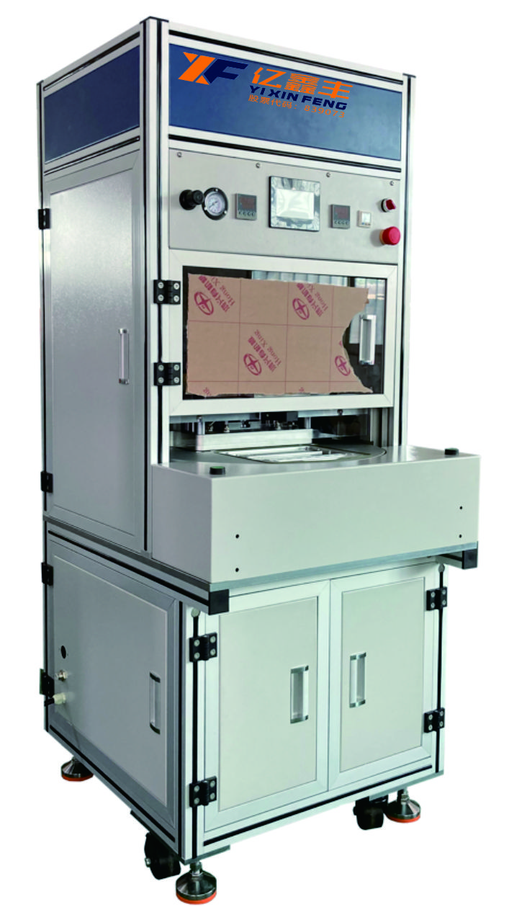
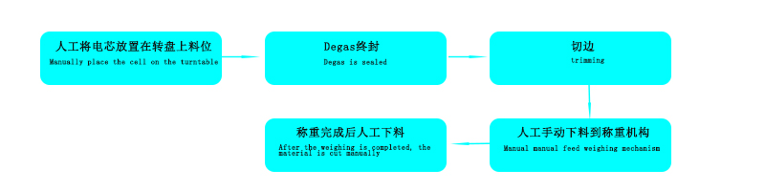
二封机
（Second sealing machine）
原理与应用 Principle and application | 二封机适用于电芯注液化成后最终真空抽气封口包装；具有刺破机构、抽气封装腔体模块、预切气袋模块，主要由转盘机构、DEGAS机构、切刀机构和称重机构组成，采用PLC控制。对投入的密封腔体的电芯负压状态下气袋刺破和终封 The two sealing machine is suitable for the final vacuum pumping sealing packaging after the cell is liquefied; It has a puncturing mechanism, a pumping sealing cavity module and a pre-cut air bag module, which is mainly composed of a rotating disk mechanism, a DEGAS mechanism, a cutting tool mechanism and a weighing mechanism, and is controlled by PLC. The air bag is punctured and sealed under the negative pressure state of the battery cell of the inserted sealing chamber
设备产能/速度 Equipment capacity/speed | 3PPM(人工操作，一次生产2个电芯，每个循环20S） 3PPM(manual operation, producing 2 cells at a time, 20S per cycle)
封头精度 Head accuracy | 1.封头平行度≤5um，封印厚度偏差≤±15um， 2.封装的位置精度：≤±0. 5mm， 3.封头温度：室温至250℃可调，温度最小调节量≤0.1℃，可设置补偿，控制精度±3℃； 4.封装压力可调范围30kgf～200kgf，精度≤±5%； 5.封装时间0-10S可调，调节精度：0.1S； 6.封装压力可调范围30kgf～200kgf，精度≤±5% 1. Head parallelism ≤5um, seal thickness deviation ≤±15um, 2. Package position accuracy: ≤± 0.5mm, 3. Head temperature: room temperature to 250℃ adjustable, minimum temperature adjustment ≤0.1℃, compensation can be set, control accuracy ±3℃; 4. Package pressure adjustable range 30kgf ~ 200kgf, accuracy ≤±5%; 5. Encapsulation time 0-10S adjustable, adjustment accuracy: 0.1S; 6. Package pressure adjustable range 30kgf ~ 200kgf, accuracy ≤±5%
电池主体压板 Battery body pressure plate | 电池具有气缸压板结构，压力可单独调整，压板有防腐蚀措施，且便于清洁；调节范围10kgf～50kgf，精度≤±5%； The battery has a cylinder pressure plate structure, the pressure can be adjusted separately, the pressure plate has anti-corrosion measures, and easy to clean; Adjustment range 10kgf ~ 50kgf, accuracy ≤±5%;
裁切质量 Cutting quality | 肉眼不可见毛刺和波浪边，压力可调范围0.4-0.6Mpa Burrs and wavy edges are not visible to the naked eye, and the pressure can be adjusted in the range of 0.4-0.6Mpa
刺破机构 Puncturing mechanism | 刺破、抽气过程电芯气袋朝上，可通过调节避免刺破封印位置，刺刀高度调节范围≥20mm，刺破口数量≥3均匀分布，刺刀压力0.4-0.6Mpa可调，刺刀寿命≥30万次，修模≥2次 During the piercing and pumping process, the battery air bag faces up, the sealing position can be avoided by adjusting, the bayonet height adjustment range is ≥20mm, the number of punctured holes is ≥3 uniform distribution, the bayonet pressure is adjustable 0.4-0.6Mpa, the bayonet life is ≥ 300,000 times, and the mold repair is ≥2 times

Slide 33
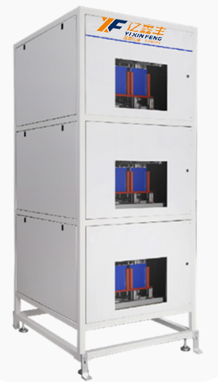
分容机
（Volumetric separator）
原理与应用 Principle and application | 分容机是锂离子电池生产过程中必不可少的设备之一，主要用于电池的分容和化成。在电池生产过程中，分容机的作用是对电池进行充放电测试，以确定其容量和其他电性能参数，并进行分级。而化成机则主要用于将注液封装后的电芯进行充电活化。 The capacity divider is one of the essential equipment in the production process of lithium-ion battery, which is mainly used for the capacity divider and formation of battery. In the battery production process, the role of the separator is to charge and discharge the battery to determine its capacity and other electrical performance parameters, and to perform classification. The forming machine is mainly used to charge and activate the battery cell after injection
输入电源 Input power supply | 220V±10% /50HZ
电流输出范围 Current output range | ±2000mA
电压测量范围 Voltage measuring range | 0.1-5V
功率 power | 8300W
电流测量精度 Current measurement accuracy | ±（0.2% 读数+0.2% 量程） ± (0.2% reading +0.2% range)
电压测量精度 Voltage measurement accuracy | ±（0.2% 读数+0.2% 量程） ± (0.2% reading +0.2% range)
定时范围 Timing range | 0-9999分钟/工步 0-9999 minutes/work step
夹具可调范围 Clamp adjustable range | 最大80mm，夹具间距34mm Max. 80mm, fixture spacing 34mm

Slide 34
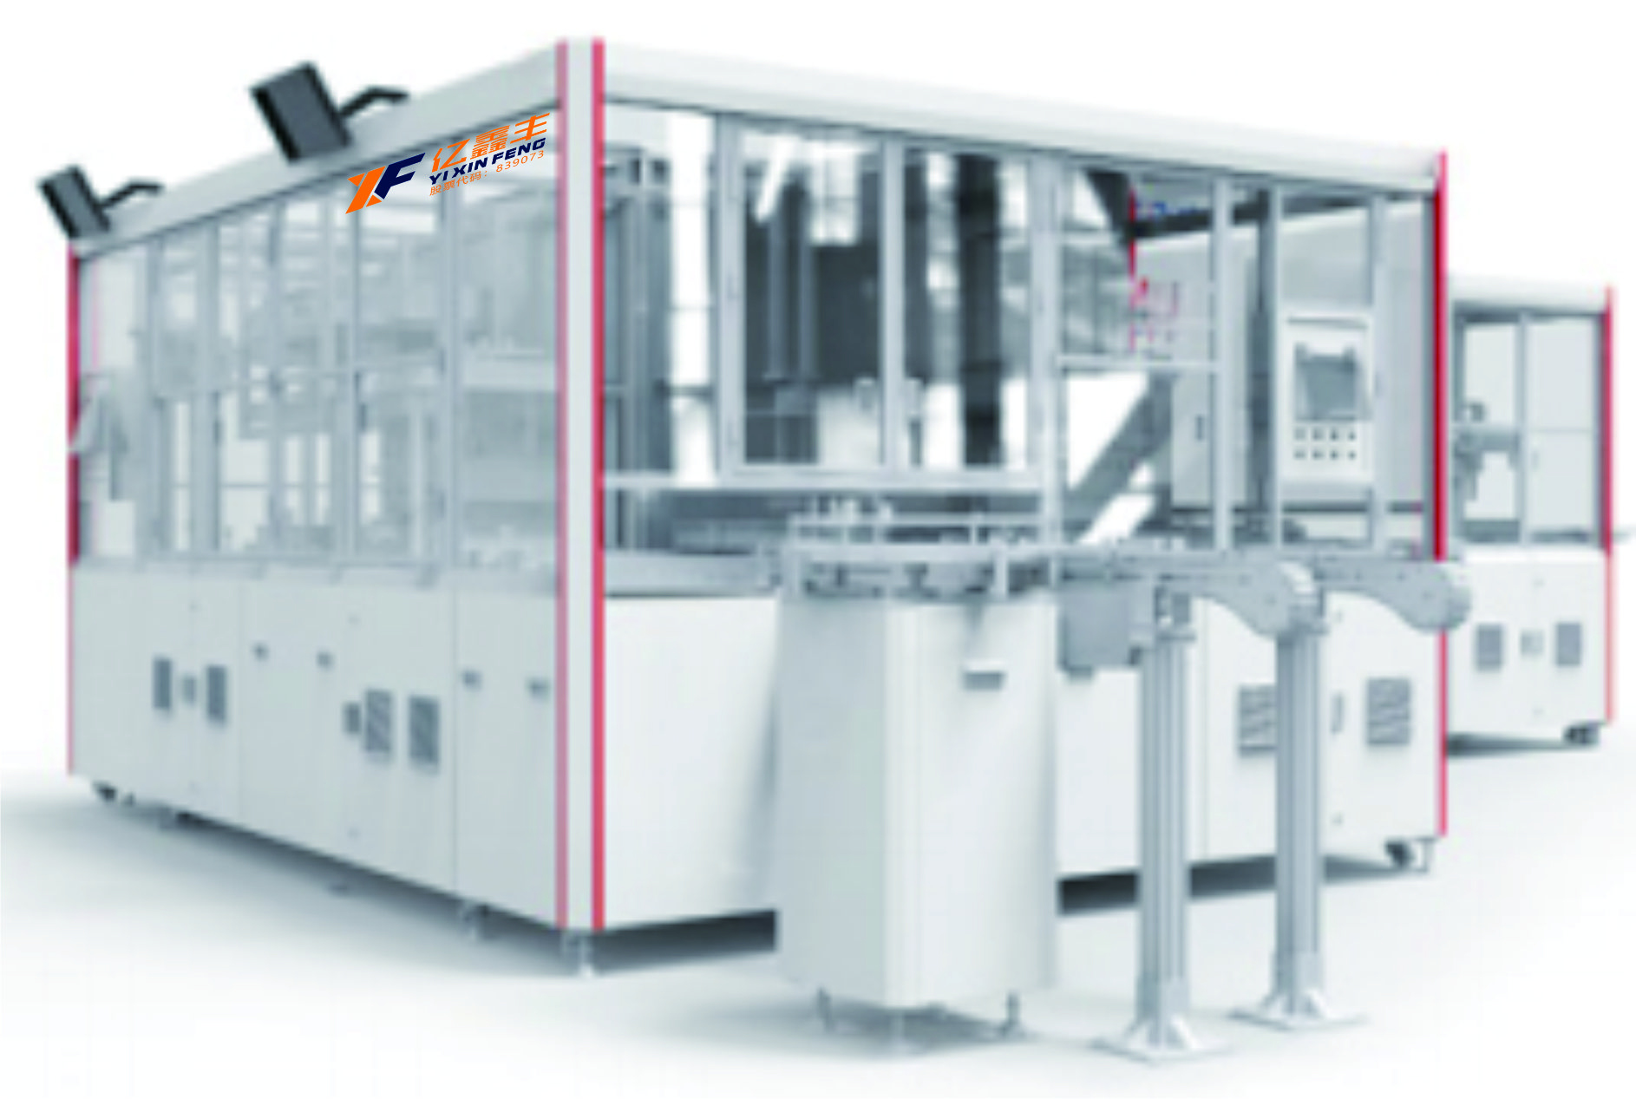
测试机
（Film Wrapping Machine）
原理与应用 Principle and application | ●采用双层结构，减小占地面积 ●该设备可选配增加预充工位 ●内阻分块安装，检修维护方便 ●装盘抓爪独立，每个电池位置检测，保证装盘电池反馈 ●Double-layer structure to reduce the footprint ●Optional: pre-charging station ●Internal resistance installed separately for easy maintenance ●Independent stacking gripper, and each cell can be detected to promise the feedback of cell stacking status
检测精度 Detection accuracy | ±0.025mΩ

Slide 35
股票代码：839073
亿鑫丰欢迎您!
MIZHI
SALES
REPOTRE
Welcome to Yixin Feng!
Notes:
感谢各位的聆听

